Slide 1
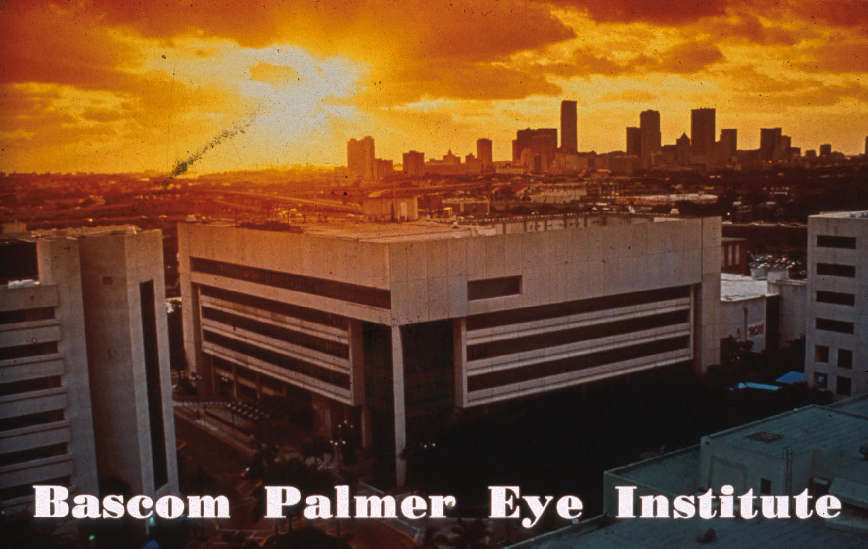

member About Gonioscopy
7 Things to Re
Paul Palmberg, MD, PhD
Professor of Ophthalmology

Slide 2
The speaker sincerely regrets not having any significant financial interest in any of the matters to be discussed.

Slide 3
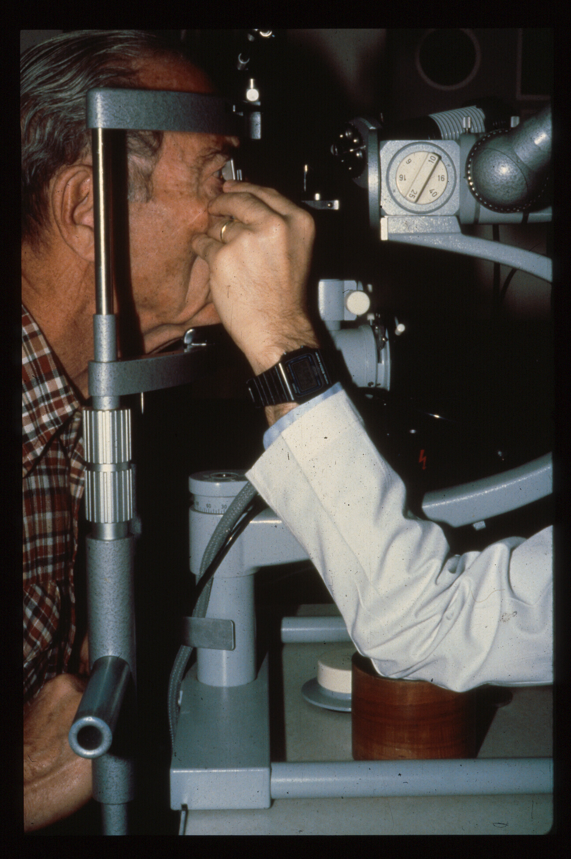
#1
# 1
Get comfortable
Both sit upright
Support your elbow and hand
Avoids movement and unintended pressure

Slide 4
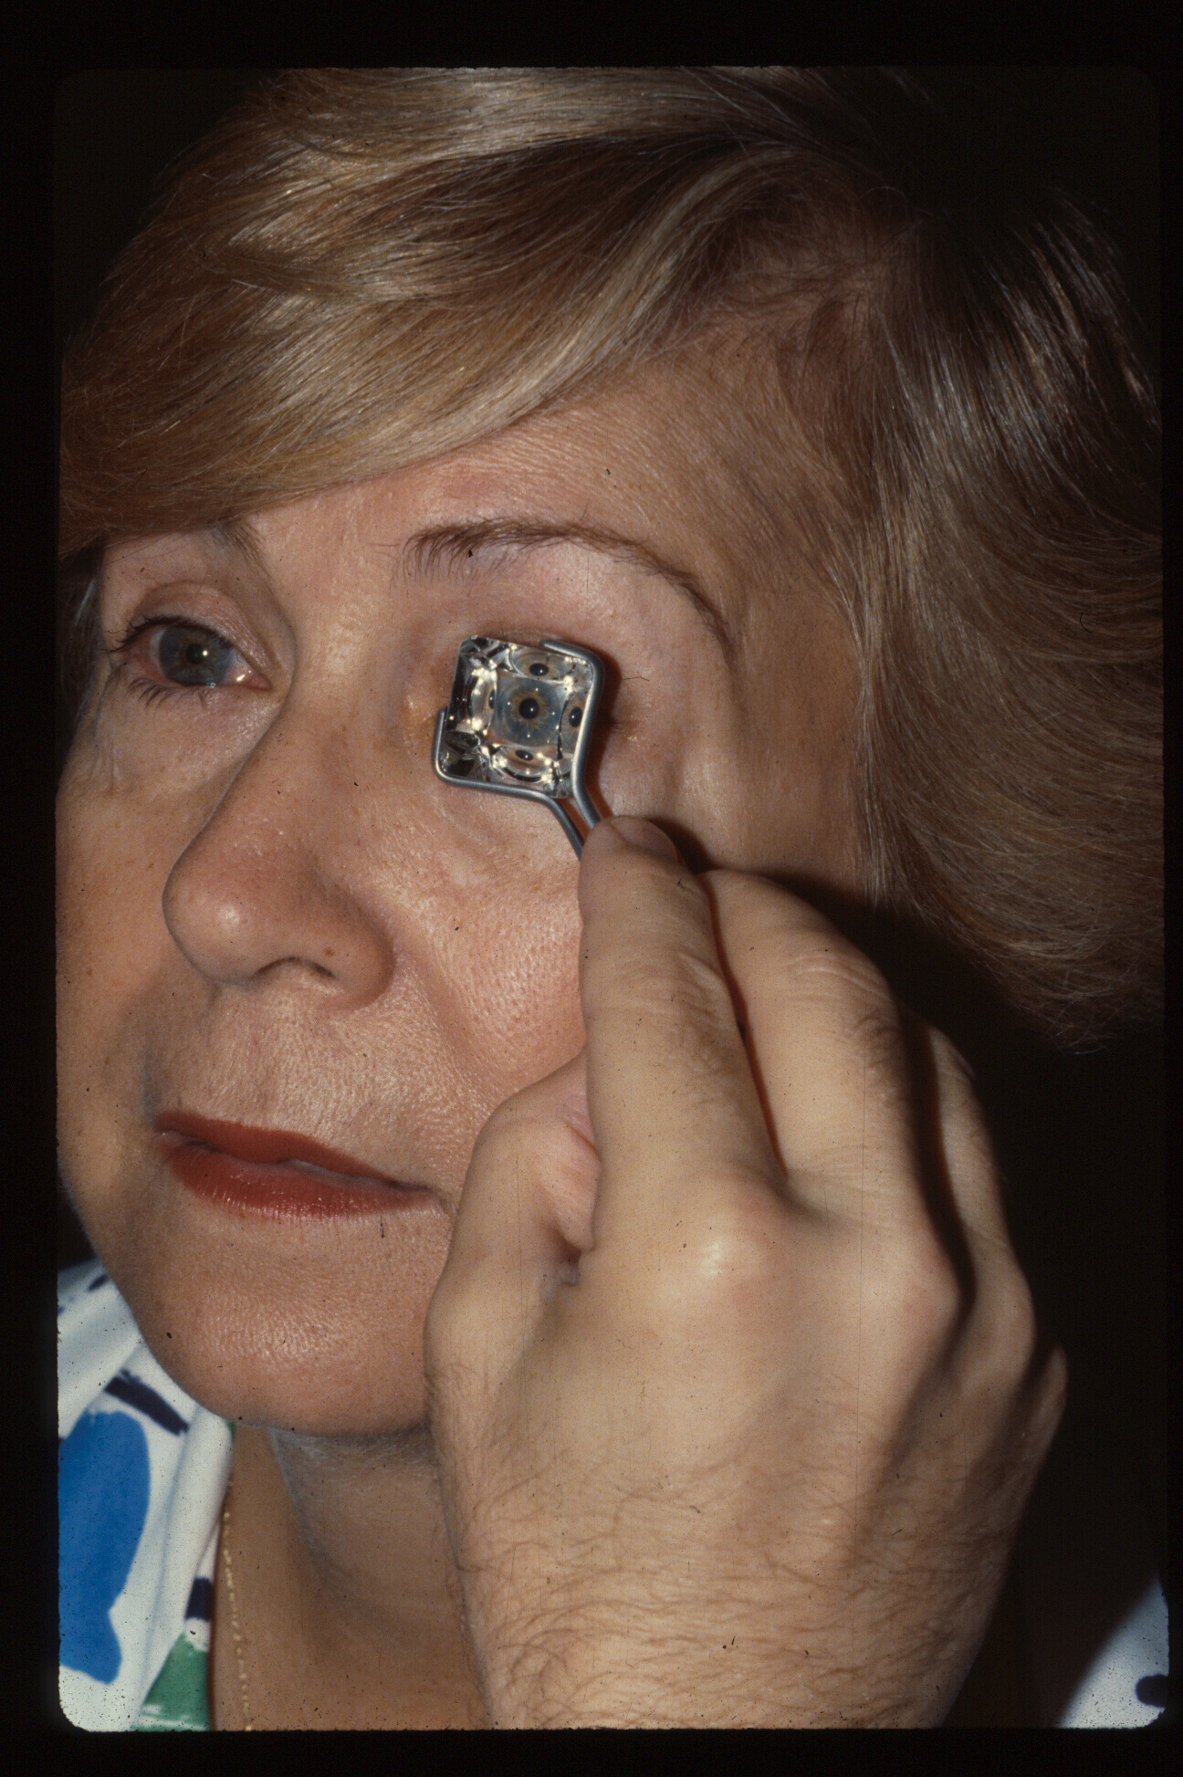
Notes:
It is easier to align a 4 mirror device (Zeiss, Posner, Sussman) with the edges parallel to the lids. The little finger rests on the patient’s cheek to steady your hand, and no pressure is applied to the cornea.

Slide 5
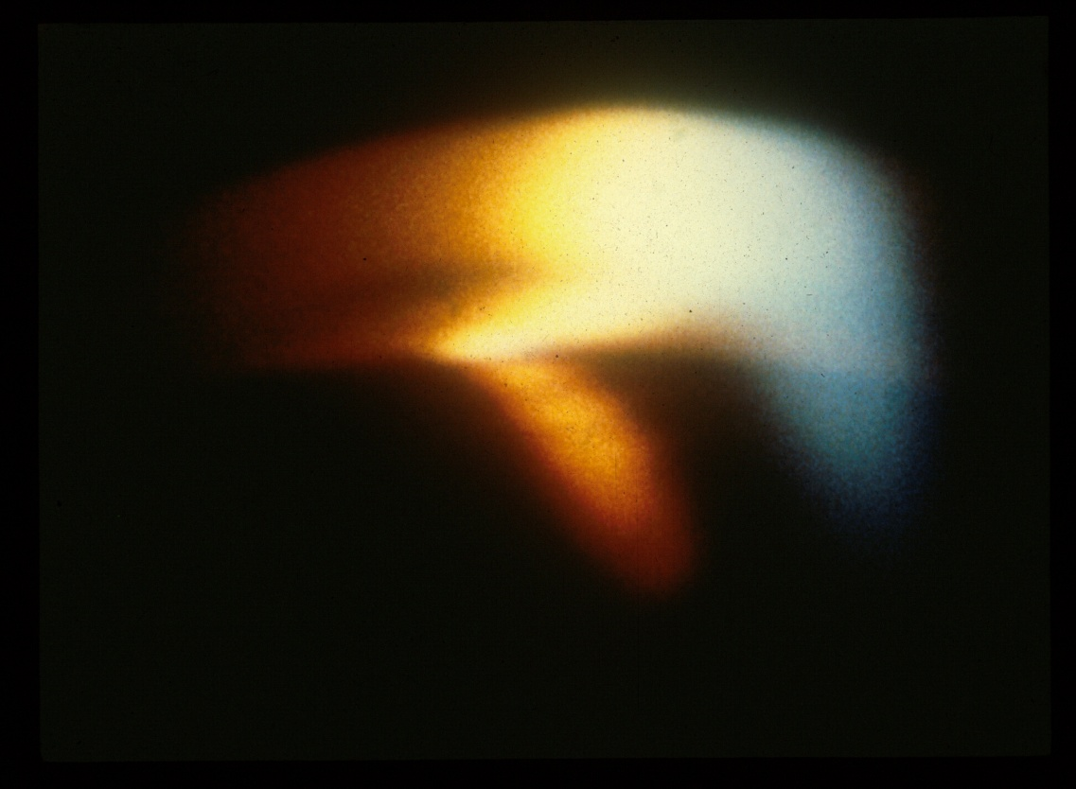
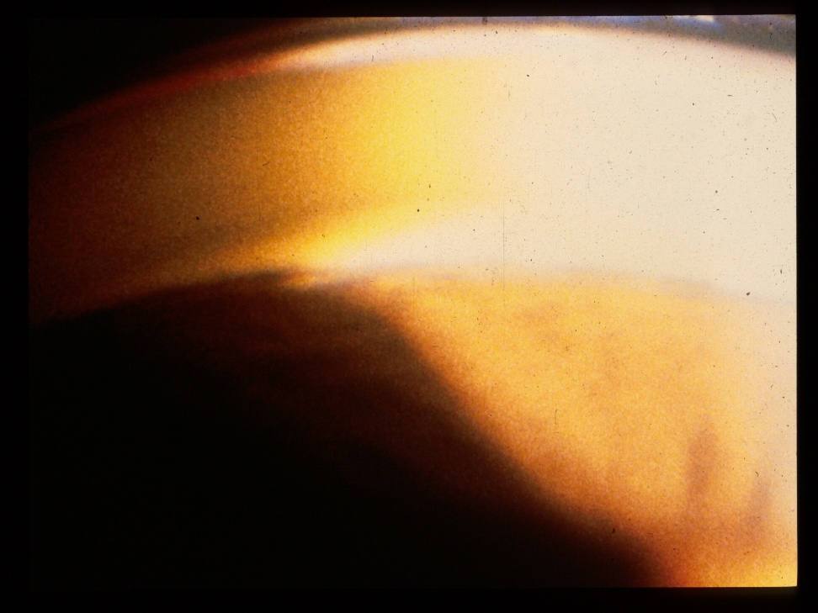
# 2
Do it in the dark!
Light constricts the pupil, opens closed angles
Palmberg P. Shedding light on gonioscopy. Arch Ophthalmol 2007; 125:1417
Barkana, et al. Agreement between gonioscopy and UBM in detecting iridotrabecular apposition. Arch Ophthalmol 2007; 125:1331-5
Gazzard, et al. Light to dark physiologic variation in irido-trabecular angle width. Brit J Ophthalmol 2004; 88:1357
Notes:
A bright, but narrow and short beam is focused on the peripheral iris. The room should be dark and no fixation light used, to avoid pupil constriction by either light or accommodation.

Slide 6
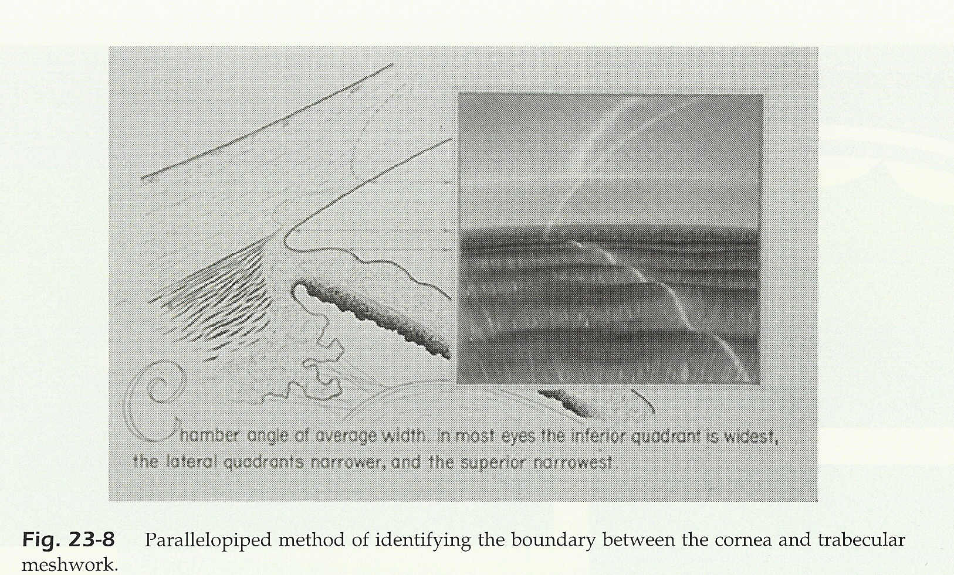
Use the Wedge!
Corneal light wedge or “parallelopiped” method
# 3
Notes:
Note that the clear cornea extends further posteriorly on the interior of the cornea. The oblique slit of light will create a corneal light wedge, which will collapse to a line at Schwalbe’s line. Which is at the posterior margin of the cornea. Posterior to Schwalbe’s line there is a narrow band of sclera anterior to the trabecular meshwork. That sclera reflects light brightly, as does the band of sclera posterior to the trabecular meshwork. Over the trabecular meshwork the light appears to be dimmer as some of the light penetrates deeper and is not reflected.

Slide 7
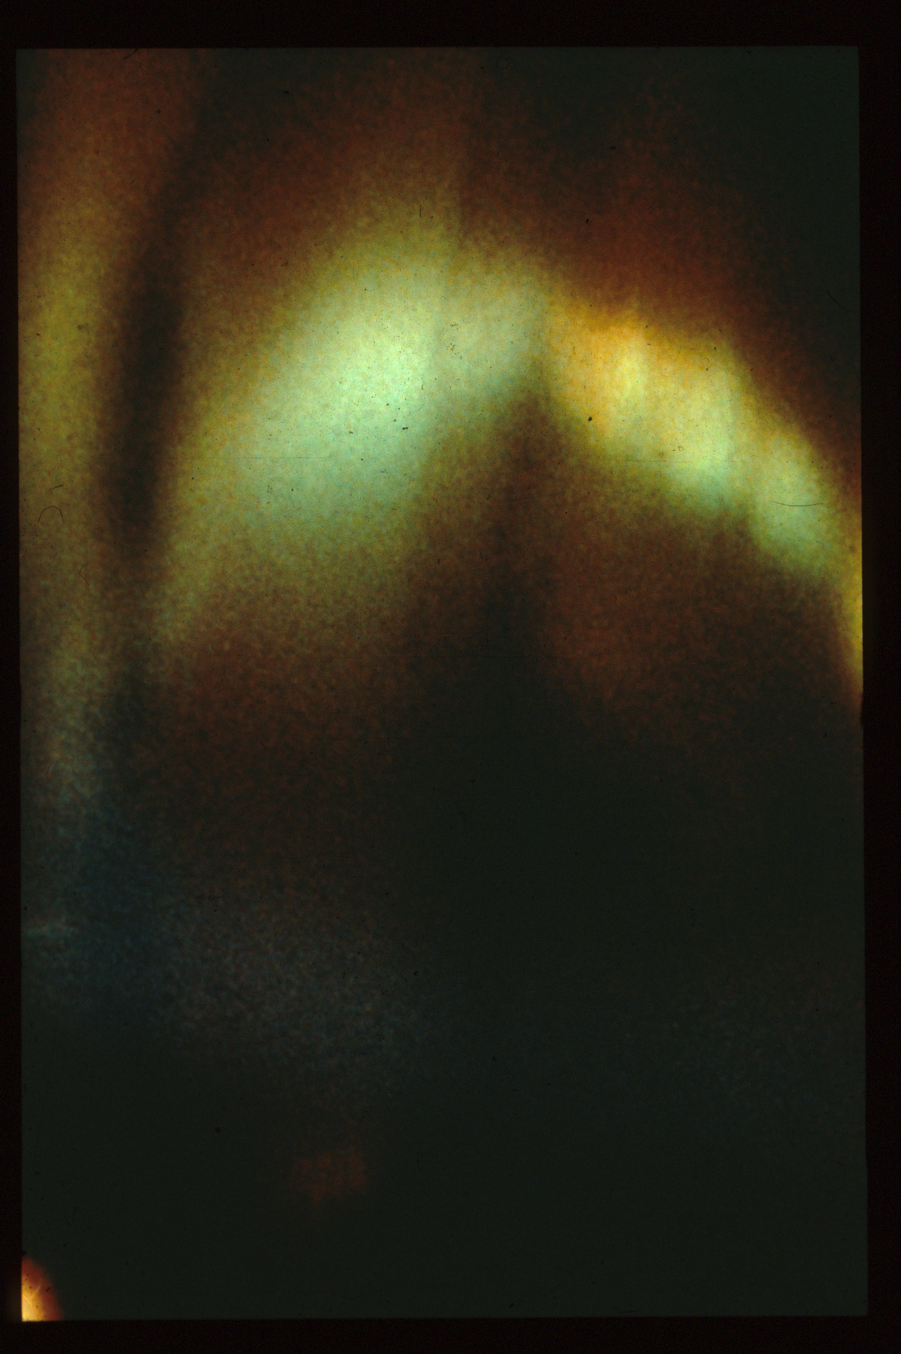
Transition from 3D figure of light to 2D at Schwalbe’s line
Notes:
In this photo the transition from a 3-dimensional figure of light in the cornea to a two dimensional and dimmer band of light identifies the cornea-trabecular junction.

Slide 8
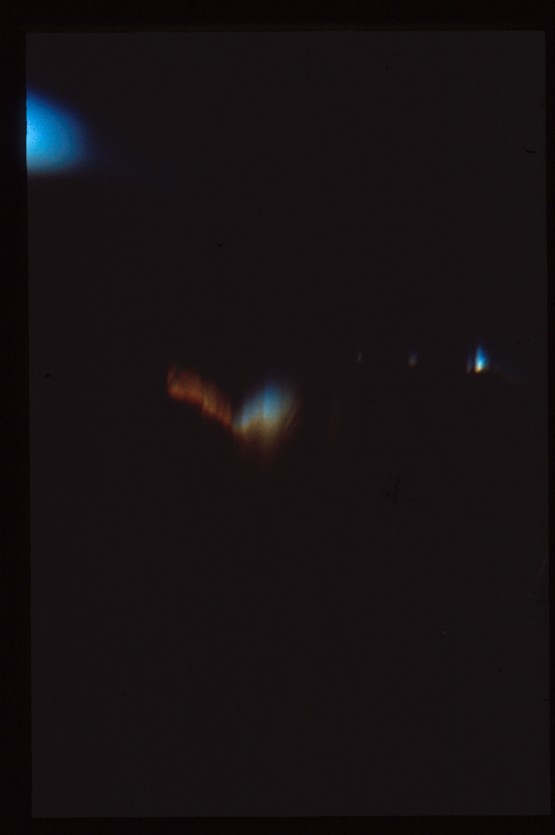
Cornea
Transition from 3D figure of light to 2D at Schwalbe’s line
TM
Scleral spur
CB band
Notes:
In this photo of a very deep anterior chamber one sees the 3-dimensional figure of light in the cornea, a bright line at Schwalbe’s line, a gray reflex over the trabecular meshwork, then a bright line at the scleral spur, and finally the brownish grey ciliary body. The iris insertion can be anywhere from the margin of the trabecular meshwork to the scleral spur or behind the scleral spur, depending upon the relative movement of tissues during development of the anterior chamber.

Slide 9
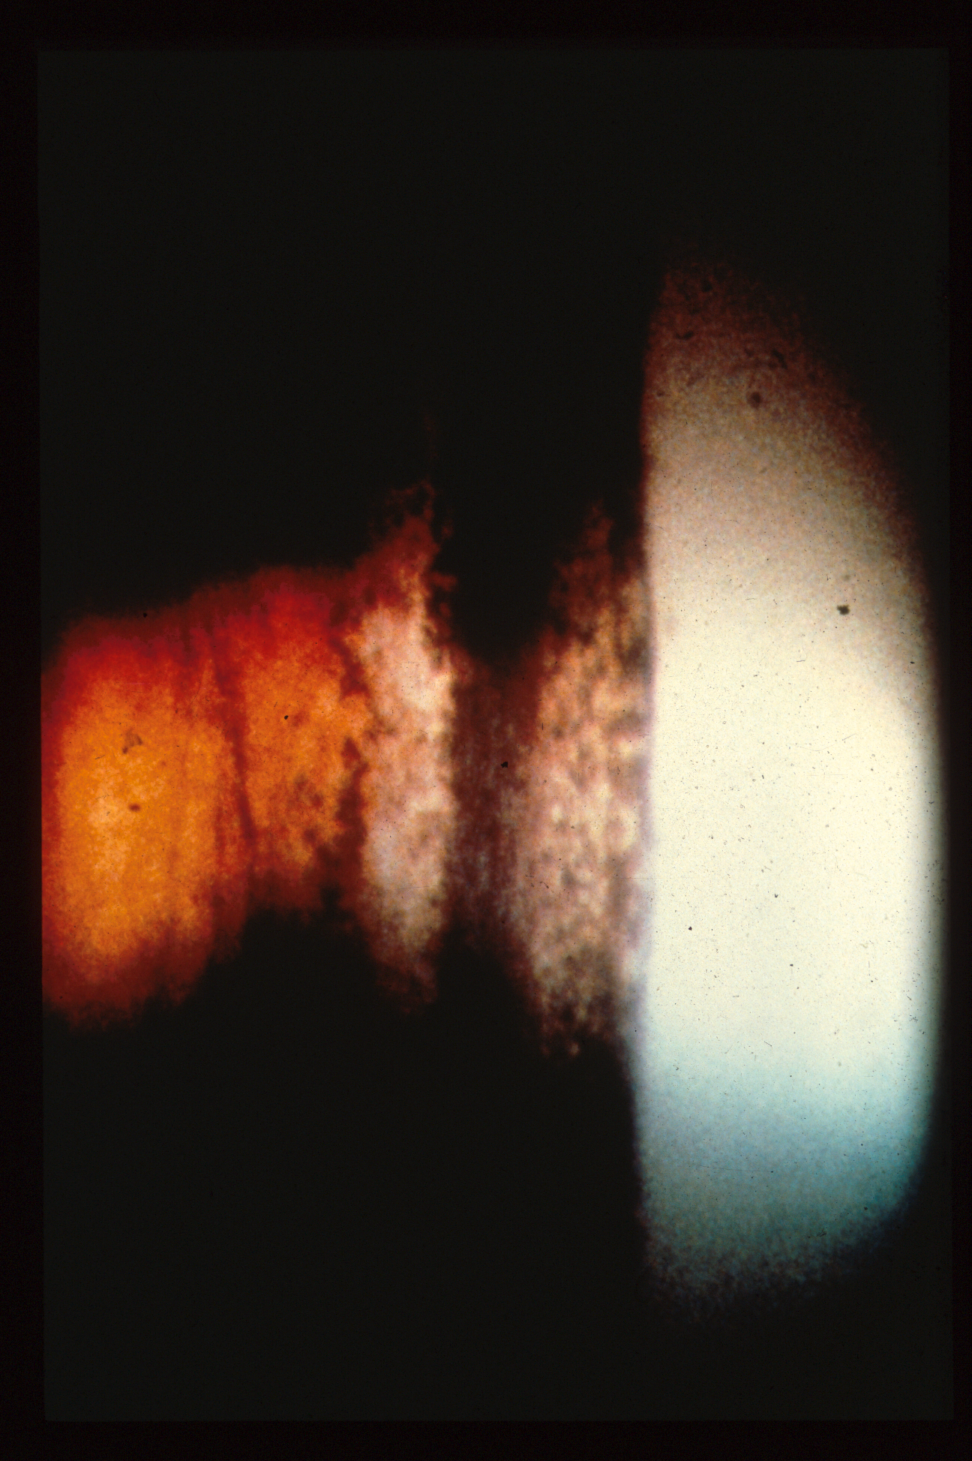
# 4
Think Pig!
TM = Fine, powdered brown sugar
In a continuous line
Sampaolasi line = salt and pepper
Discontinuous line
Notes:
This 3x magnified view of the angle of a patient with Pigmentary Dispersion shows the bright cornea at the top, then clumps of pigment on Schwalbe’s line, which acts as a shelf, and further back a dense and continuous band of “fine powdered brown sugar” appearing pigment on the functional trabecular meshwork, then the sclera spur and then the ciliary body.

Slide 10
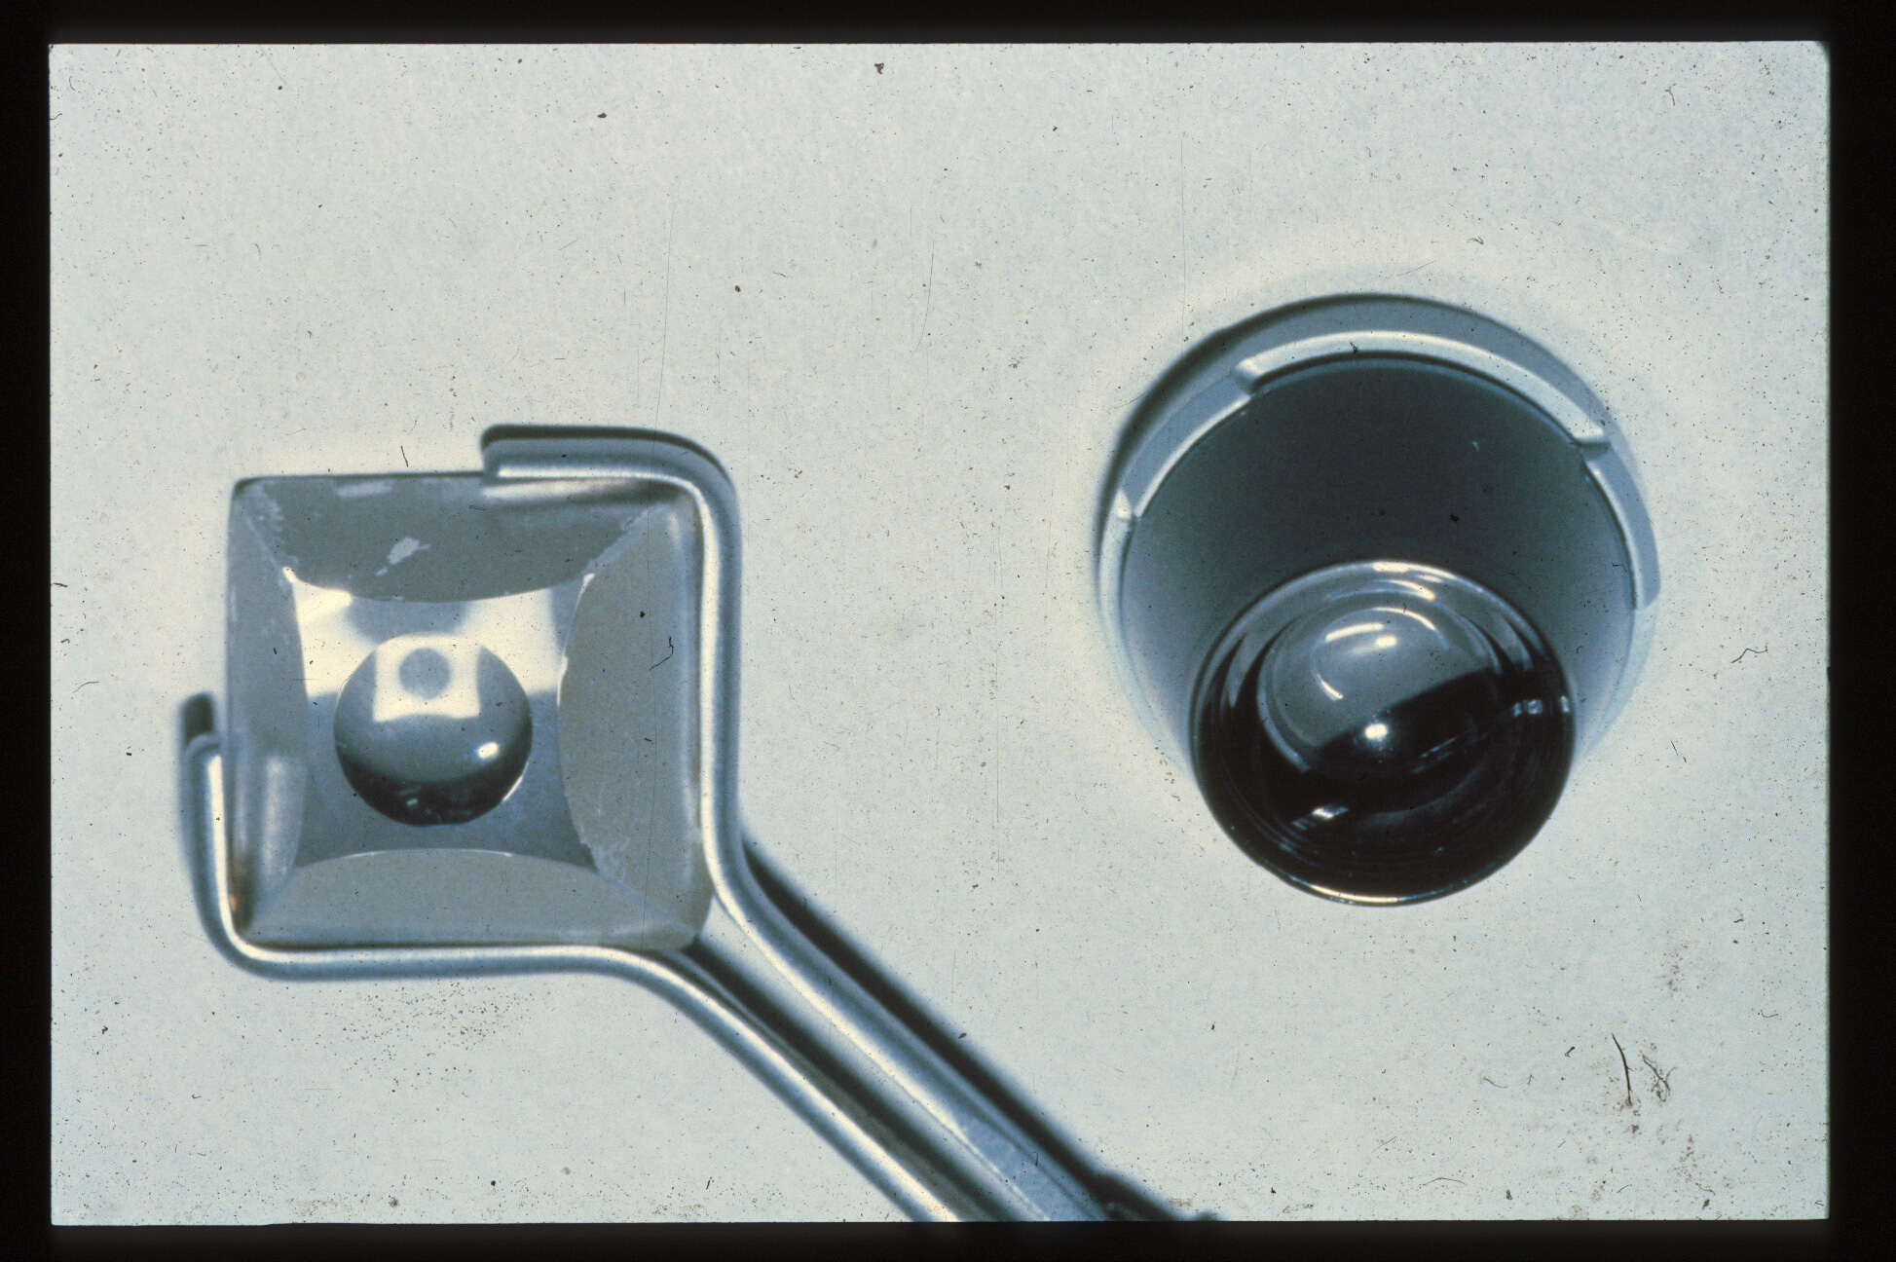
#5
Goldmann lens sucks on cornea!
Zeiss Lens
9 mm interior rim
Goldmann Lens
11 mm interior rim
13 mm exterior rim
Notes:
The Goldmann lens has an outer rim of 13 mm in diameter, that sits on the sclera when applied to the eye, and an 11 mm interior rim. It is more steeply vaulted than the cornea of patients and so the space between the lens and the cornea must be filled with a clear, viscous solution, such as methyl cellulose. When applied quickly to the eye to prevent escape of that fluid, the pressure exerted expels some of the fluid creating a suction cup effect that helps to keep the lens in place, but also distorts the anterior chamber anatomy, which can artifactually open a closed angle. The Zeiss lens on the other hand has a 9 mm interior rim, which sits on the cornea, and its vault closely approximates most corneas, so that a drop of saline or topical anesthetic solution can achieve optical coupling between this lens and the cornea, without creating any suction cup effect. Thus, if the lens is applied without any pressure, it allows avoids raising the IOP, which could otherwise open a closed angle.

Slide 11

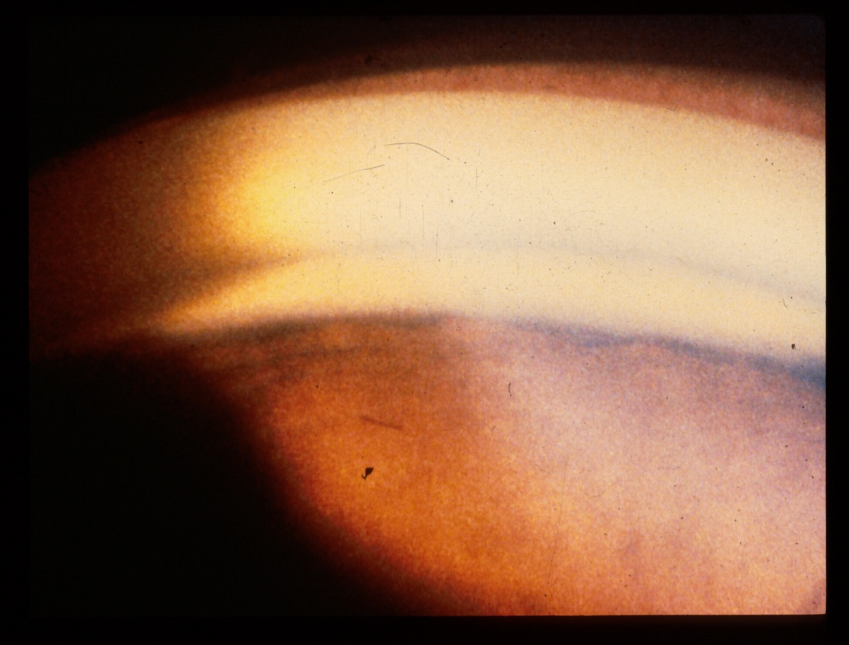
Appositional angle closure on Zeiss gonioscopy!
Goldmann lens suction opens a closed angle, resulting in a missed diagnosis of angle closure!
Notes:
Just to demonstrate the advantage of the Zeiss-style lens, here is a patient with appositional angle closure documented on Zeiss gonioscopy that on Goldmann lens gonioscopy is seen to have an open angle in some portions between focal Peripheral Anterior Synechiae. (That was also true with a narrower slit beam.)

Slide 12
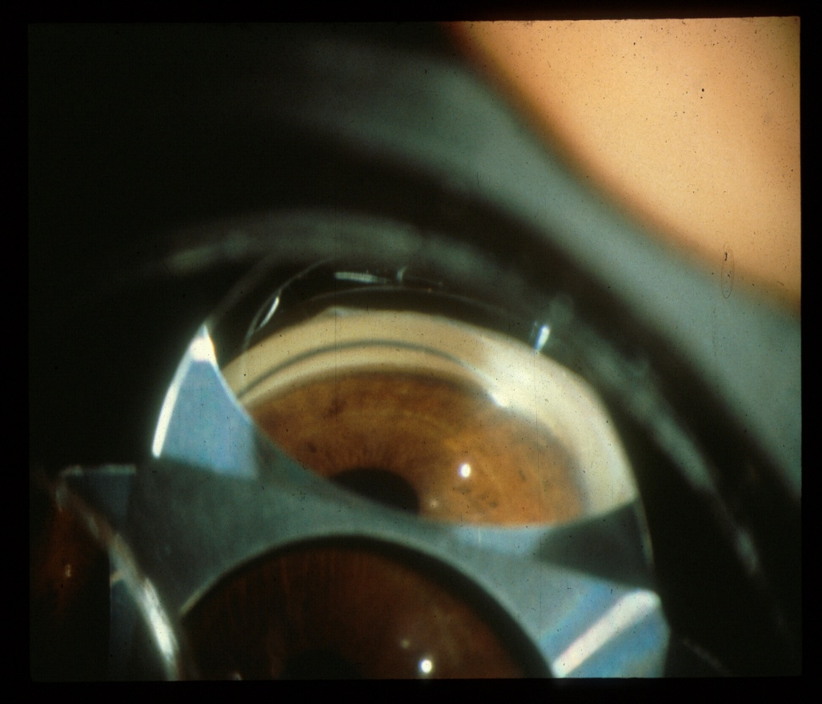
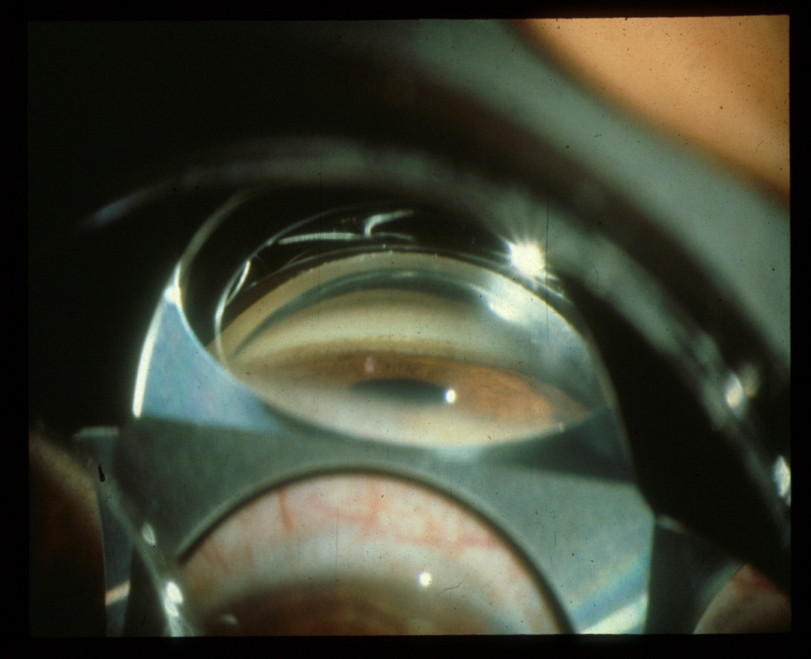
# 6 Adjust your point of view
Dive bomber view to see into the narrow space between iris and trabecular meshwork.
Cruise missile view for trabeculoplasty, the closest to perpendicular to the TM
Notes:
When a gradient of pressure between the posterior chamber and the anterior chamber causes a forward bowing of the iris one can have the patient look down about 15 degrees to allow a “dive bomber” view into the narrow space between the iris and the trabecular meshwork. On the other hand, when one is performing laser trabeculoplasty, it helps to have the patient look towards the mirror to obtain a view parallel to the iris, a “cruise missile view” that is more perpendicular to the trabecular meshwork for a better laser application.

Slide 13
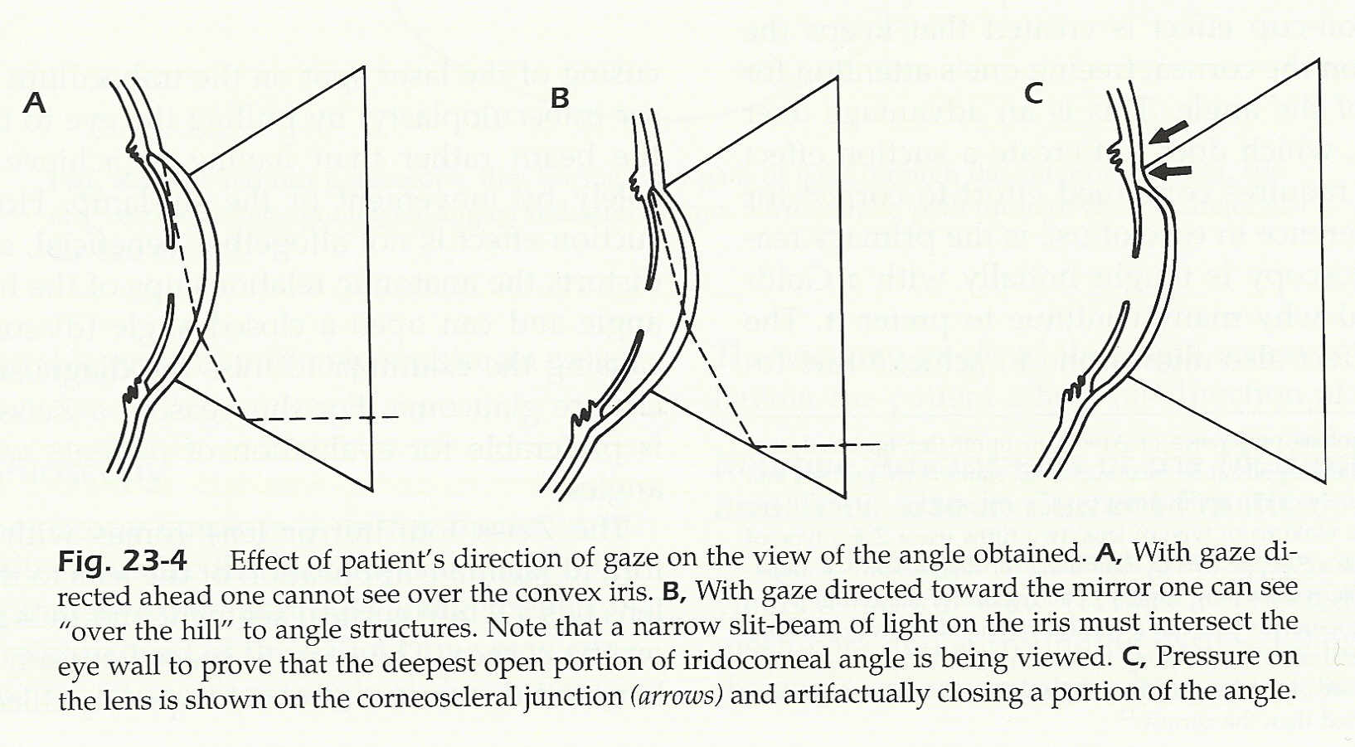
Tell the patient to look down about 15 degrees so you can see “over the hill of iris bombe.
Notes:
These diagrams illustrate that A) a straight ahead eye position may leave the periphery of the iris hidden, while B) having the patient look down 15 degrees lets on look over the peripheral iris to a narrowly open angle, but that C) it is important to NOT press the superior rim of the gonioprism against the cornea as one can artifactually close an angle.

Slide 14
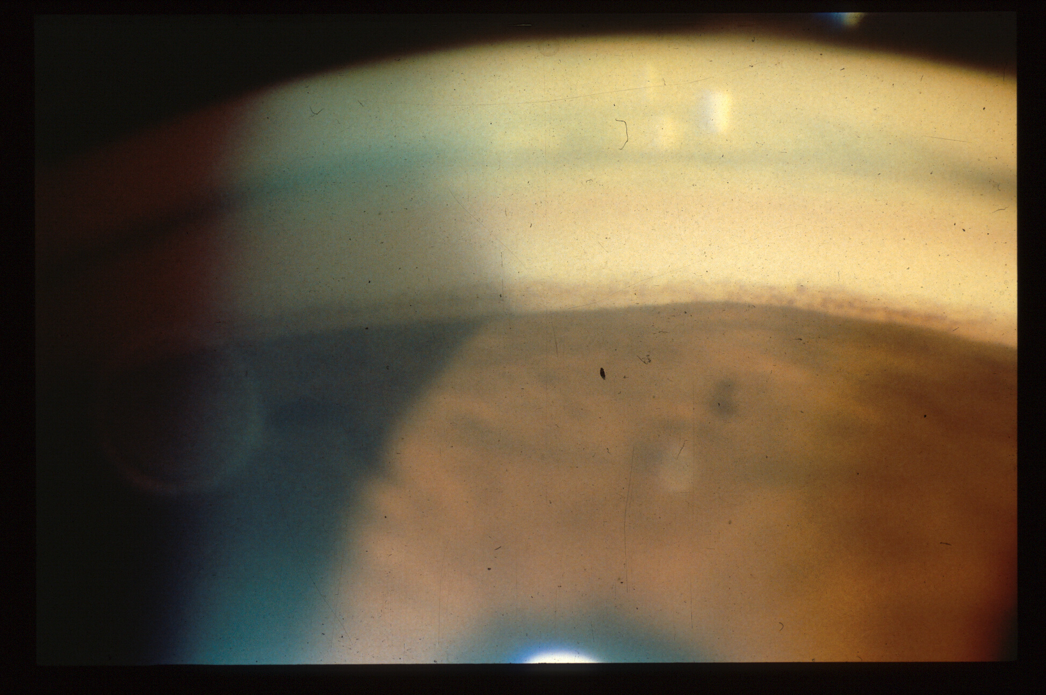
# 7 Get pushy! Indentation gonioscopy
What is the character of this pigmented line? Is it the TM?
Notes:
Is this an open or closed angle. It might appear open, given that there is a clear view of a pigment line perhaps thought to be a trabecular meshwork. However, the character of the pigment is of smudged and discontinuous pigment deposits, which in this case were a Sampaolasi line of pigment on the peripheral cornea. How to tell? See the next picture!

Slide 15
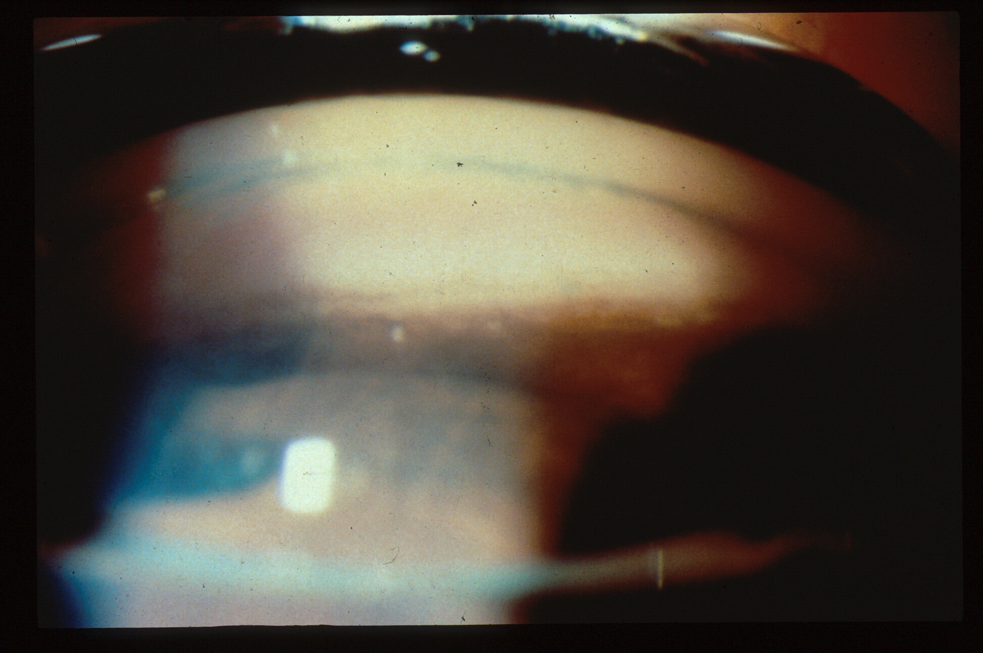
That line is a Sampaolasi line!
The TM with PAS revealed with indentation
Notes:
With indentation of the cornea the pressure gradient across the iris is reversed and the previously unseen second pigmented line, the true trabecular meshwork is disclosed, with some PAS to it. To avoid optical distortion, a technique pearl is to selectively indent the inferior cornea with the inferior rim of the Zeiss style lens, which produces a more regular bending of the cornea. In addition, that also selectively displaces anterior chamber fluid toward the viewed angle.

Slide 16
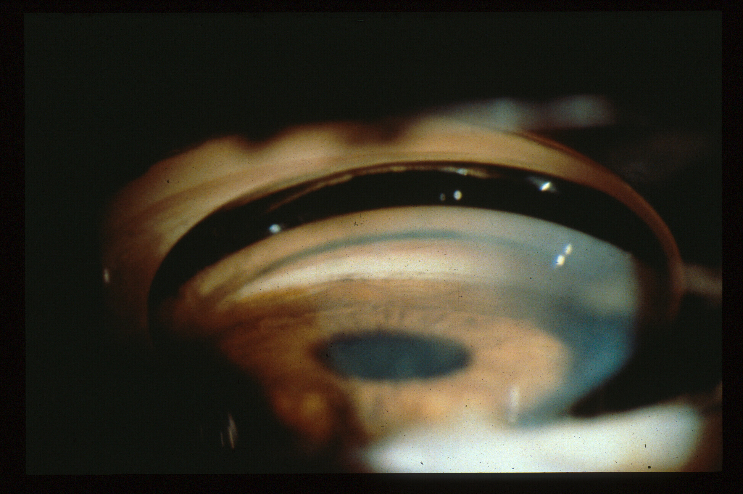
PAS tethers iris during indentation while adjacent iris moves backwards
Notes:
Dynamic gonioscopy, in which one pushes and releases pressure on the cornea, also helps in distinguishing PAS from iris processes, as PAS will tether the iris in place, while the iris in adjacent areas of appositional closure can move down away and back up.

Slide 17
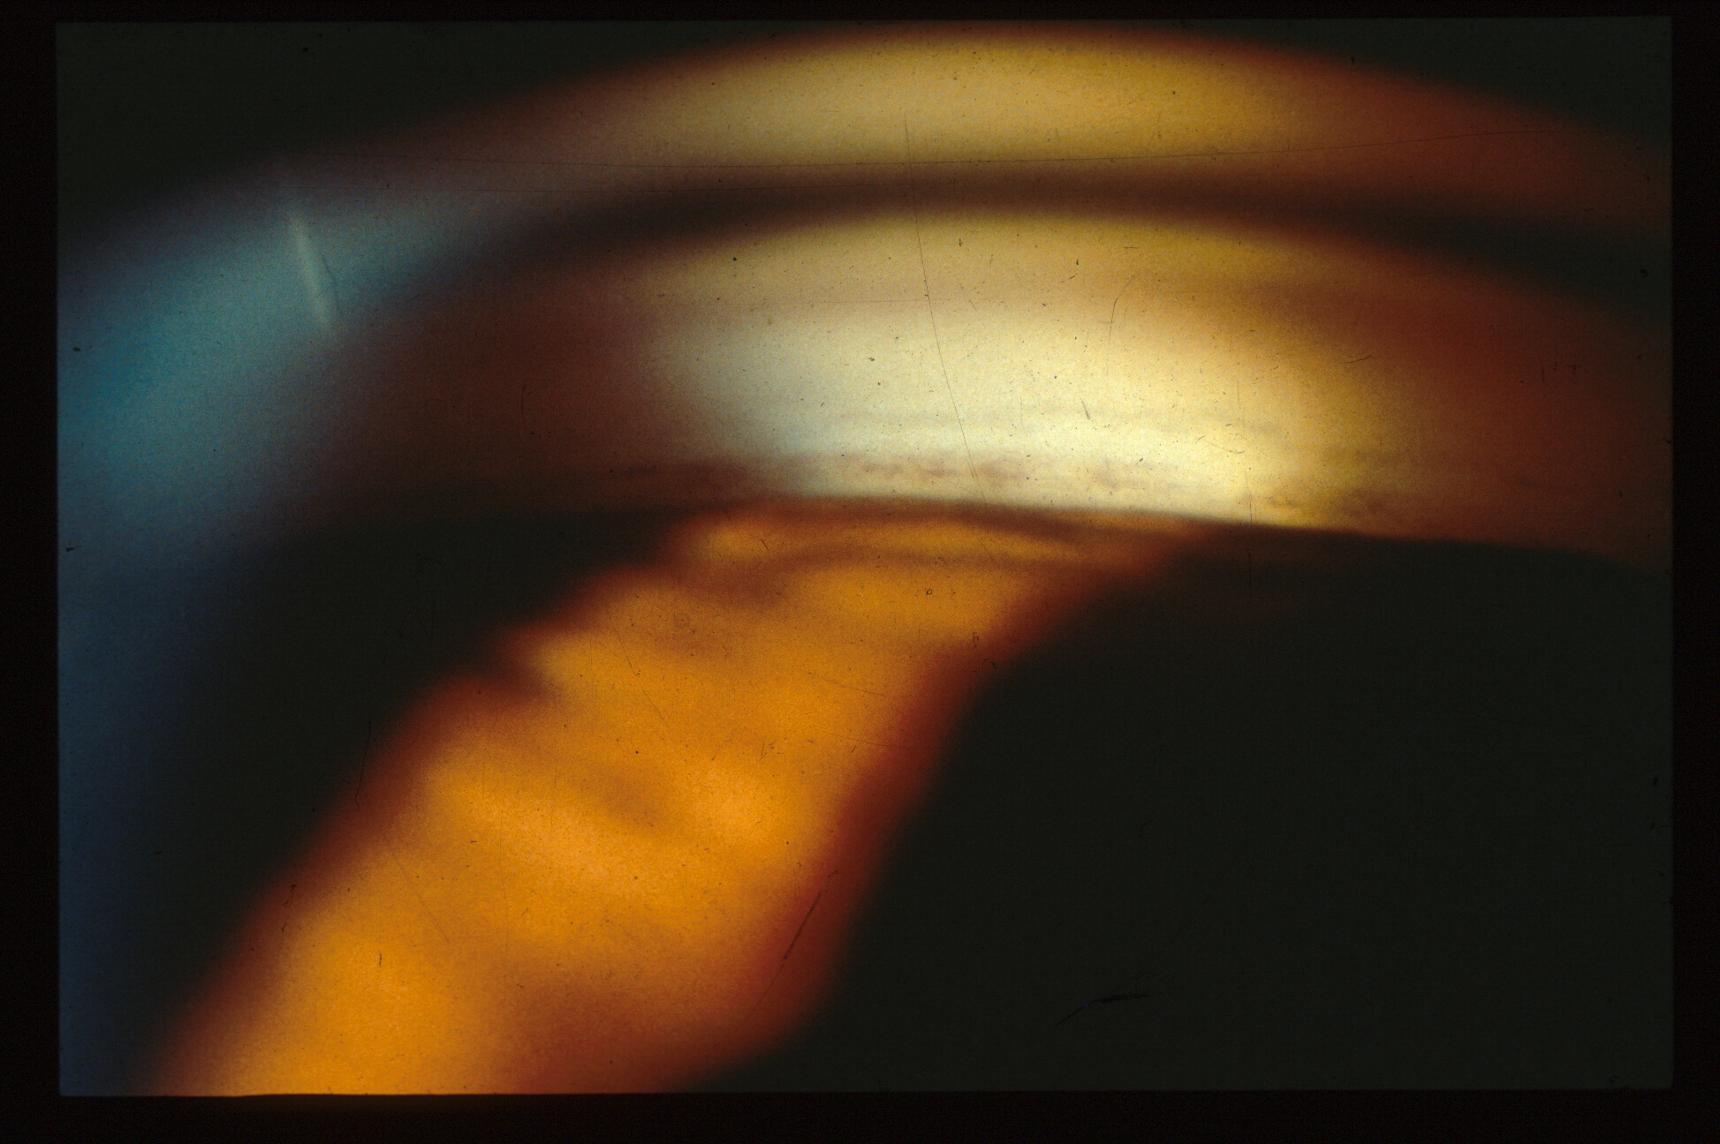
Is this the TM?
Notes:
Here is another test case. Is the angle open or closed? In brown irides the iris plane may only be slightly bowed forward in cases of appositional closure as the iris is thicker and stiffer than in blue eyes. Again, there are clues that this might be a closed angle. Not shown was that the corneal light wedge extended to the iris insertion. Here one sees that there is some forward bowing of the iris, and also that the character of the pigment is typical of a Sampaolasi line, with a discontinuous line of “salt and pepper”, or clumps of pigment and bare spaces. SO, we need to perform indentation gonioscopy.

Slide 18
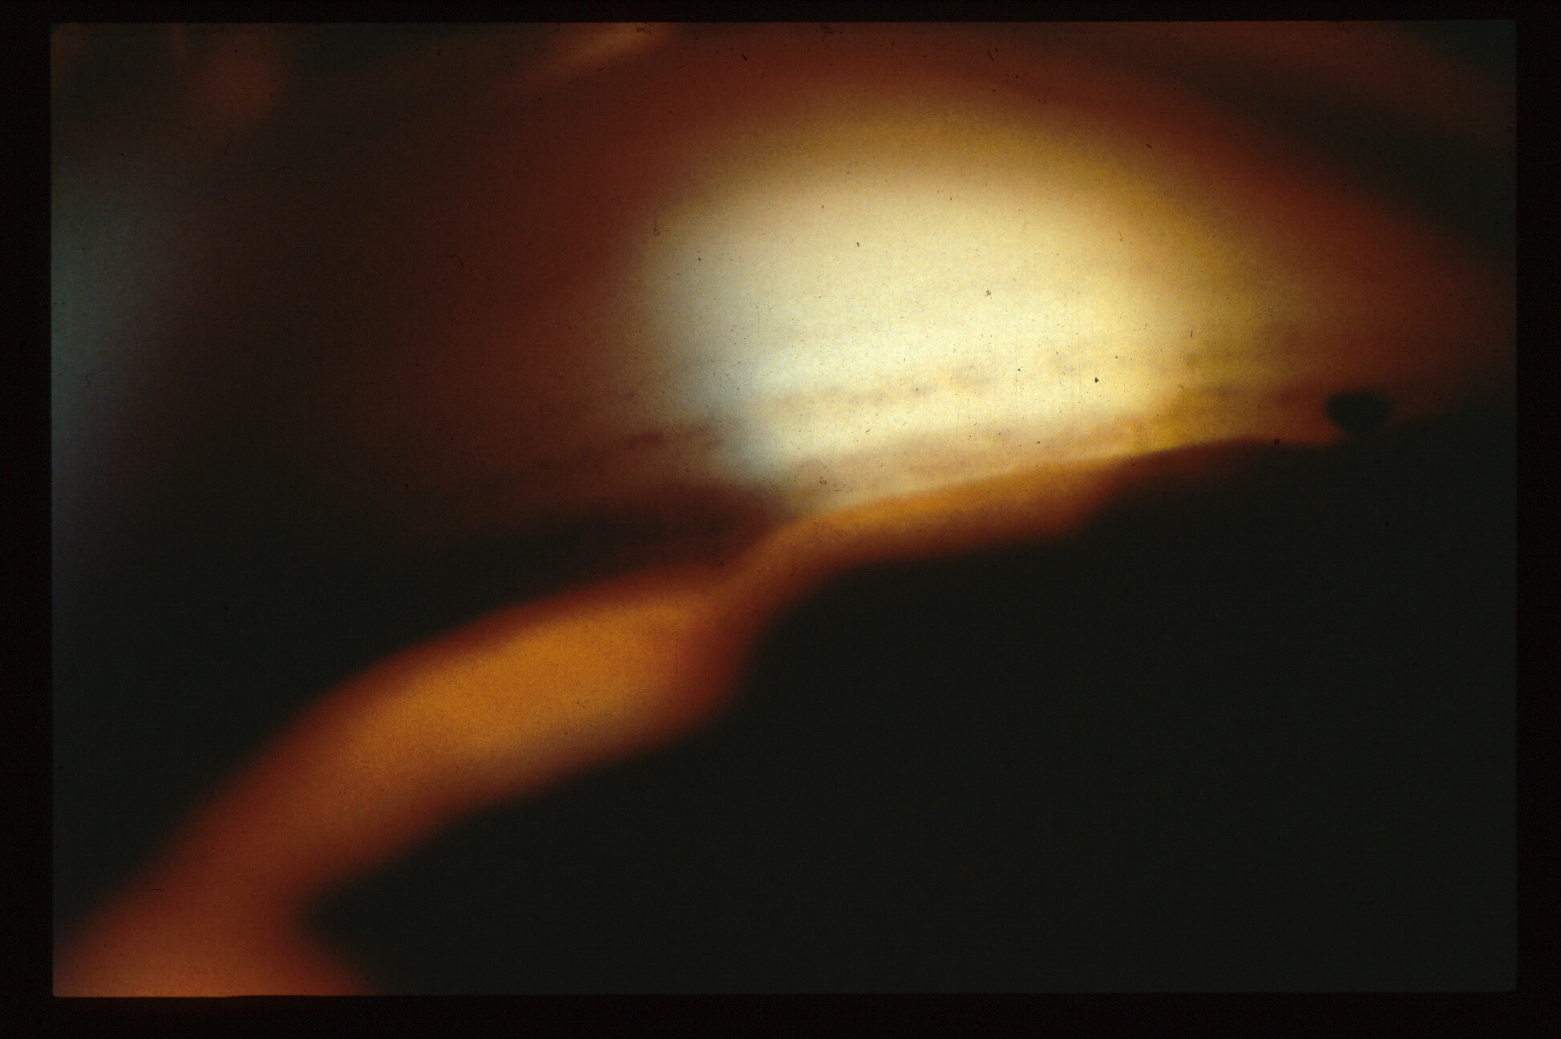
Saompaolasi line, not the TM!
This is the TM
During indentation gonioscopy
Notes:
With indentation gonioscopy, now revealed is the previously hidden true trabecular meshwork with a continuous line of pigment resembling “fine powdered brown sugar”.

Slide 19
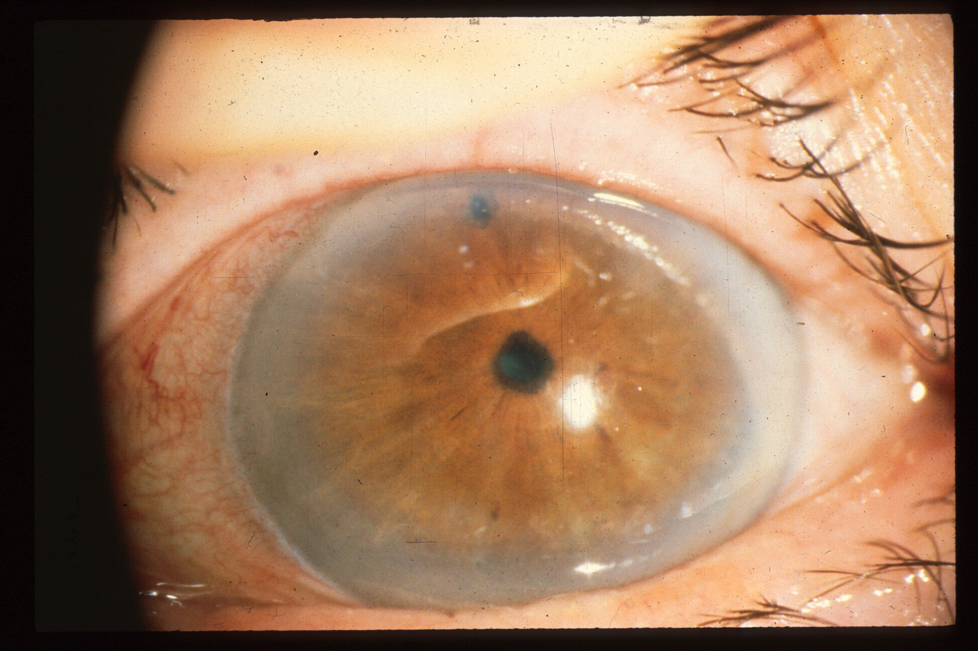
Next case: LPI performed
Notes:
Laser iridotomy in my view is still the preferred treatment for predominantly appositional angle closure, while lens extraction with goniosynechiolysis is likely more effective when there are fairly extensive PAS, or trabeculectomy in cases with near total PAS and advanced optic nerve damage (see Palmberg, Journal of Glaucoma: 2019; 28(9):765-766, which is about plateau iris syndrome management, but applies to pupil block angle closure as well).
The location of the LPI can be important, and is probably best placed temporally with the patient looking temporally as that avoids light being focused as a line on the retina by light passing through the superior tear film meniscus, causing a distressing line in the vision under certain light conditions, and also avoids bubbles formed from obstructing the view during treatment and also aims any laser light reaching the retina in the far periphery.

Slide 20
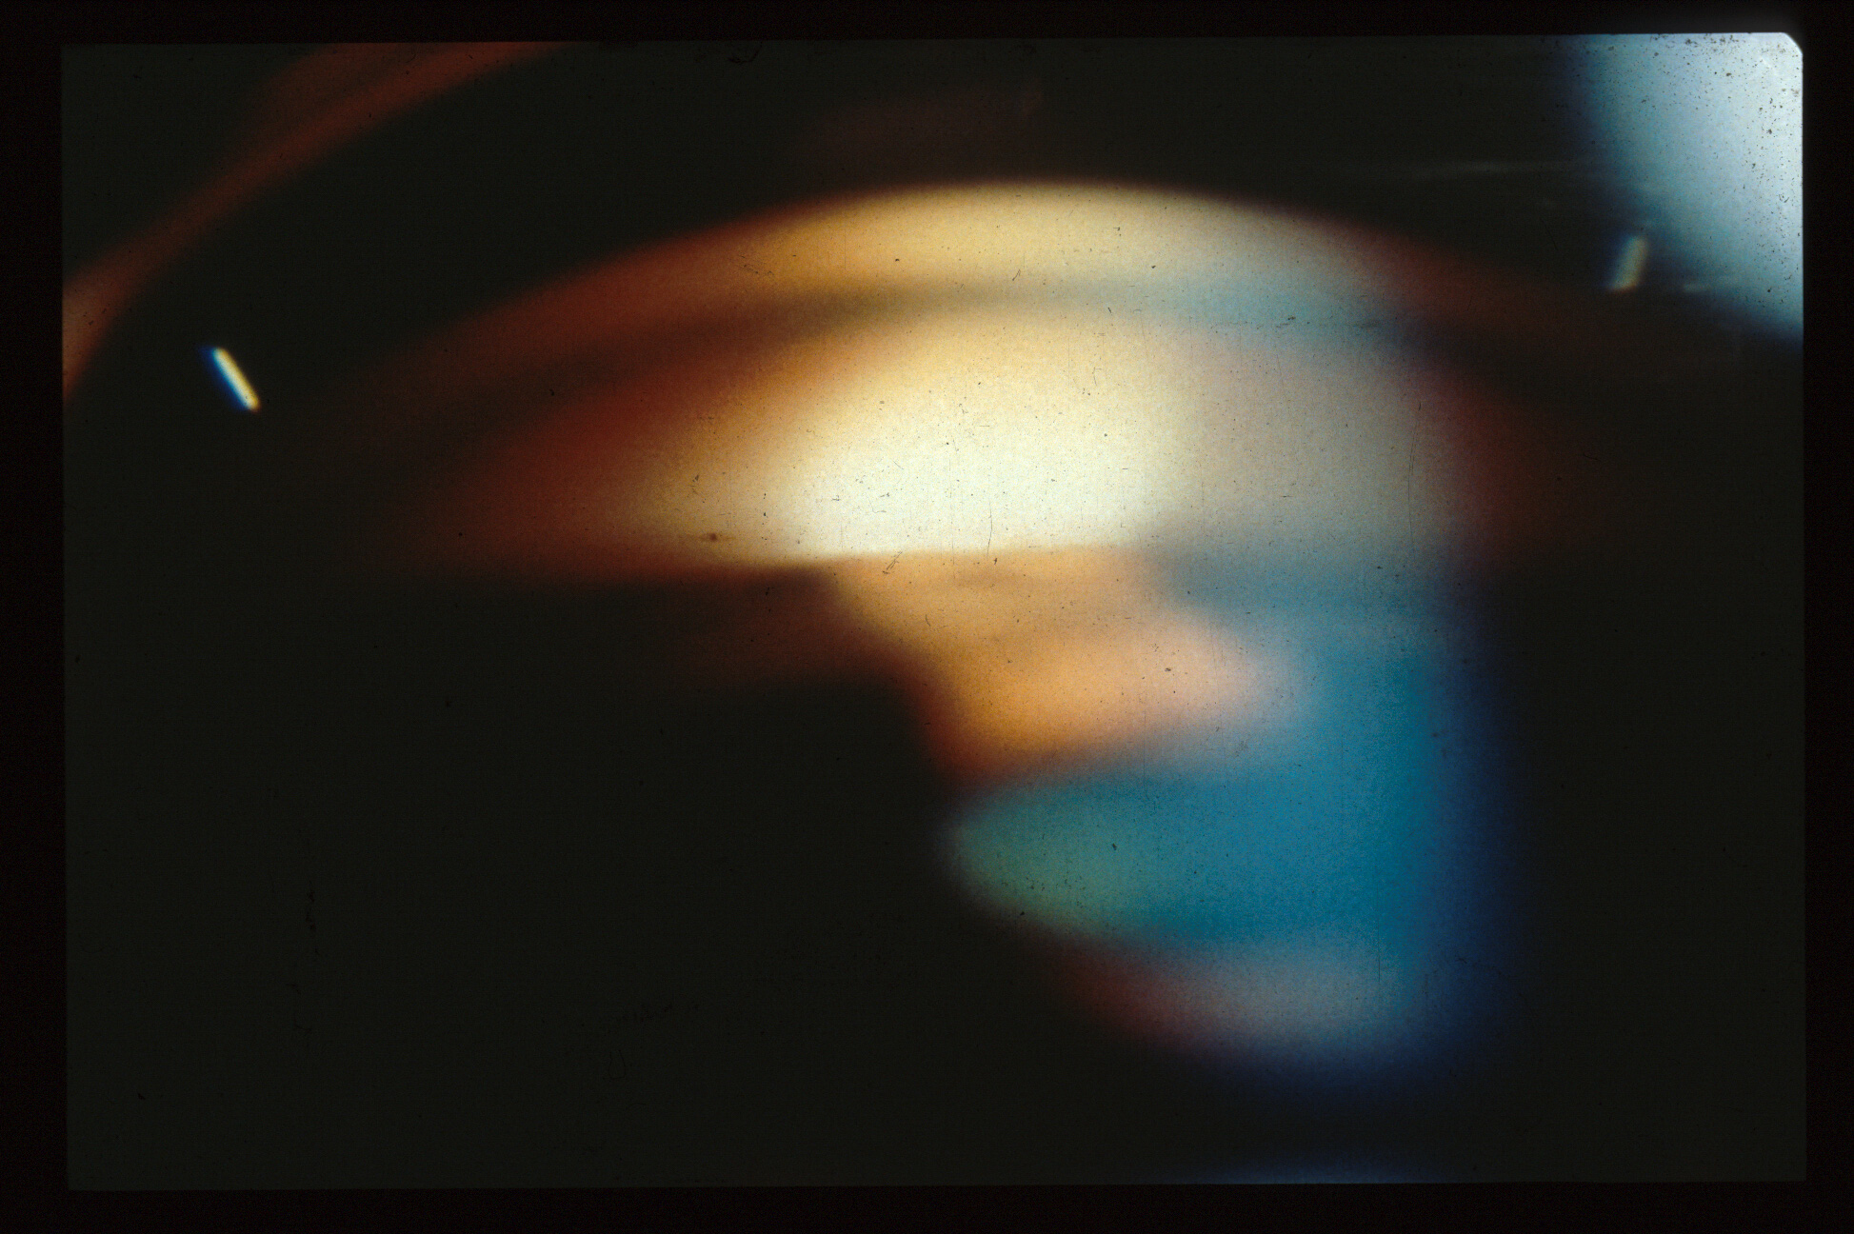
No angle structures visible after LPI: Synechial or appositional closure?
Notes:
After an LPI was placed in this case, the superior angle was still closed. What now?

Slide 21
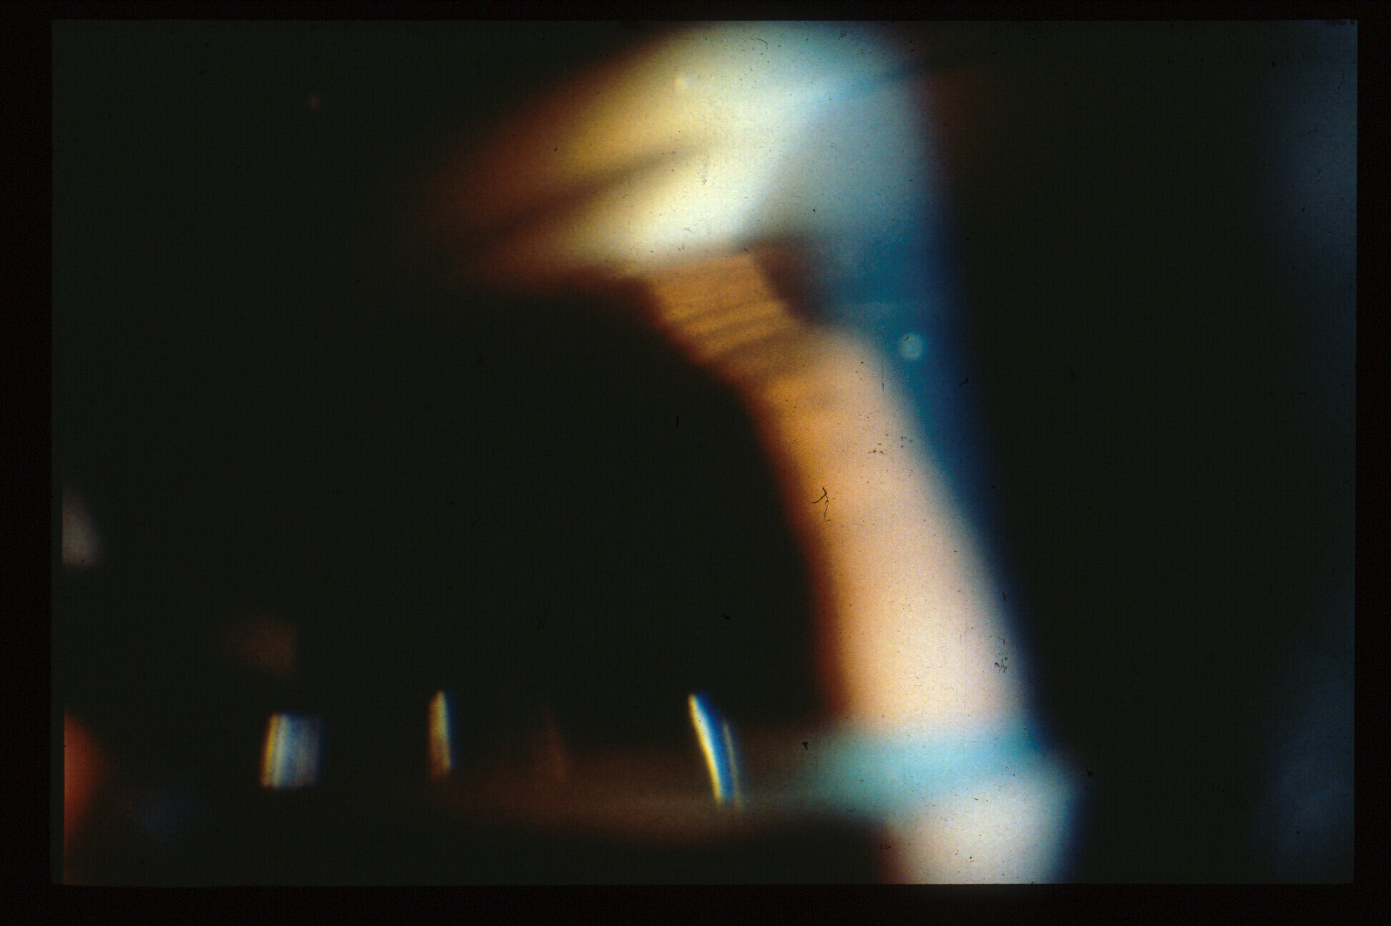
TM now revealed
With indentation gonioscopy: double hump sign
Notes:
Indentation gonioscopy reveals that there was only appositional angle closure, and a “double hump sign”, with the iris draped in the periphery over a “bicycle tire” of forwardly rotated ciliary body processes, or a “plateau iris”.

Slide 22
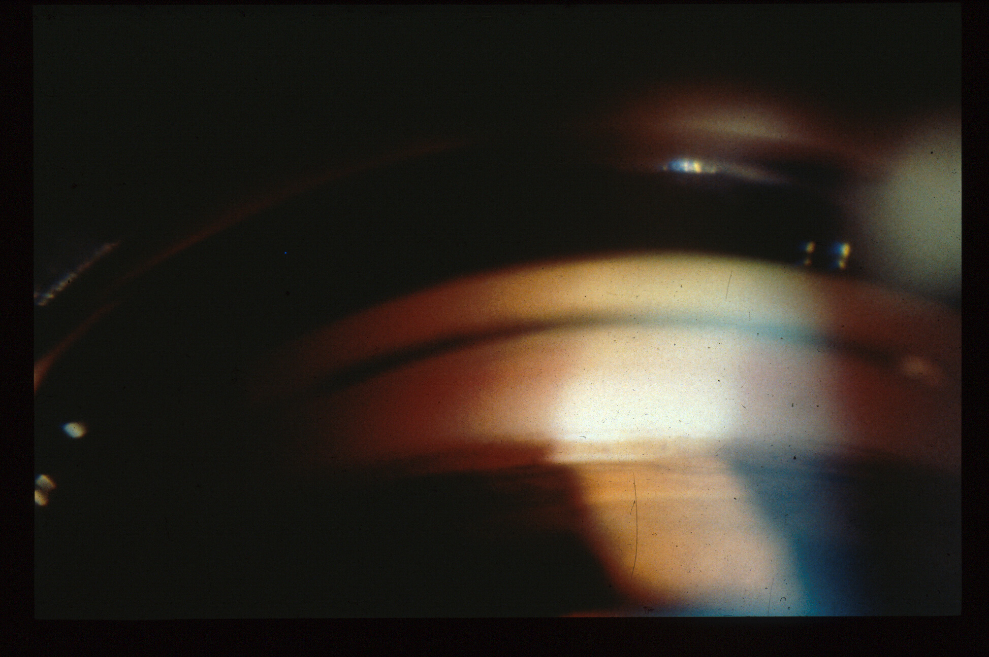
After Laser iridoplasty
Notes:
I still think that in predominantly appositional angle closure due to a plateau iris that peripheral iridoplasty is a highly effective and the least invasive treatment. Lens removal and goniosynechiolysis, coupled with the use of treatment of the ciliary body processes to shrink them with an endolaser is probably better when there are extensive PAS, and trabeculectomy best when there are very extensive PAS and advanced optic nerve damage, in which case the damage to the trabecular meshwork is more likely to be irreversible and the target pressure hard to reach without filteration surgery.

Slide 23
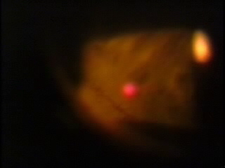
Laser Iridoplasty, courtesy of Robert Ritch, MD
Notes:
Here is Argon Laser Peripheral Iridoplasty, video courtesy of Robert Ritch, MD

Slide 24
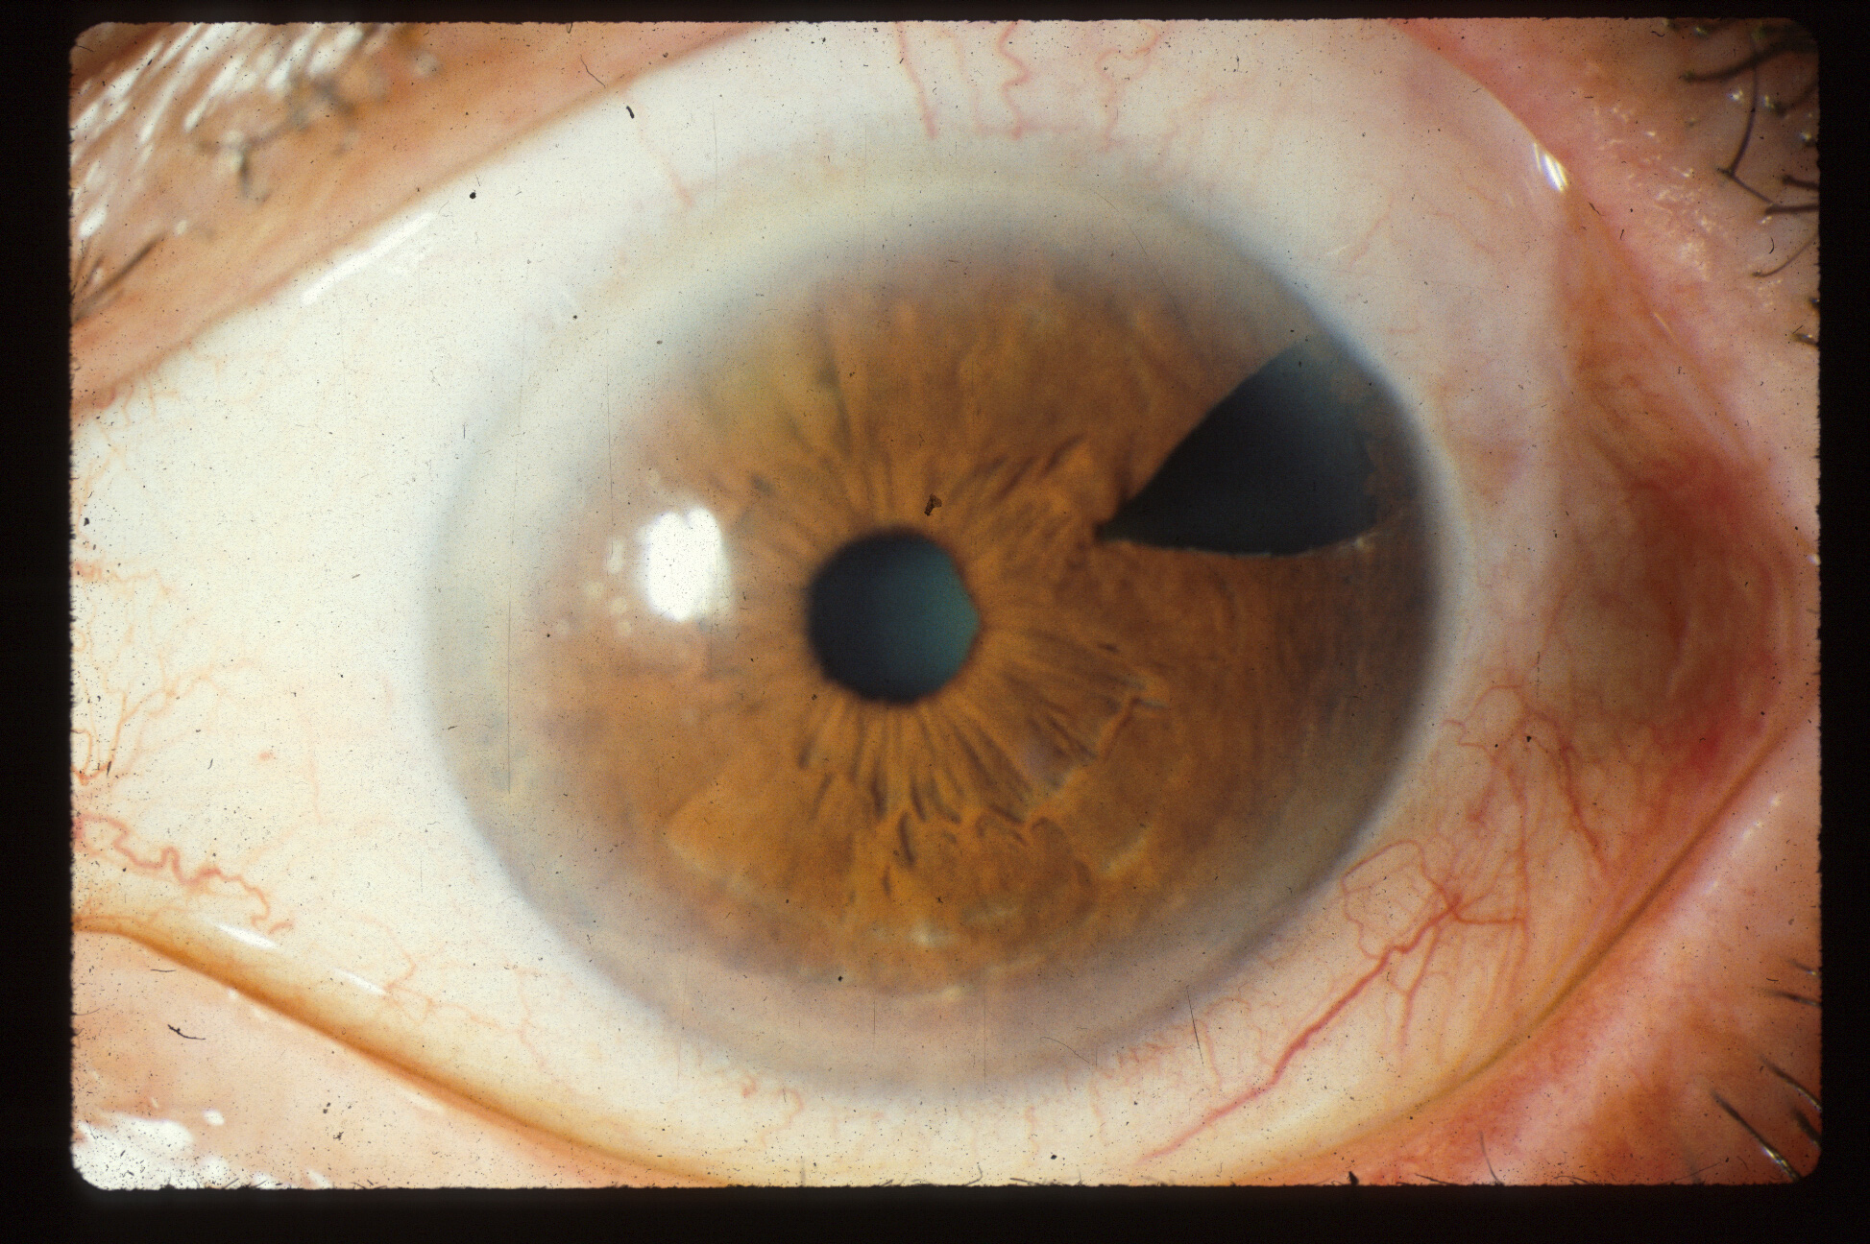
Surgical PI in 1979, recurrent angle closure in 1988—How is this possible?
Notes:
Here is a case of recurrent angle closure developing 9 years after an adequate (surgical) iridectomy. How is this possible?

Slide 25
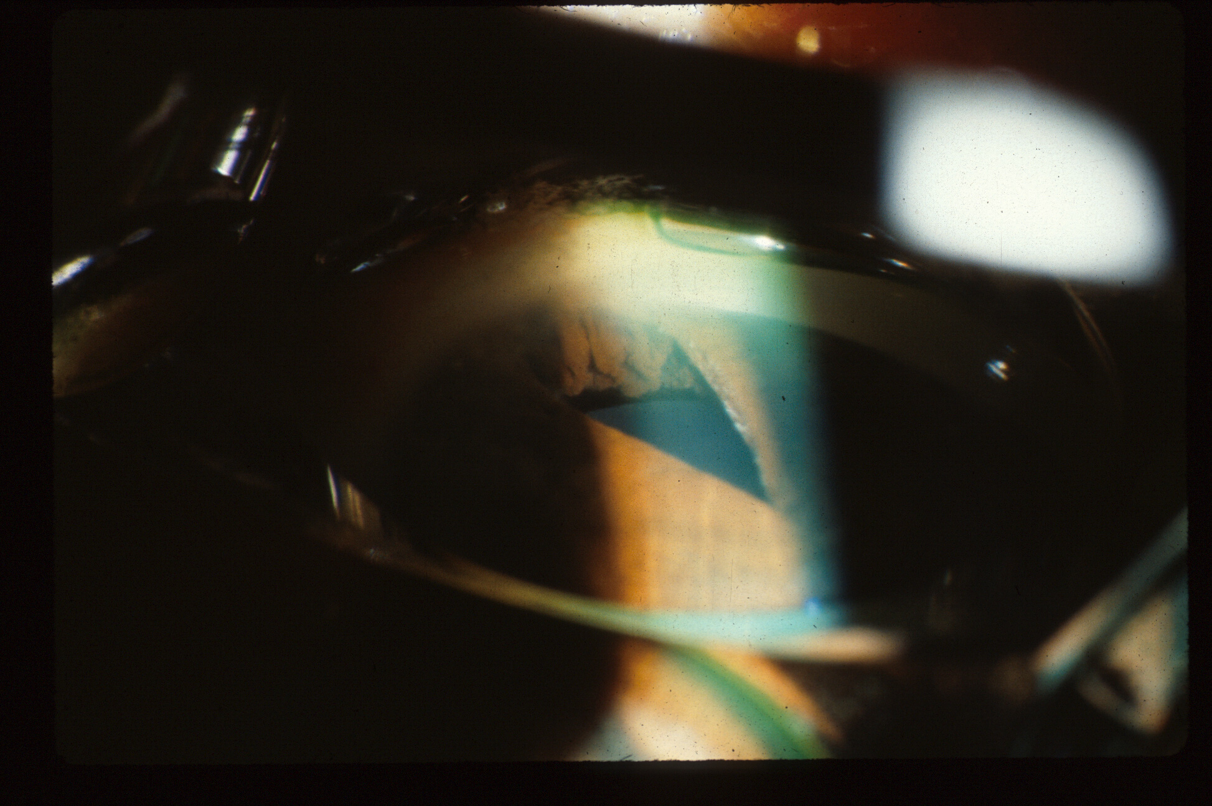
CB processes anterior in plateau iris syndrome
Notes:
Here one sees forwardly rotated ciliary body processes lifting the iris in plateau iris syndrome.

Slide 26
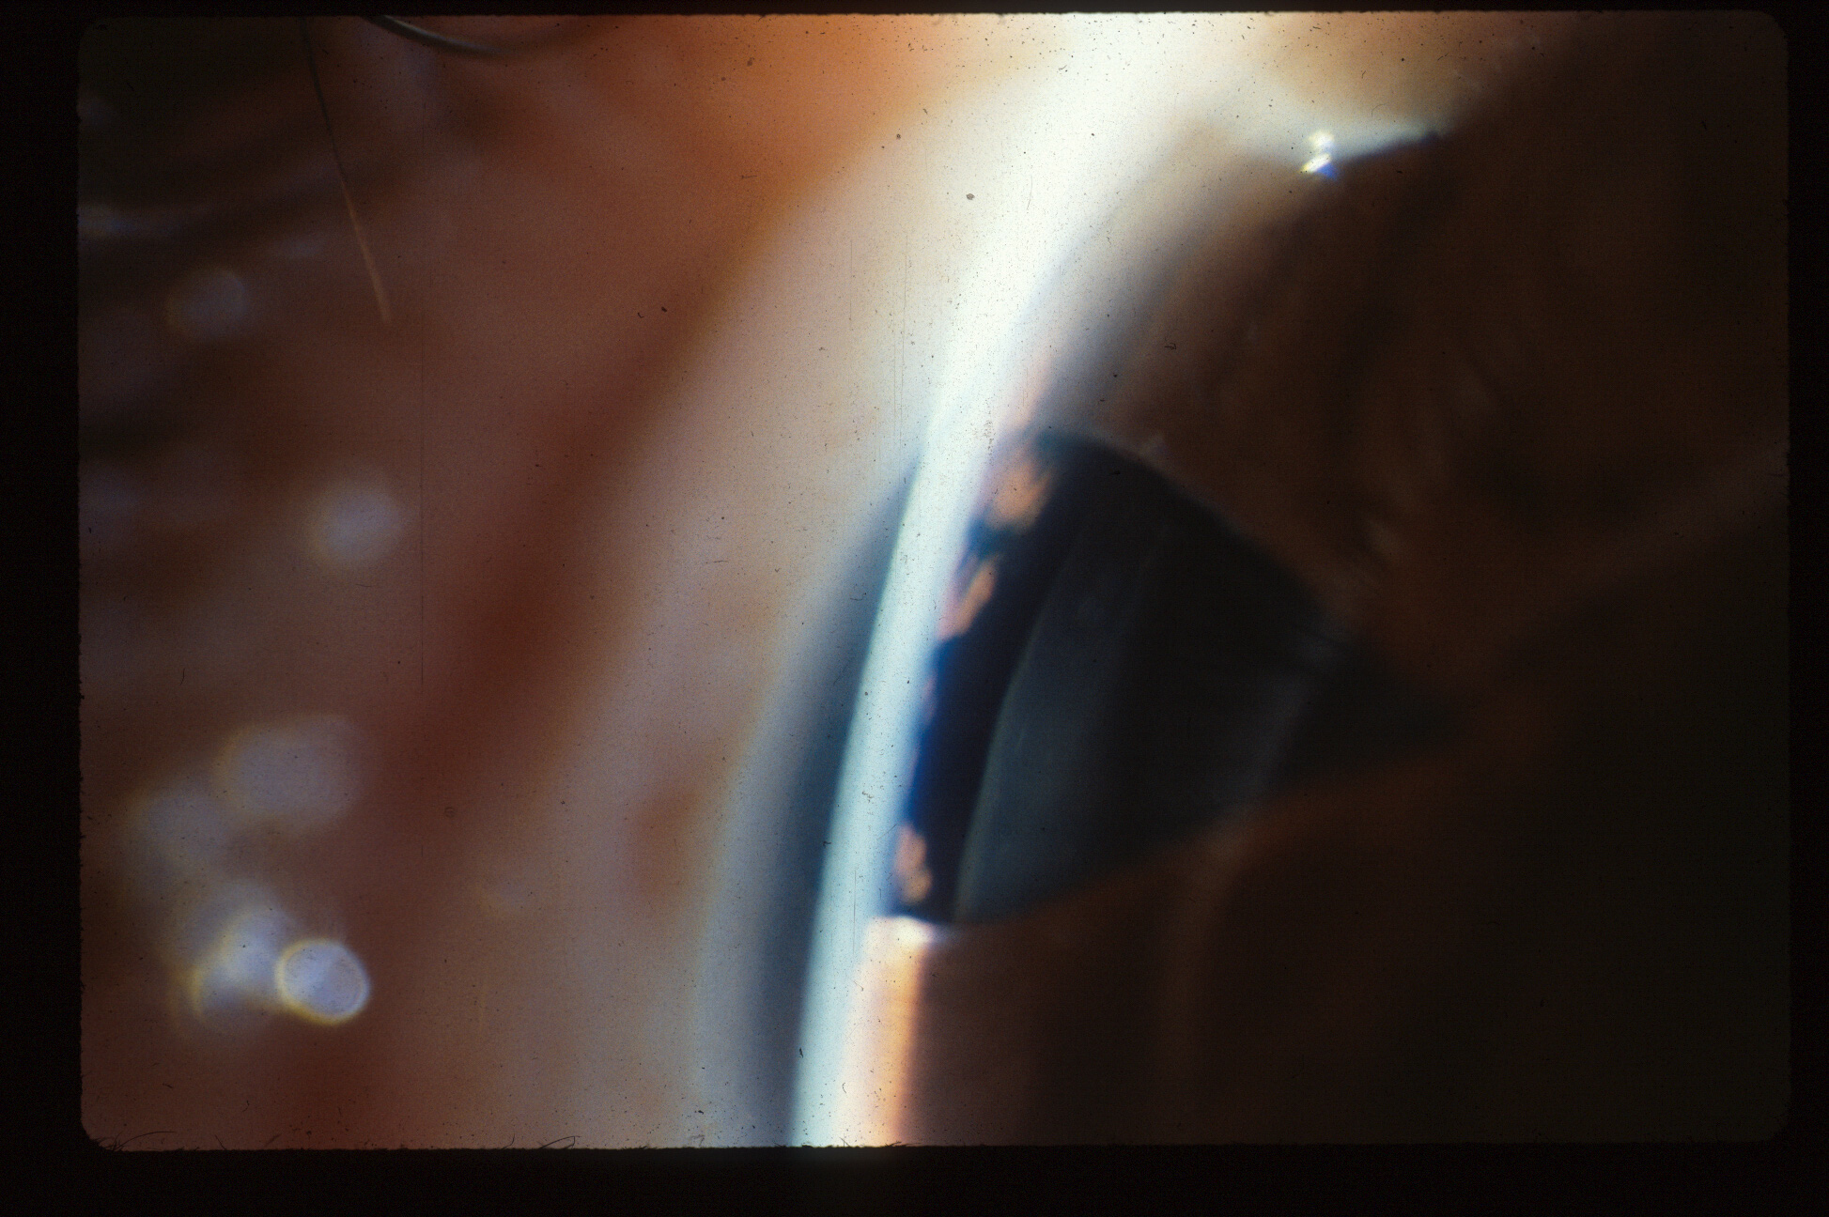
Notes:
Another view. The ciliary body processes are pushing the iris forward.

Slide 27
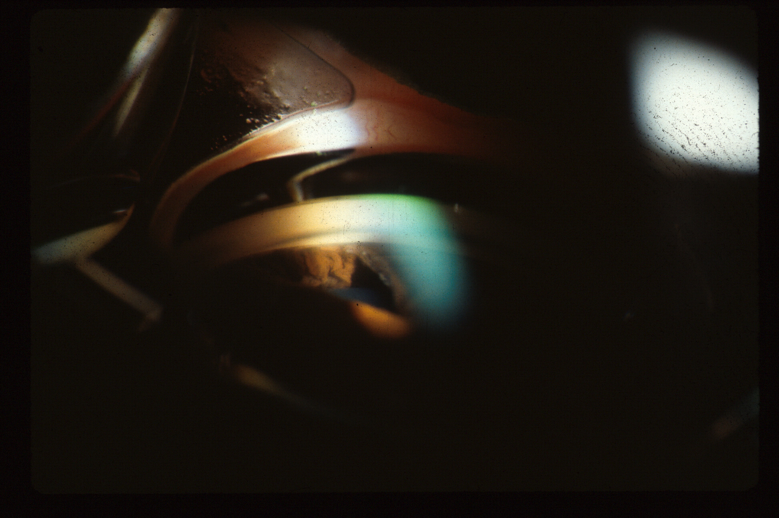
CB Processes are rolled forward prior to indentation gonioscopy
Notes:
Without indentation gonioscopy

Slide 28
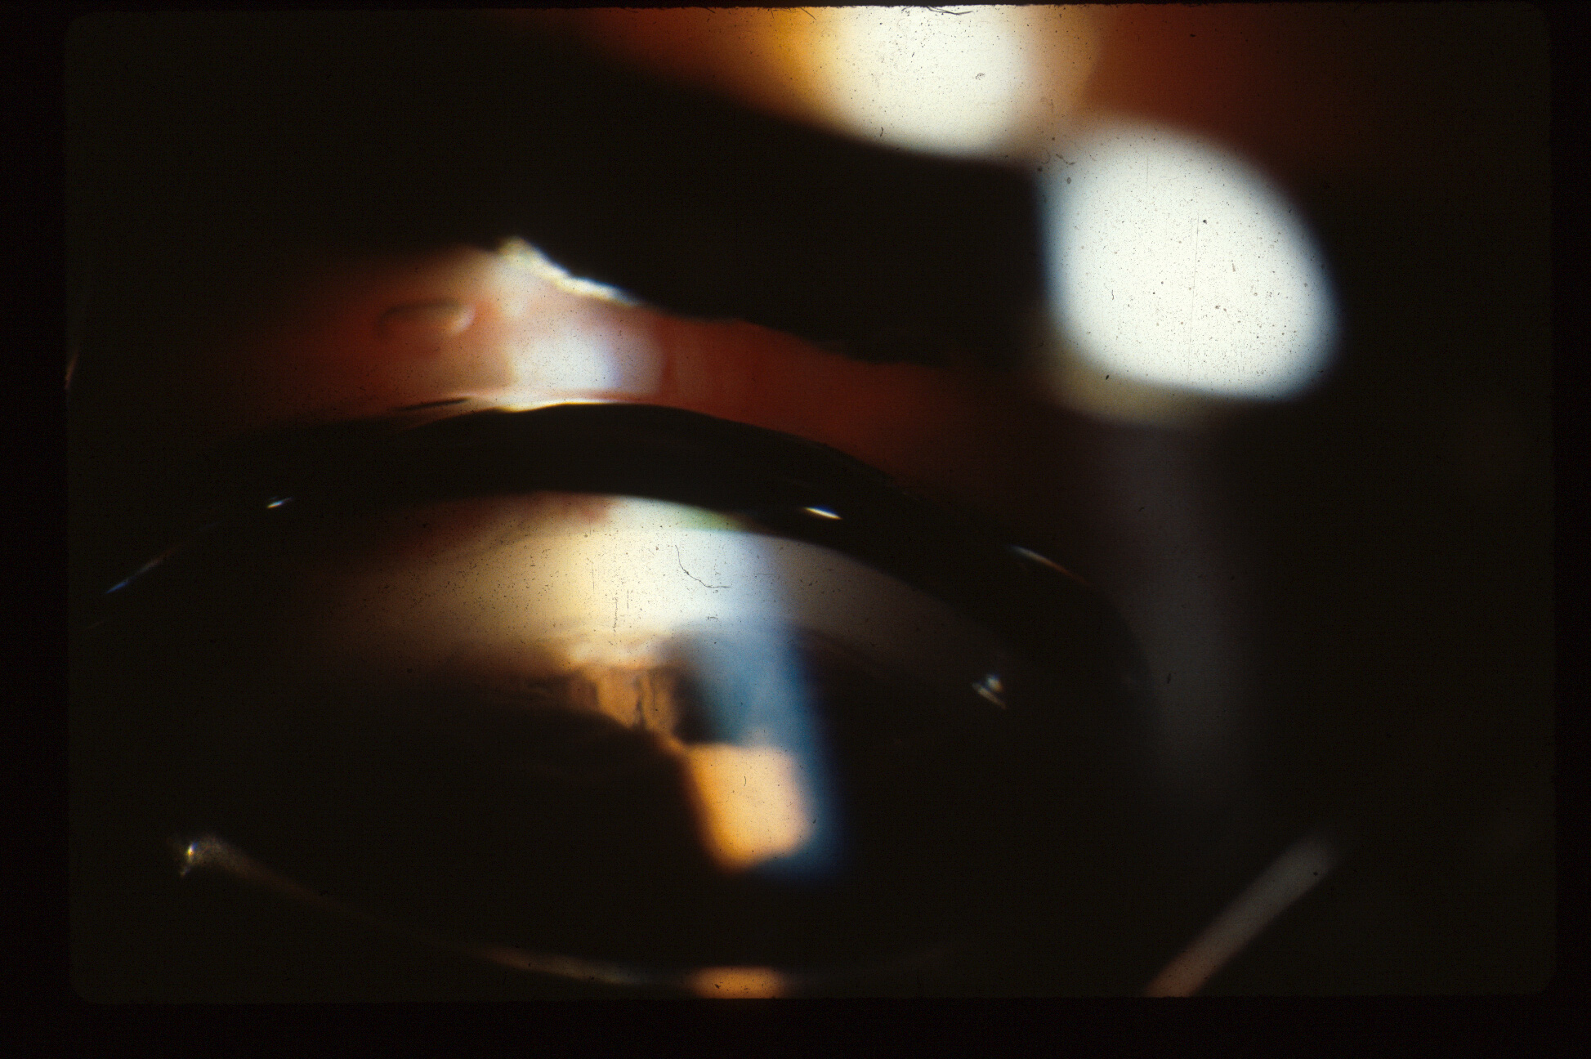
CB processes move back with indentation
Notes:
With indentation gonioscopy one sees that the appostional closure is temporarily reversed. Since there cannot be a pressure gradient between the anterior and posterior chambers in the presence of that surgical irdectomy, the mechanism is that increasing the intraocular pressure by indentation is stretching the corneal-scleral ring, which results in a posterior rotation of the ciliary body processes. This mechanism also helps to explain why Goldmann gonioscopy, which elevates the intraocular pressure by creating a suction cup effect, artifactually opens appositionaly closed angles, and SHOULD NOT BE USED in evaluating patients for angle closure.

Slide 29
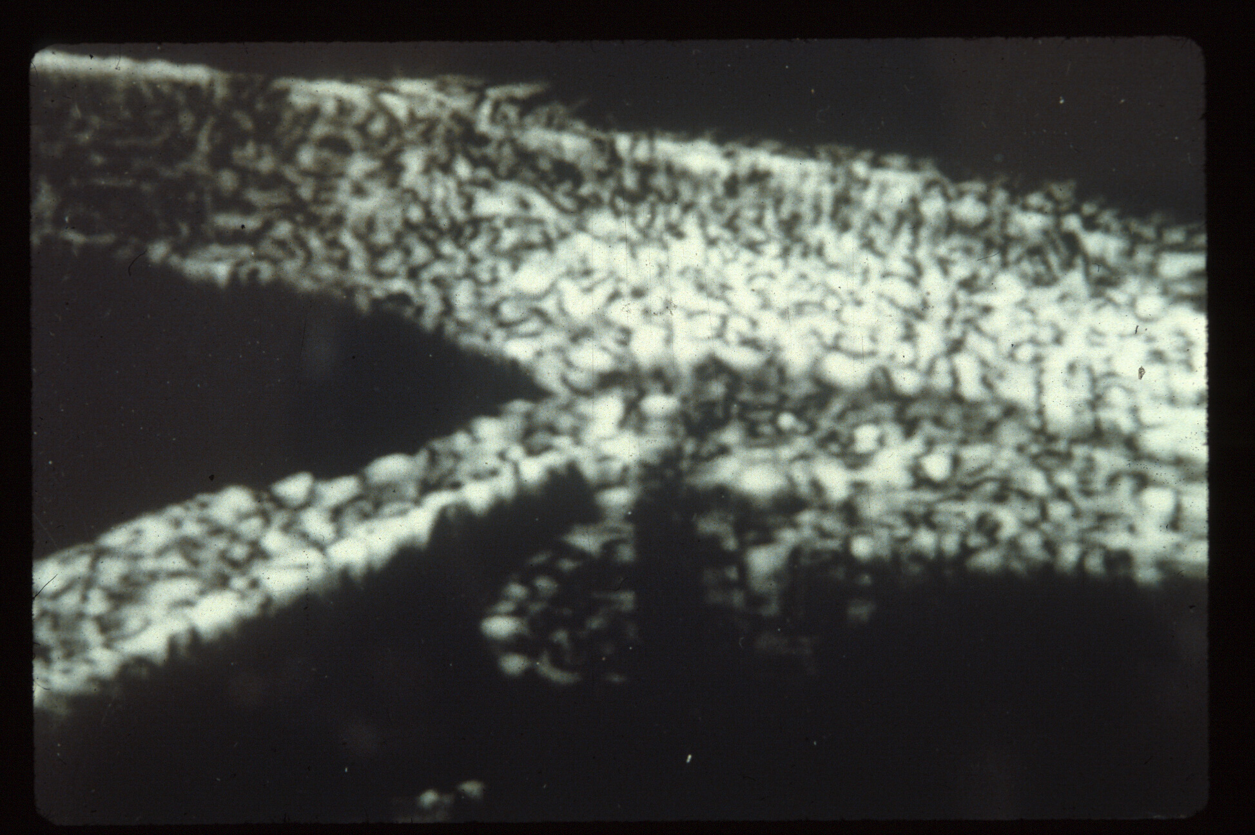
Normal angle UBM, from Ritch
Notes:
Ultrasound Biomicroscopy of a normal angle, courtesy of Bob Ritch.

Slide 30
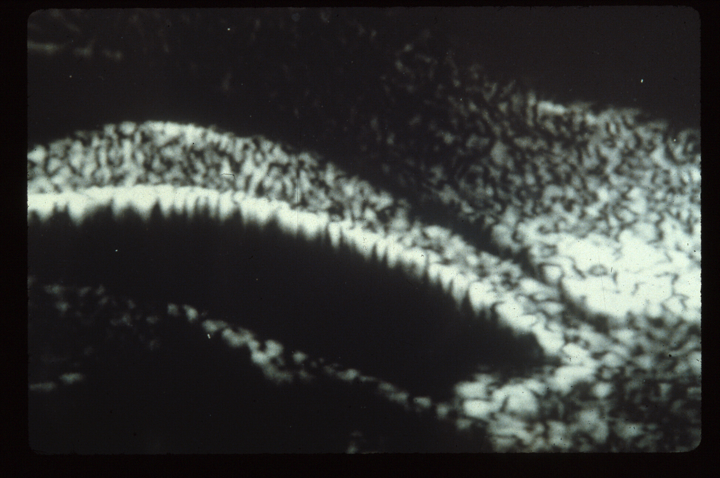
Pupil block angle closure UBM, from Ritch
Notes:
UBM of pupil block angle closure, viewed in the dark.

Slide 31
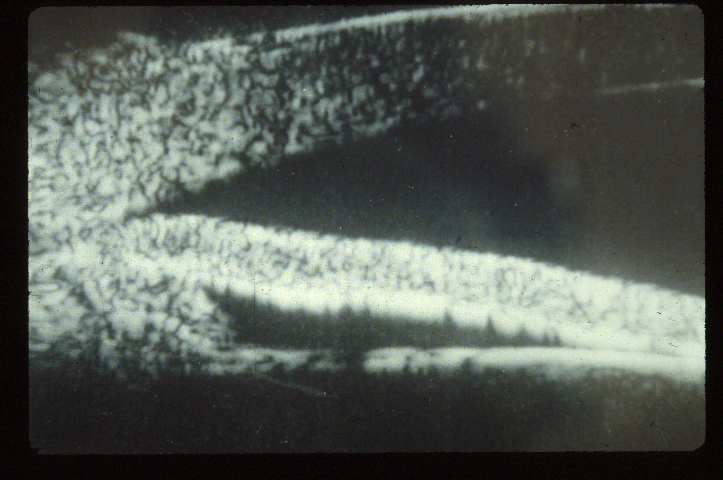
Plateau iris syndrome angle closure, CB processes rolled forward, UBM from Ritch
Notes:
UBM of plateau iris angle closure

Slide 32
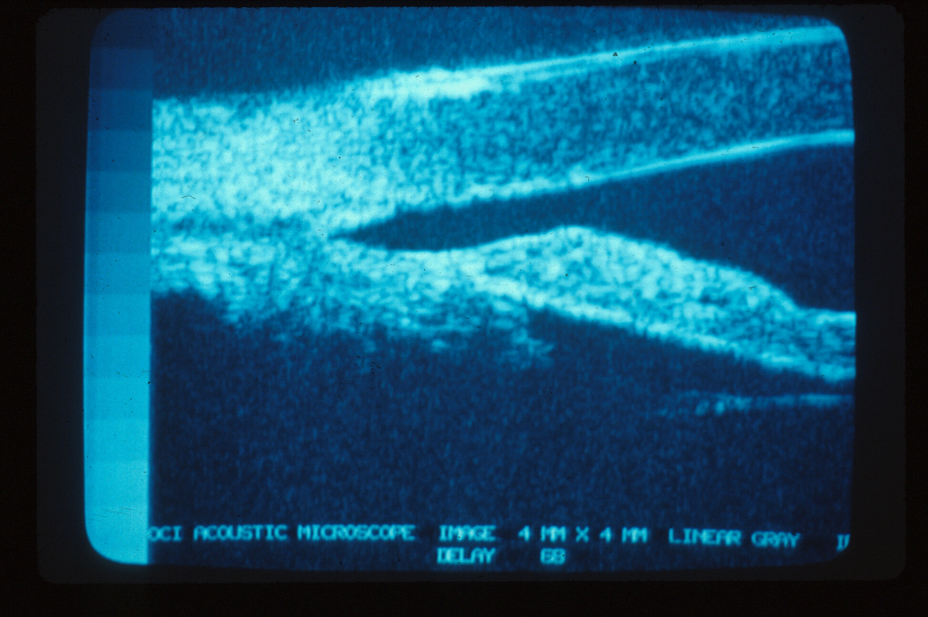
After laser iridoplasty, UBM from Ritch
Notes:
UBM of plateau iris after Argon laser peripheral iridoplasty

