Slide 1
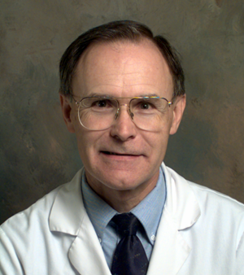


Solving Problems in Glaucoma Surgery!
1. Reconsidering Anatomy: avoiding leaks and bleeding
Paul Palmberg, MD, PhD
Consultant and Medical Monitor for InnFocus Micro Shunt FDA Clinical Trial
Consultant (unpaid) and trainer for Aurolab AADI Clinical Trial
Consultant and trainer for AqueSys XEN FDA clinical trial

Slide 2
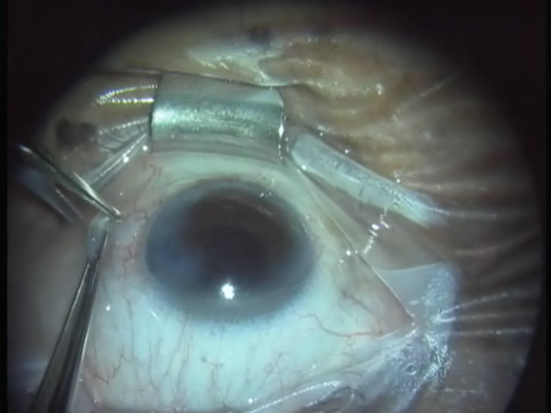
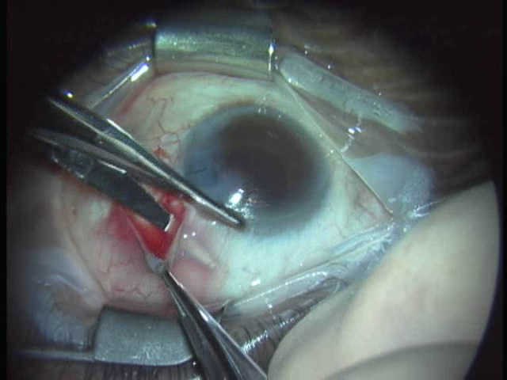
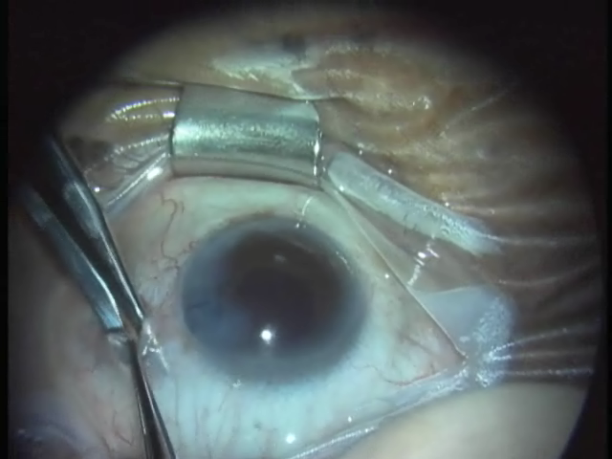
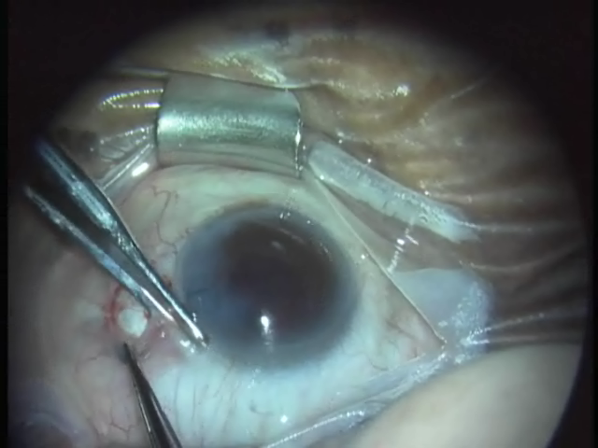
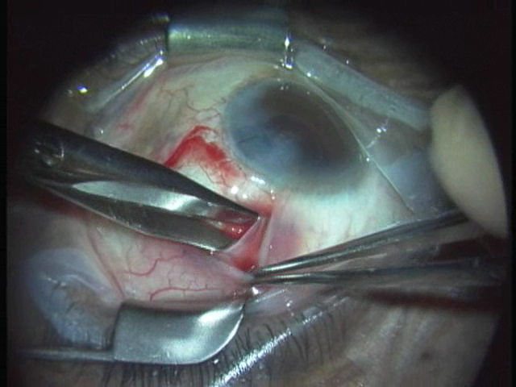
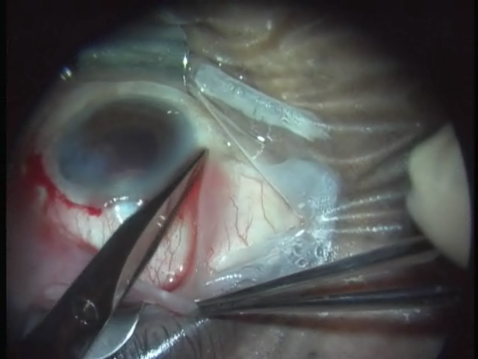
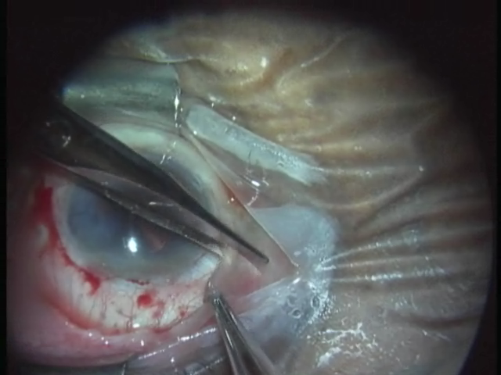
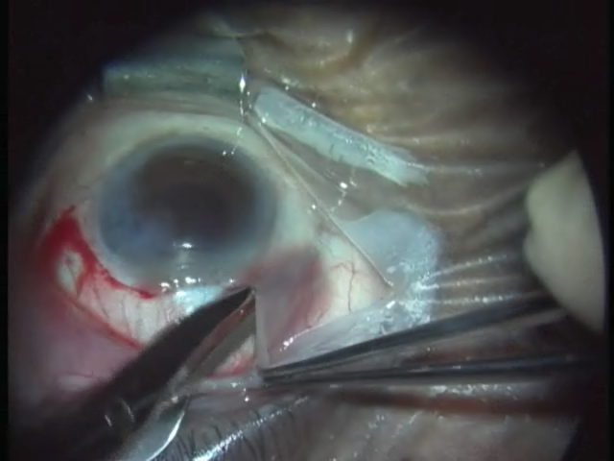
Conjunctival Flap—Avoiding Bleeding
Get Under, not into Tenon’s!
Tenon’ thickest from 10-2 o’clock above, and from 4 to 8 below
Sneak under the Border!

Slide 3
Conjunctival Flap—Avoiding Bleeding
Get Under, not into Tenon’s!
Tenon’s runs from 8-12 o’clock
Sneak under the Border!

Slide 4
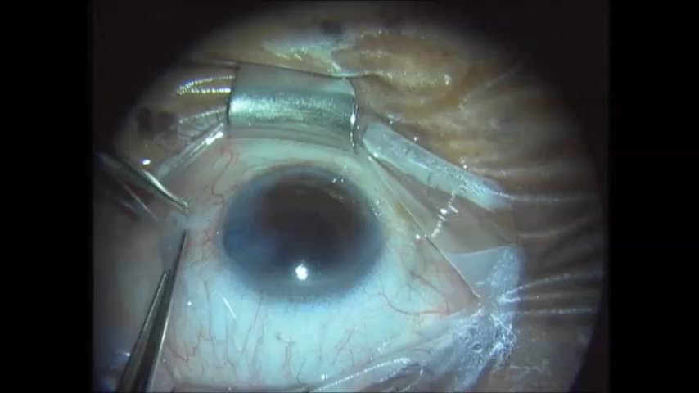
Conjunctival Opening

Slide 5
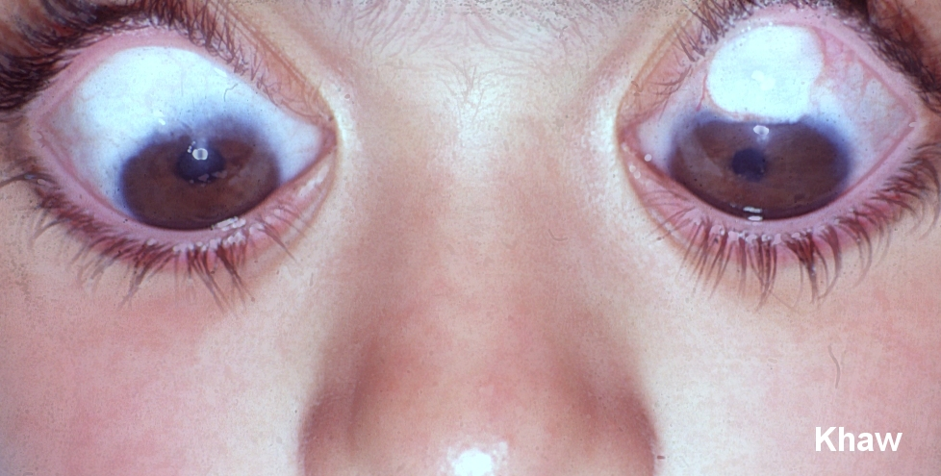
Applying MMC widely under a fornix flap avoids
“ring of steel” which can delimit the bleb posteriorly
Thank you Sir Peng Khaw!
After change
Fornix based
Large Area
MMC 0.5 mg/ml
Before Change
Limbus based
Small Area
MMC 0.4 mg/ml
Bleb related problems inc leaks / blebitis / endophthalmitis
0% 20%
My bleb problems reduced from 8% to 1% at 5 years.
Ophthalmology 2003 in press

Slide 6
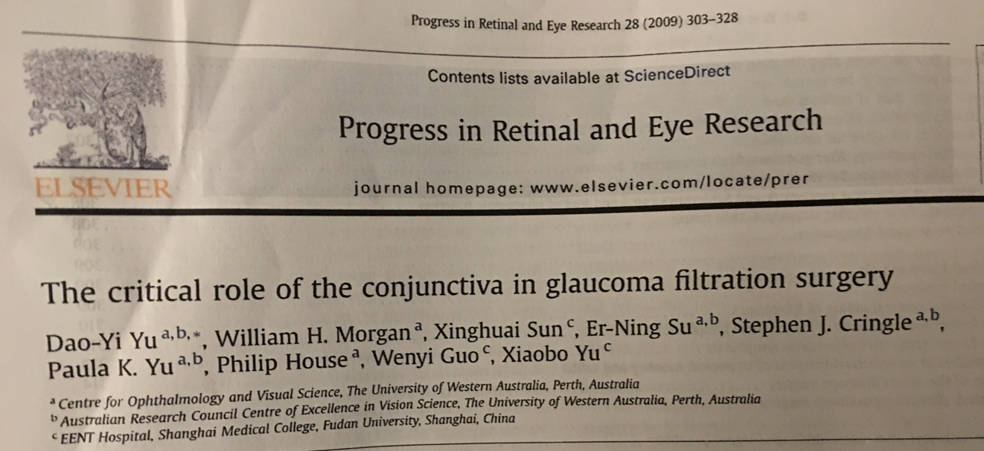
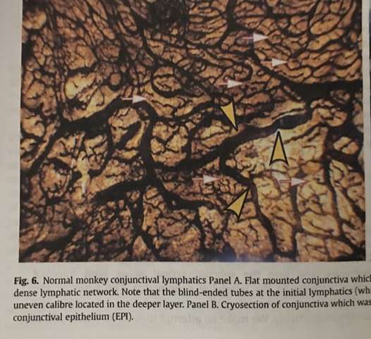
Dao-Yi Yu, PhD, working with William Morgan, MD:
In Perth, Australia, studied drainage to lymphatics, a prime route of aqueous drainage from blebs!

Slide 7
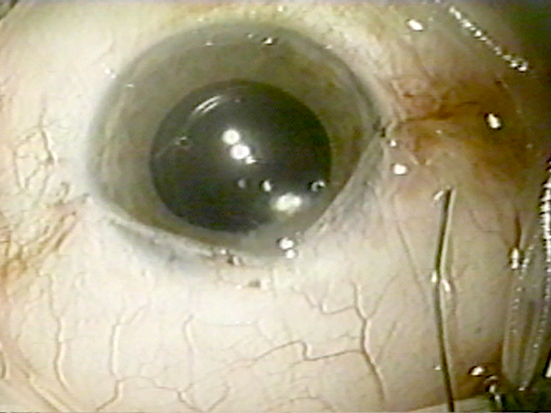
How to Achieve a Water-Tight
Conjunctival Closure

Slide 8
Getting it Right, Getting it Tight!
Comparing the architecture of square wave and skimming bites in sclera
Choice one: mattress sutures are oriented parallel to the limbus: enter sclera perpendicularly, turn to horizontal, then twist up
Choice two: anchor stitches in grooves at the edge of the cornea, pass suture radially
Square wave bites, good!
Skimming bites, bad!
Skimming bites tear and loosen, you lose! Third day p/o leak

Slide 9
Getting it Right, Getting it Tight!
Comparing the architecture of square wave and skimming bites in sclera
Square wave bites, good!
Skimming bites, bad!
Skimming bites tear and loosen, you lose! Third day p/o leak

Slide 10
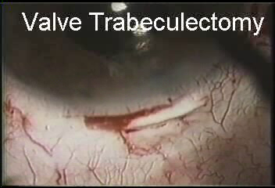
Safety Valve Trabeculectomy with MMC
Advantages:
Avoids hypotony, early and late (when sutures in flap dissolve)—used 1988 on
No iridectomy needed
Less astigmatism as flap sutures are not tight
No device cost
Fairly efficient
No net VF loss at mean of 7 years F/U, mean IOP 11 mm Hg
Suner, et al, Ophthalmol 1997

