Slide 1

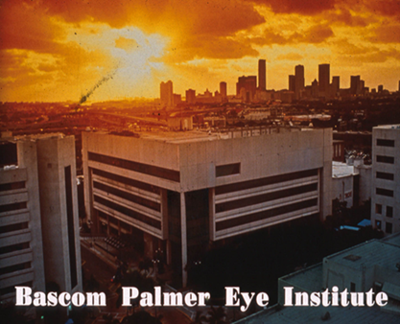

Solving Problems in Glaucoma Surgery!
Part 4 Repair of Leaking Blebs
Paul Palmberg, MD, PhD
Consultant and Medical Monitor for InnFocus Micro Shunt FDA Clinical Trial
Consultant (unpaid) and trainer for Aurolab AADI Clinical Trial
Consultant and trainer for AqueSys XEN FDA clinical trial

Slide 2
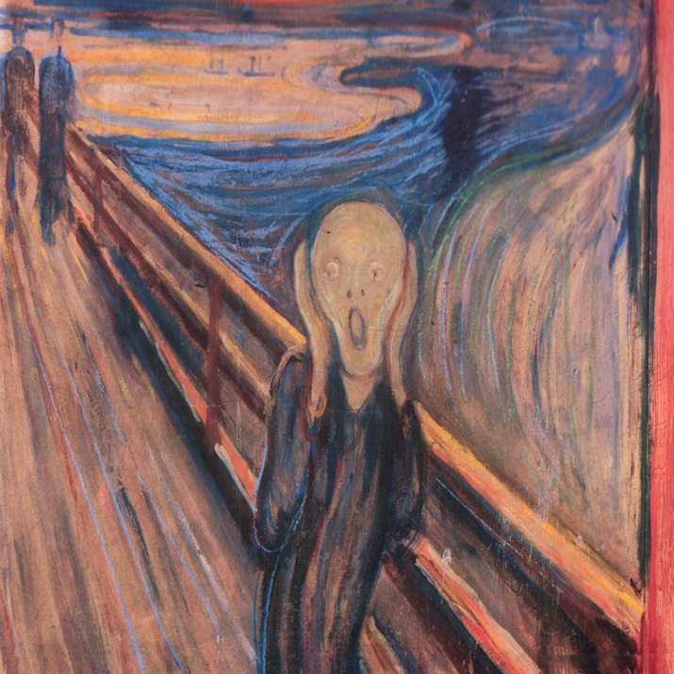
Oh No, There is a Leak at the Limbus!

Slide 3
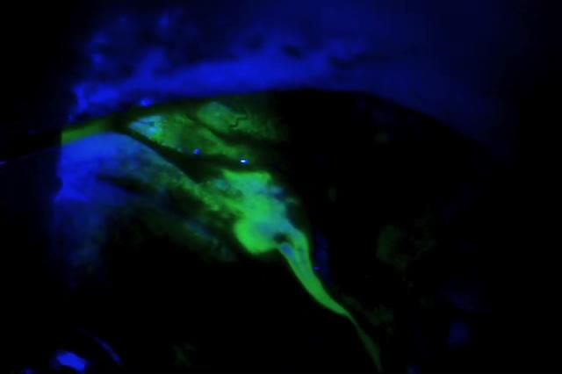
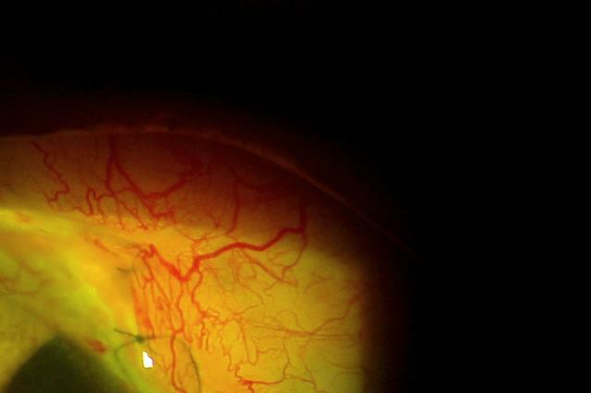
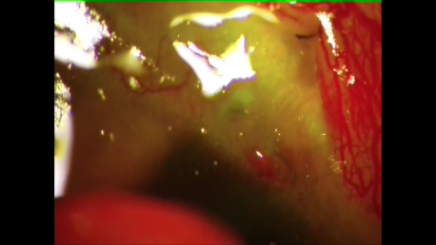
What Type of Leak(s)?
1) Conjunctival edge leak
2) Vicryl suture melt (not shown)
3) Corneal suture hole

Slide 4
Why Did This Happen?
Tenon’s capsule dehiscence leaves just fragile conjunctival flap

Slide 5
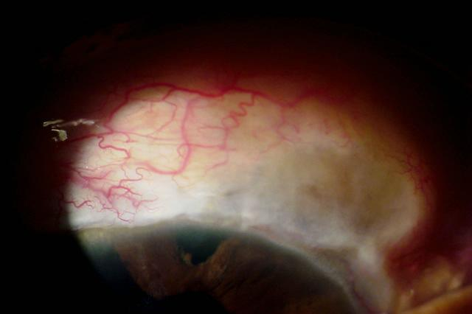
How to Avoid It Next Time
Tenon’s Capsule Dehiscence

Slide 6
What NOT to do!
Do NOT Stop Steroids!
You don’t want the bleb to fail
Inflammation melts tissue (cf Schuman)
Do Not Observe if bleb flat
When the rivulet closes the bleb is gone
Risks infection
Risks epithelial downgrowth

Slide 7
Why Did This Happen?
Tenon’s capsule dehiscence leaves just fragile conjunctival flap
Skimming scleral suture bites loosen!

Slide 8
Why Did This Happen?
Tenon’s capsule dehiscence leaves just fragile conjunctival flap
Skimming scleral suture bites loosen!
Penetrating corneal suture bites (either conj flap closure sutures or traction sutures)
Conjunctival-conjunctival closure without scleral bite support
(MMC touching conj edge NOT important!)

Slide 9
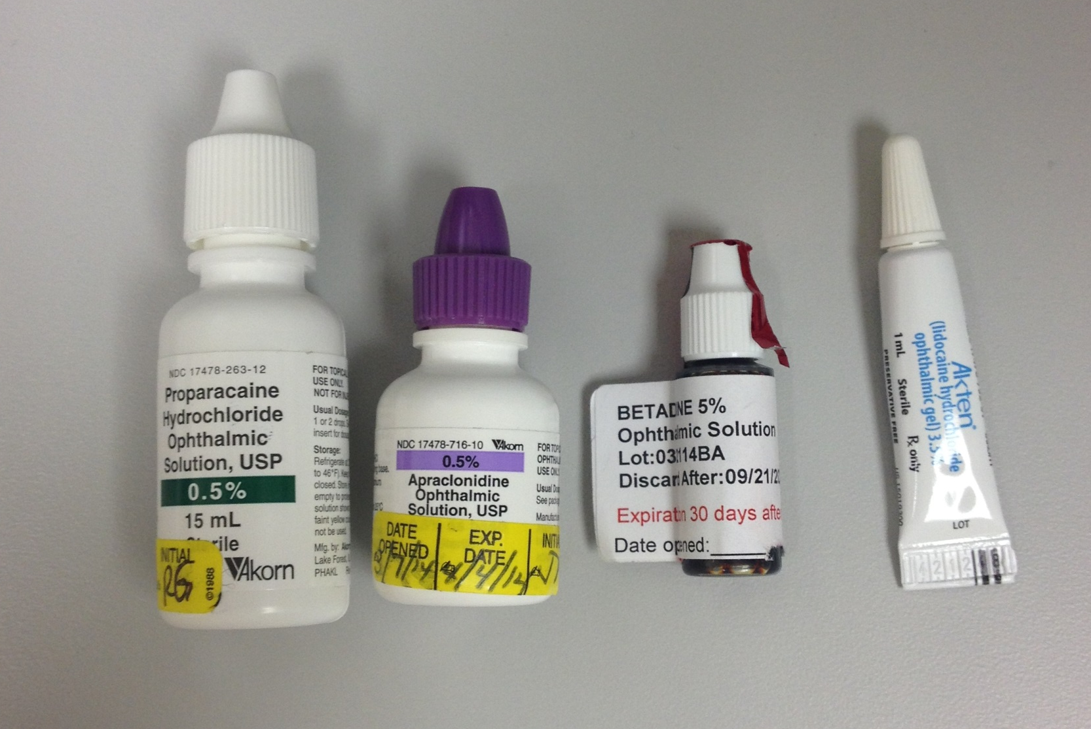
Prep for Slit Lamp Procedure
Proparacaine Apraclonidine Povidone Iodide 5% 2% Xylocaine gel

Slide 10
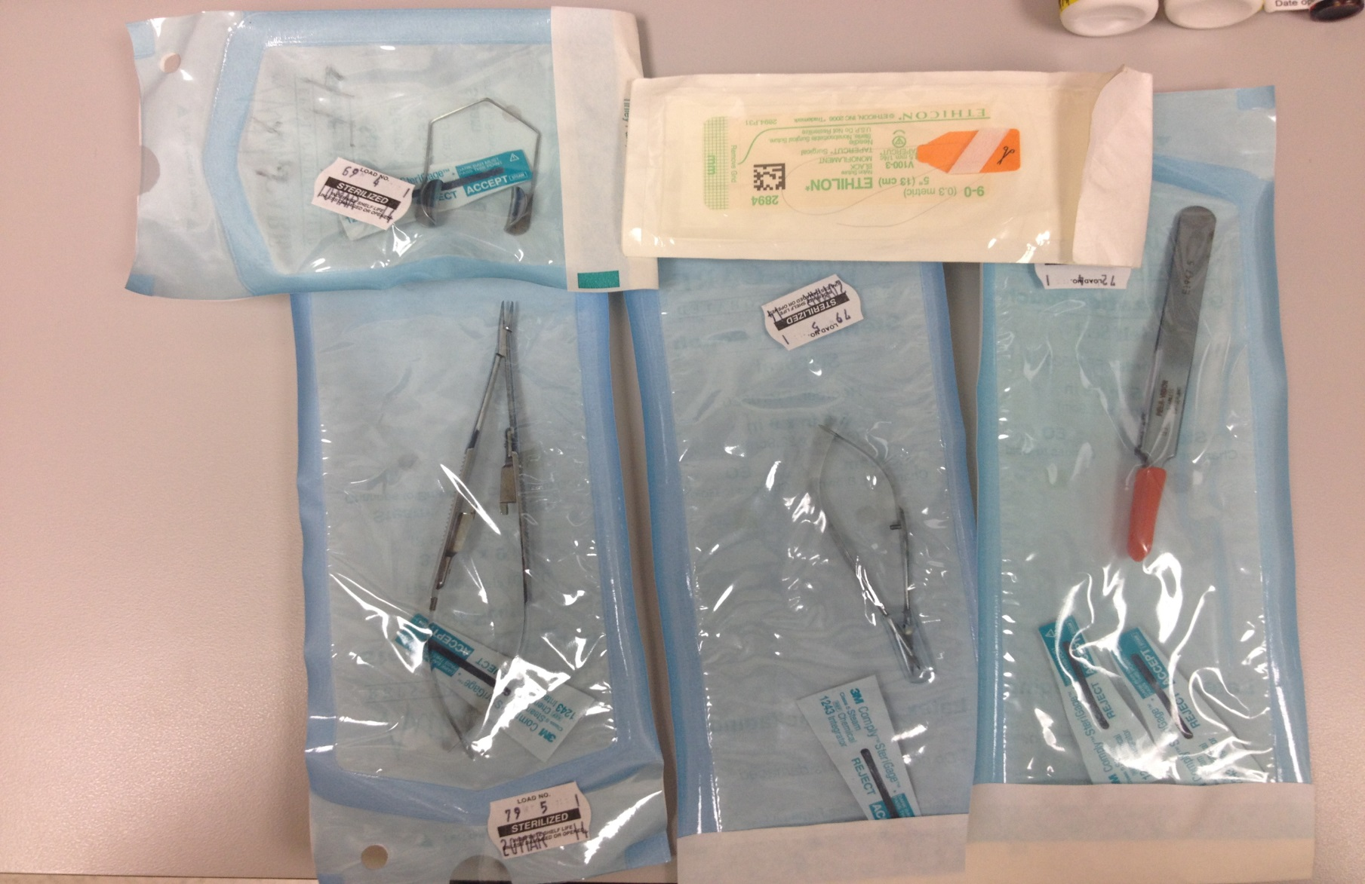
Instruments for Slit Lamp Procedures

Slide 11
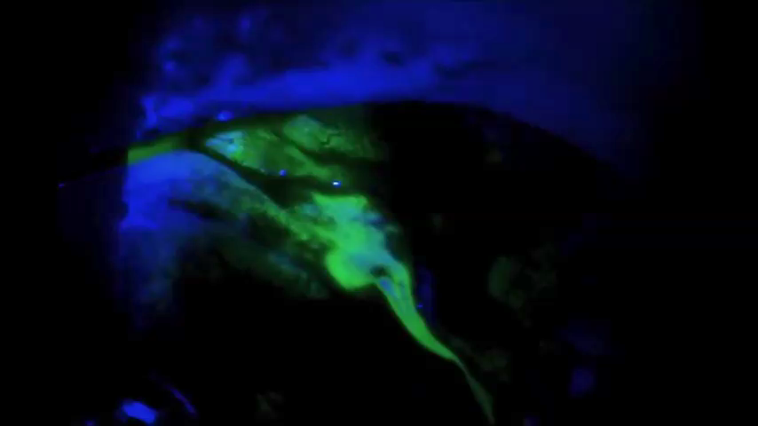
How to Fix It at the Slit Lamp

Slide 12
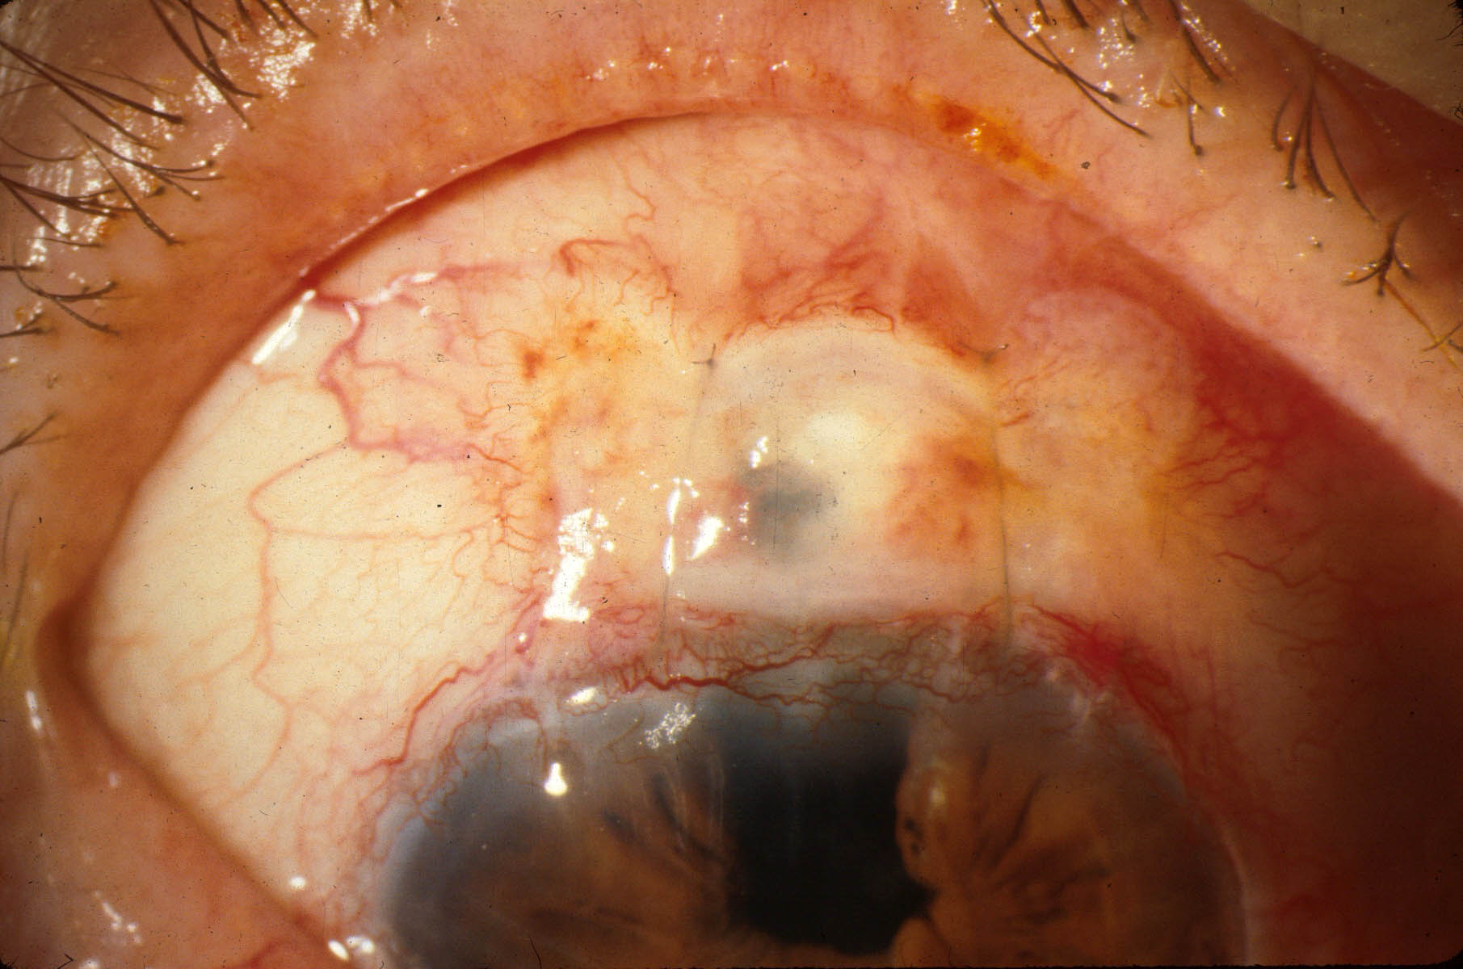
.
27 year old Scheie procedure: bleb ruptured at each end that day by refrigerator handle injury.
The first bleb compression case, 1991 (old technique).
Notes:
Bleb compression stitches began with this case: A woman had hit her only eye with the door handle of a refrigerator and then could not see clearly. A Seidel test showed a leak on each side of a thin bleb. There was a lot of scarring behind the bleb. If only I could isolate those holes. Maybe a couple of stitches acting like bungee cords could do it! I placed two 10-0 nylons through the cornea, across the bleb cavity and out behind the bleb and then back over the bleb and tied them tightly. It worked, the bleb formed as the pressure rose, and she could see. I showed it to our Fellow, James Robinson, who suggested a much better way to do it--anchoring a mattress stitch in the cornea and behind the bleb.

Slide 13
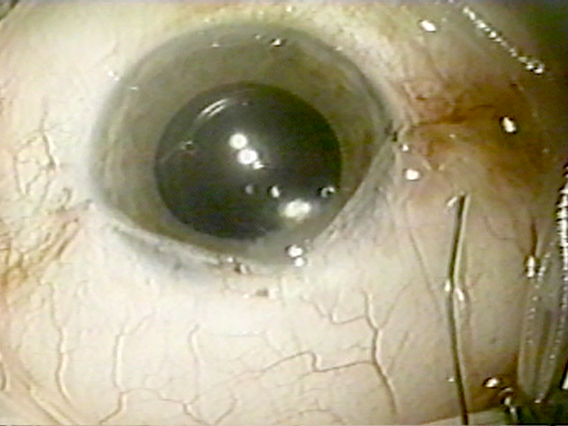
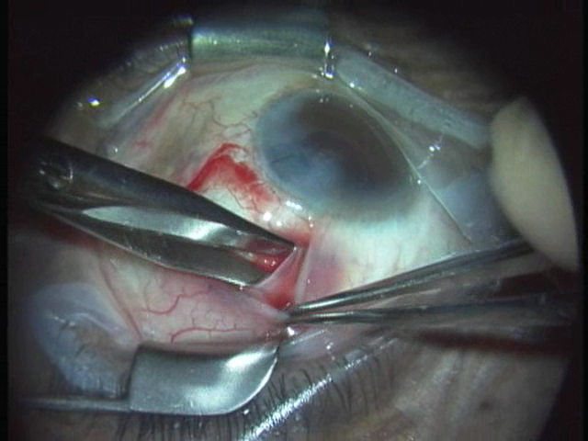

Blebs are Like Babies
Making them is fun!
Knowing the anatomy helps!
If they wet themselves, don’t wait to fix it!
Pray they have a long and healthy life

