Slide 1
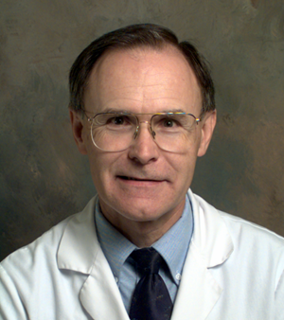


Solving Problems in Glaucoma Surgery!
2. Safety-valve trabeculectomy to avoid hypotony
Paul Palmberg, MD, PhD
Consultant and Medical Monitor for InnFocus Micro Shunt FDA Clinical Trial
Consultant (unpaid) and trainer for Aurolab AADI Clinical Trial
Consultant and trainer for AqueSys XEN FDA clinical trial

Slide 2
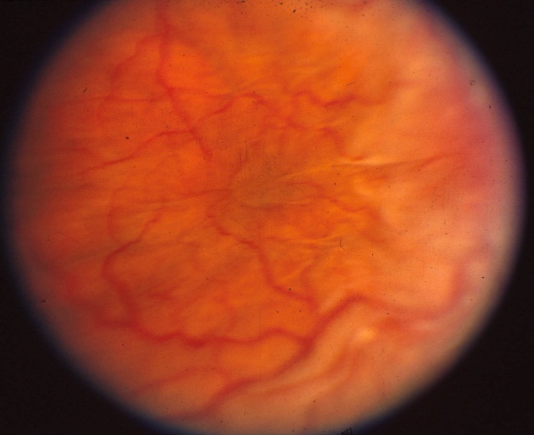
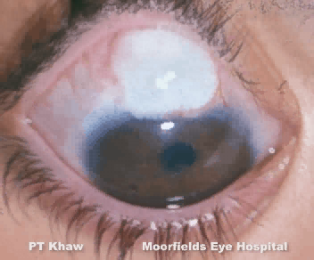
MMC or 5-FU can give us low IOP
We can reduce post-op healing and get lower pressures.
What is the cost in serious side effects, bleb problems and hypotony?
How can we get a discount?

Slide 3
Hypotony Maculopathy
MMC and 5-Fluorouracil never cause hypotony!
However, they will certainly preserve whatever hypotony you create!
Hypotony may be avoided by using a valve-like incision, when possible, and/or by careful adjustment of the scleral flap resistance intraoperatively to set the IOP at equilibrium flow. It works, it’s not voodoo!

Slide 4
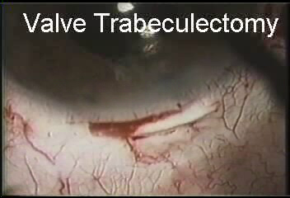
Safety Valve Trabeculectomy with MMC
Advantages:
Avoids hypotony, early and late (when sutures in flap dissolve)—used 1988 on
No iridectomy needed
Less astigmatism as flap sutures are not tight
No device cost
Fairly efficient
No net VF loss at mean of 7 years F/U, mean IOP 11 mm Hg
Suner, et al, Ophthalmol 1997

Slide 5
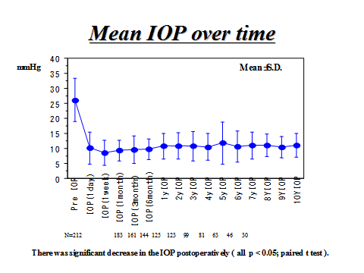
The Proof that Intraoperative Adjustment of IOP Works Fairly Well

Slide 6
Reduced Vision from Hypotony
Hypotony Maculopathy (with chorioretinal folds)
Variable Refraction (without chorioretinal folds)

Slide 7
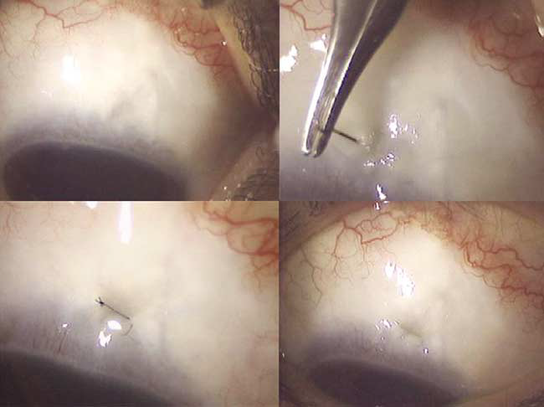
When there are no chorioretinal folds, but reduced vision from variable refraction,
re-suturing the scleral flap right through the conjunctiva may suffice!
Technique of Shirato, also see Eha, et al, cases.
FIGURE 1. (Top left) Large bleb before the procedure. (Top
right) Suturing by a round, tapered needle with 10-0 nylon
suture. (Bottom left) Just after suturing. (Bottom right) Site of
suture 1 week after the procedure. Note the suture is buried
under the bleb. Shirato, et al, AJO 2004

Slide 8
But When Hypotony Maculopathy with Chorioretinal Folds
Does Happen, You Need to do More!
Hypotony maculopathy: chorioretinal folds (not CME) affecting the macula (Dellaporta and Gass)
Caused by contraction of the elastic sclera in hypotonous eyes after filtration surgery or cyclodialysis
Risk factors: young age (elastic sclera), myopia (thin sclera) and high pre-op pressure going to very low
Strategy for repair: Two Sets of Stitches Technique Suner, et al, Ophthalmology 1997; 104:207-214.
Scleral compression sutures and patch grafts may be needed.

Slide 9
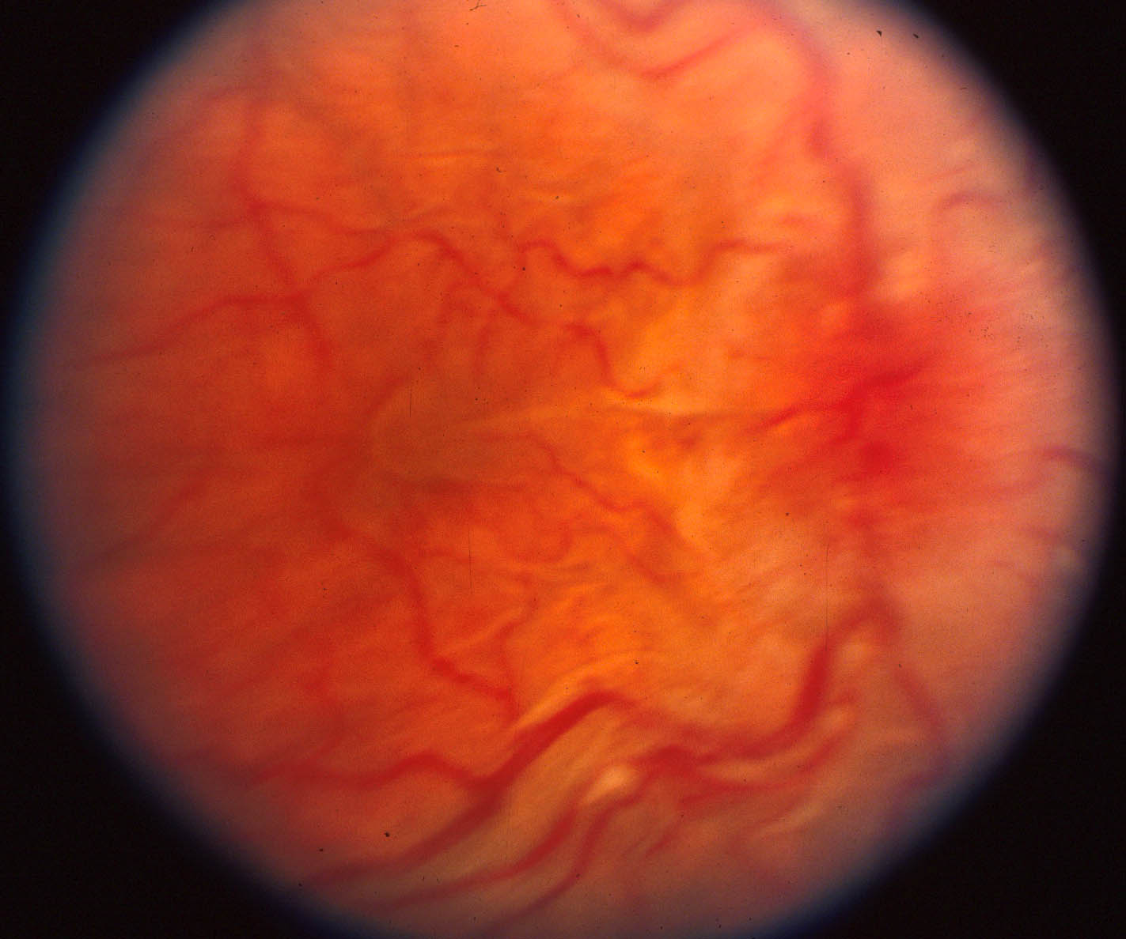
Notes:
Young man with glaucoma after PK for Acanthamoeba Keratitis had a MMC trabeculectomy with a poor valve effect. He noted blurred vision after rubbing the eye two weeks post-op. I had cut one stitch and he broke the other. After a month I presented him at Grand Rounds at Bascom Palmer to Don Gass. After Rounds I spent a lot of time thinking about what to do.

Slide 10


Slide 11
Two Sets of Stitches Technique to Treat Hypotony Maculopathy
Reset scleral resistance to the target pressure with first set of flap stitches.
Place second set of flap stitches to raise the IOP to > 20 mm Hg to stretch sclera, which takes time.
Observe resolution of chorioretinal folds in 1-4 weeks.
Laser second set of stitches to achieve target pressure.

Slide 12
Scleral Flap Compression Sutures
Consider when additional, tight flap sutures would threaten to produce claw holes or increased astigmatism.
Two horizontal compression sutures can be used in the two sets of stitches technique.

Slide 13
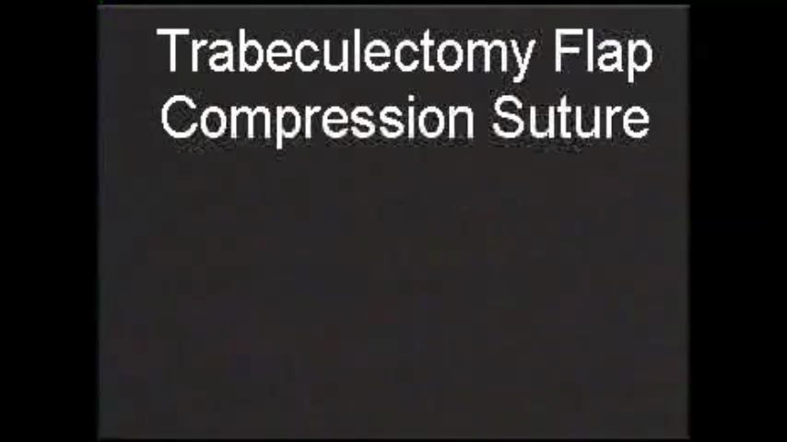
Notes:
1.5x version

Slide 14
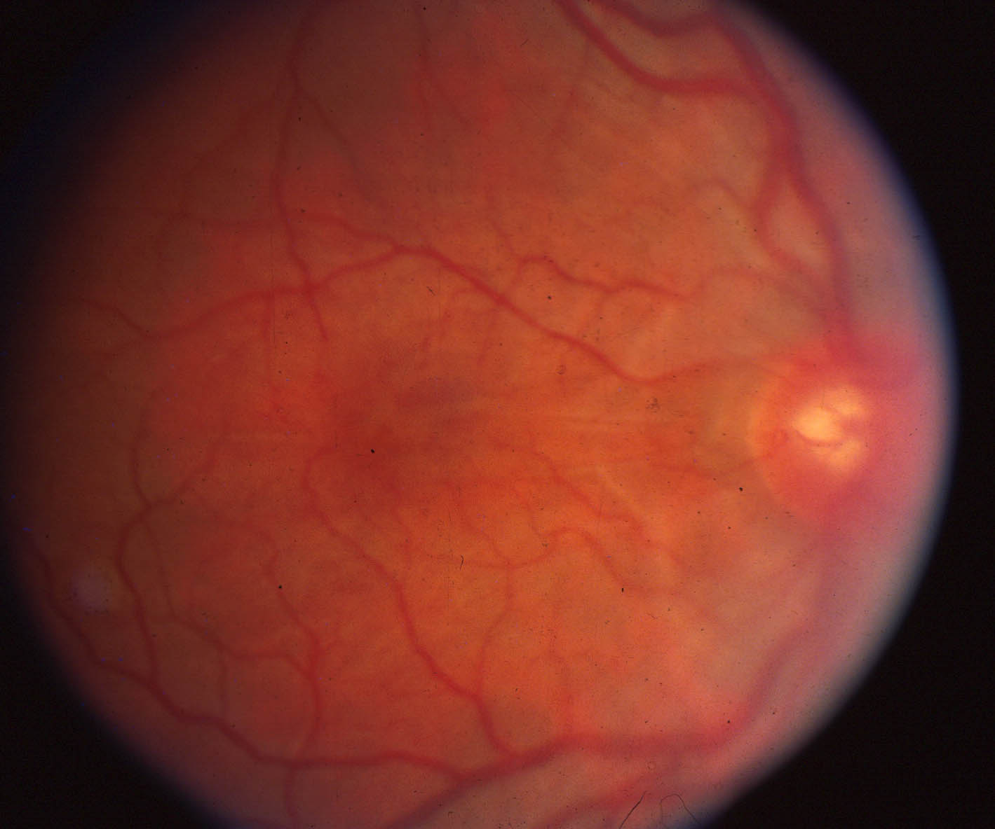
“Cat whisker” folds remains, but not in fovea

Slide 15
Scleral Patch Grafts
When the scleral flap is torn or melted, one may create the needed scleral resistance with a suspended patch graft.
The patch graft may be suspended with two horizontal, compressing sutures to treat hypotony maculopathy.

Slide 16
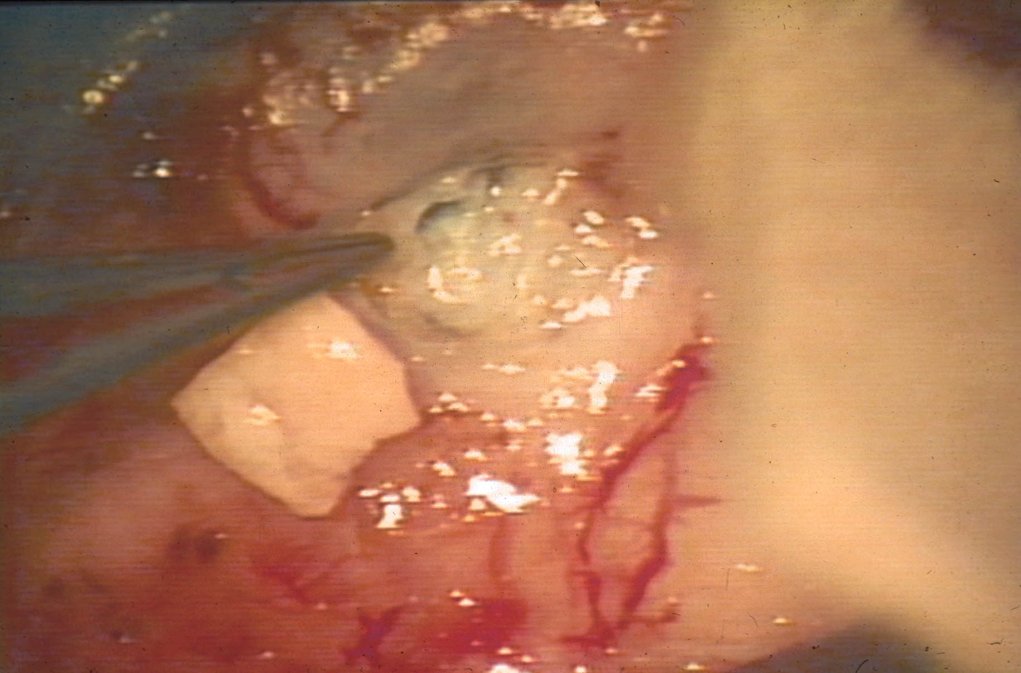

Slide 17
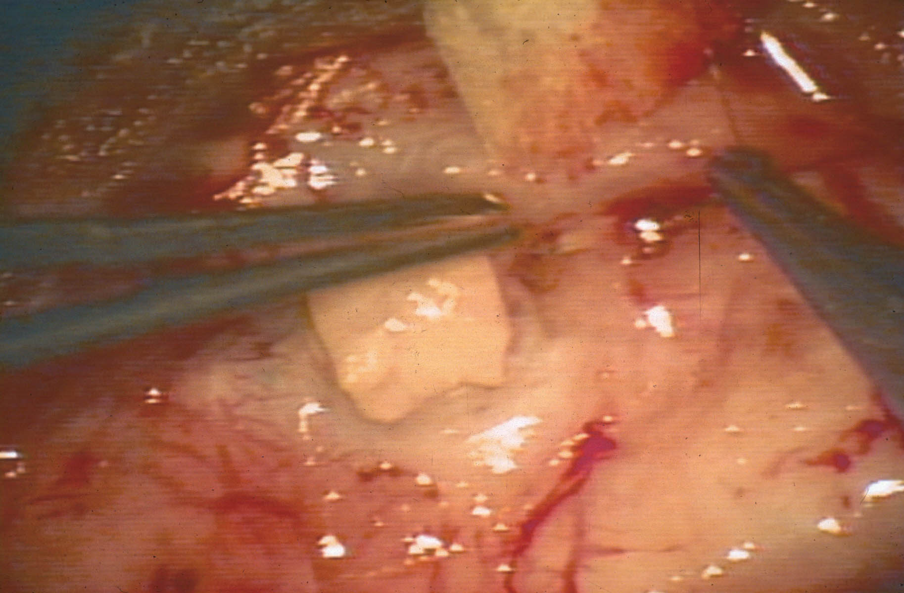

Slide 18
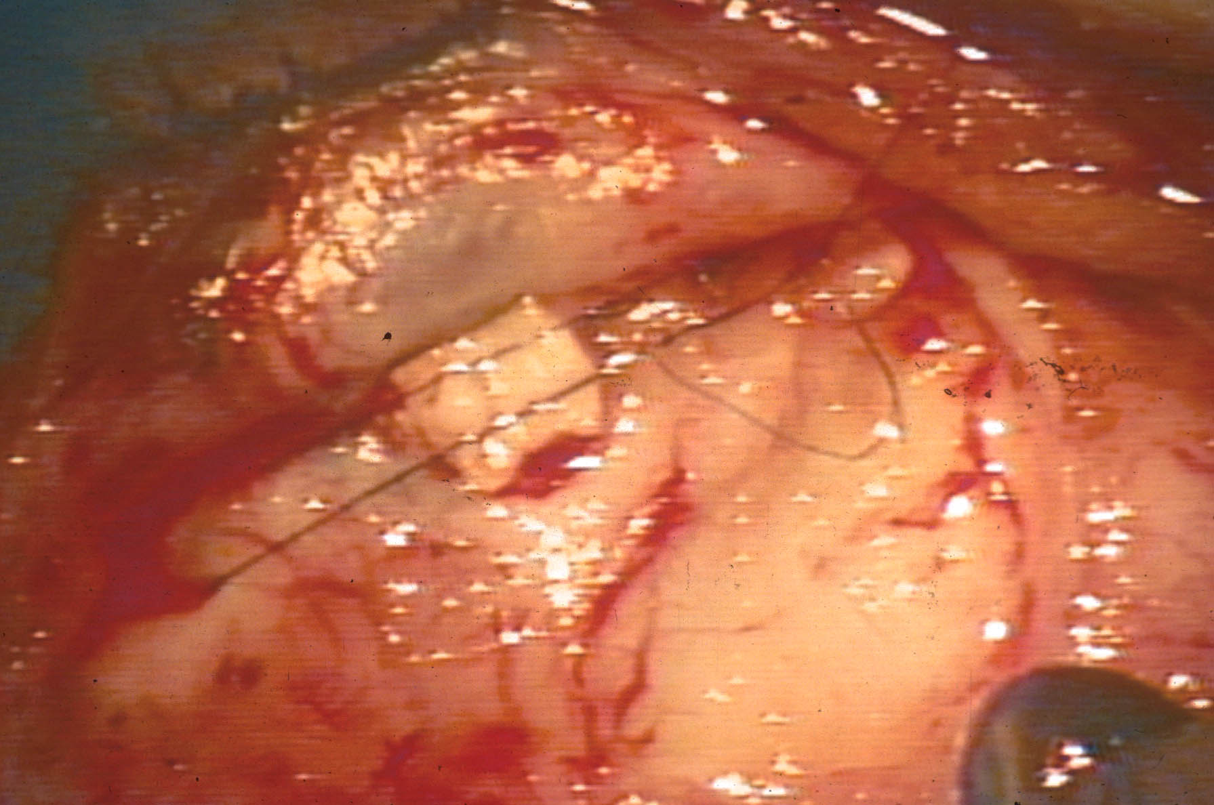

Slide 19
Results of Two Sets of Stitches Technique for Hypotony Maculopathy
Done within 6 months of onset
39 of 40 cases were improved, from a median of 20/100 to a median of 20/25.
The mean IOP was adjusted from 2 to 14 mm Hg.
Two blebs were lost, four patients required medication.
38 of 40 cases had resolution of metamorphopsia.
No patient lost fixation or suffered notable visual field loss progression from the period of elevated IOP.

