Slide 1
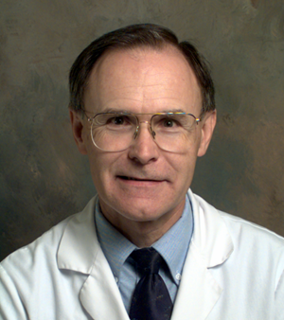


Solving Problems in Glaucoma Surgery!
8. Cyclodialysis Repair
Paul Palmberg, MD, PhD
Consultant and Medical Monitor for InnFocus Micro Shunt FDA Clinical Trial
Consultant (unpaid) and trainer for Aurolab AADI Clinical Trial
Consultant and trainer for AqueSys XEN FDA clinical trial

Slide 2
Cyclodialysis Repair
Small dialysis—often can use Argon laser to adjacent sclera
Medium dialysis—often can use 10-0 prolene mattress suture across the anterior chamber (STC-6 needles) to close
Large cyclodialysis—double scleral flap and direct closure with 10-0 prolene on a curved needle
Recently described use of a capsular tension ring in the sulcus

Slide 3
Cyclodialysis Repair
But here we present an unusual case which illustrated the complexities that can arise in special circumstances
A patient with POAG had a trabeculectomy and then phaco
He developed a rhegmatogenous retinal detachment, complicated by a serous choroidal detachment
It did not resolve, and we drained the choroidal, but it recurred

Slide 4
