Slide 1
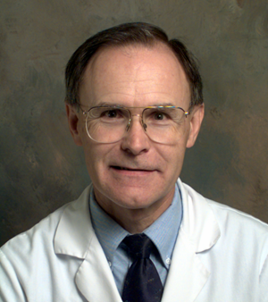


Solving Problems in Glaucoma Surgery!
Part 7 Pearls for Safer Tube Surgery
Paul Palmberg, MD, PhD
Consultant and Medical Monitor for InnFocus Micro Shunt FDA Clinical Trial
Consultant (unpaid) and trainer for Aurolab AADI Clinical Trial
Consultant and trainer for AqueSys XEN FDA clinical trial

Slide 2
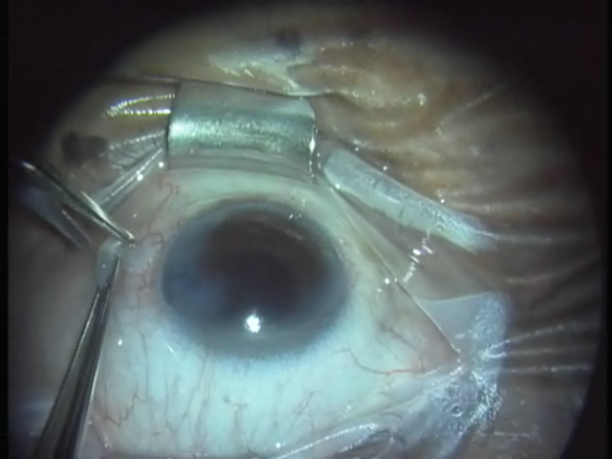
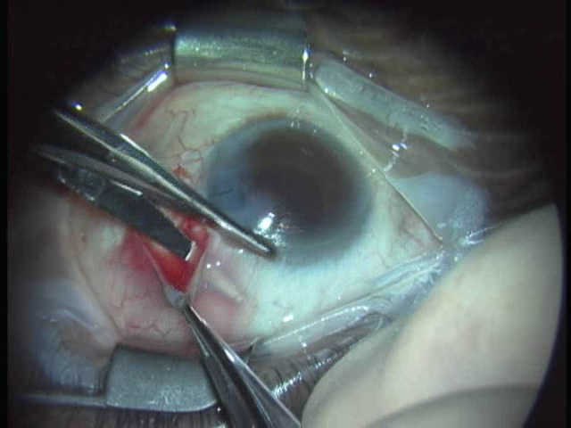
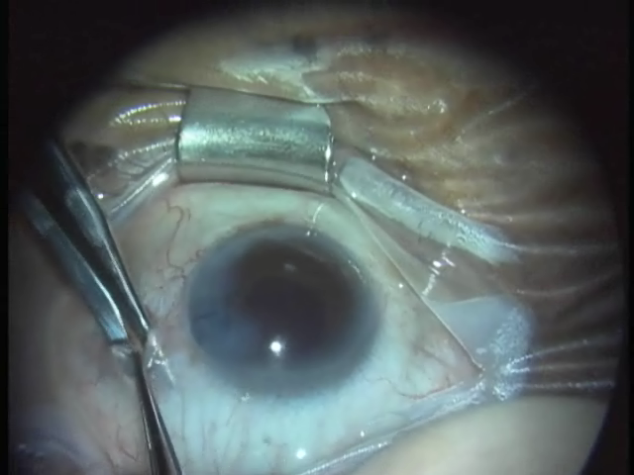
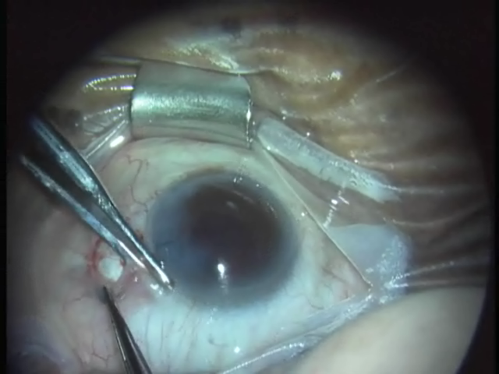
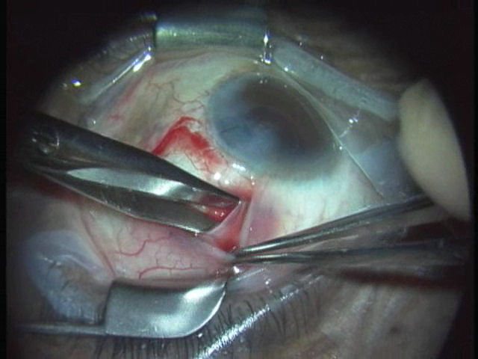
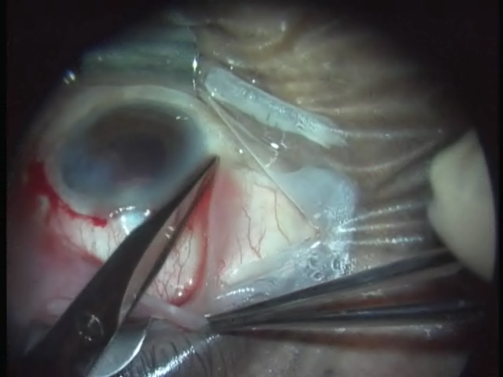
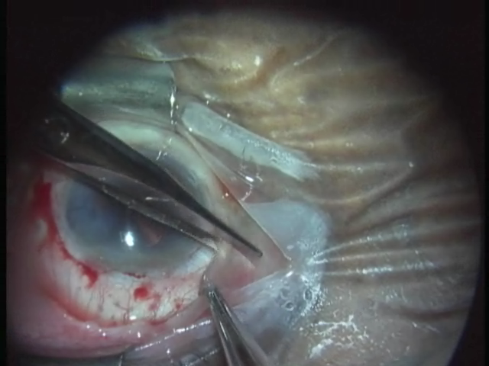
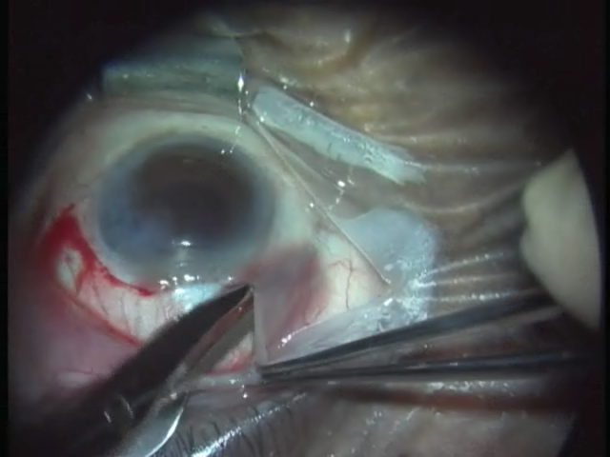
Conjunctival Flap—Avoiding Bleeding
Get Under, not into Tenon’s!
Tenon’ thickest from 10-2 o’clock above, and from 4 to 8 below
Sneak under the Border!

Slide 3
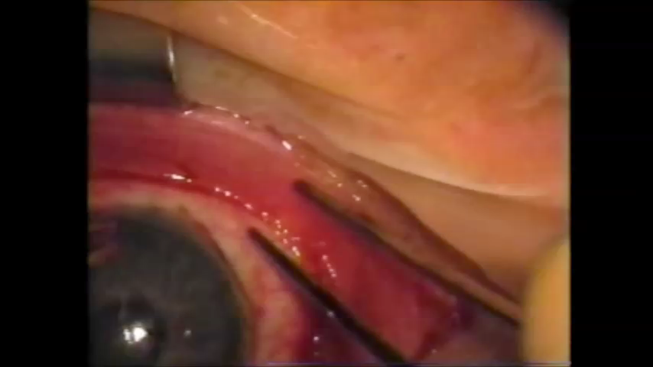
Tube Tricks: How to Avoid Muscle Entrapment with Baerveldts: “Reverse Chopsticks Technique
Notes:
Reverse chopsticks 1.25x MPEG4

Slide 4
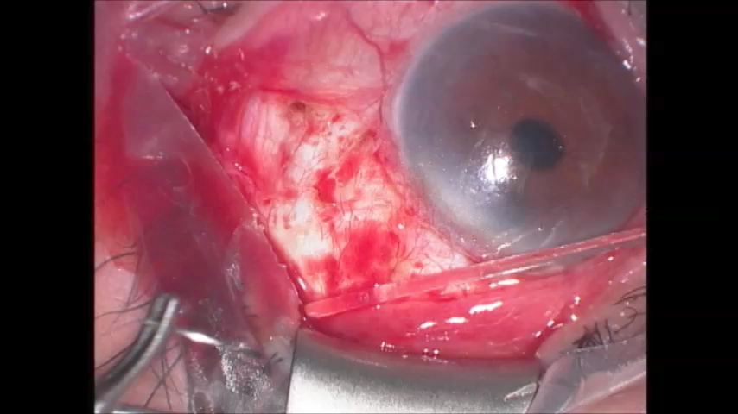
“Bicycle Kick Technique” for Anchoring Glaucoma Implant Plates

Slide 5
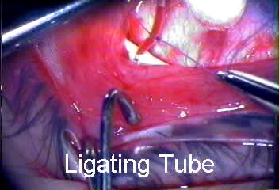

Slide 6
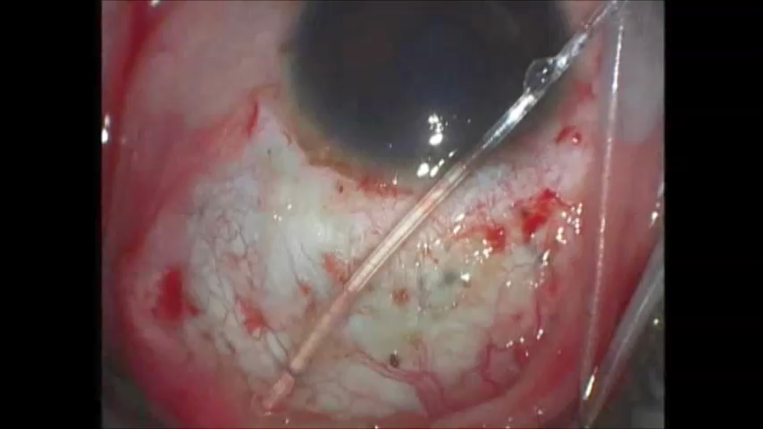
Tube Trim Bevel Up Technique

Slide 7

Groove Technique and Side-Bent Needle for Safer Needle Pass and Tube Insertion in Phakic Eyes
Notes:
Use Groove Needle Technique 1.75x speed

Slide 8
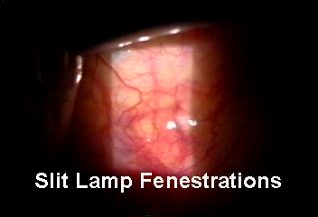

Slide 9
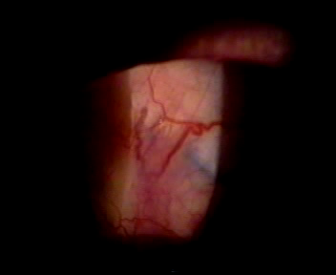

Slide 10
