Slide 1
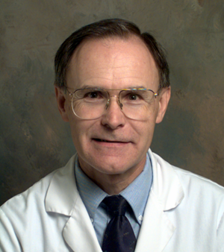


Solving Problems in Glaucoma Surgery!
Part 6 Slit Lamp Procedures With a 30g Needle
Paul Palmberg, MD, PhD
Consultant and Medical Monitor for InnFocus Micro Shunt FDA Clinical Trial
Consultant (unpaid) and trainer for Aurolab AADI Clinical Trial
Consultant and trainer for AqueSys XEN FDA clinical trial

Slide 2



Micro

Slide 3
Angle Closure Attack
How do you get the cornea clear enough to do the laser iridotomy?
Topical agents?
Oral agents?
Press on cornea with muscle hook?
30g needle paracentesis?

Slide 4
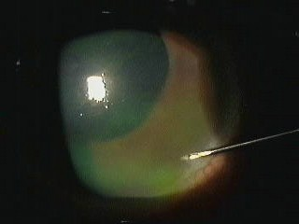
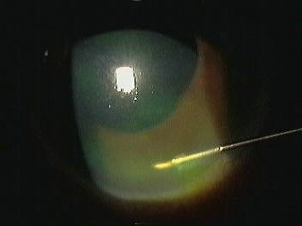
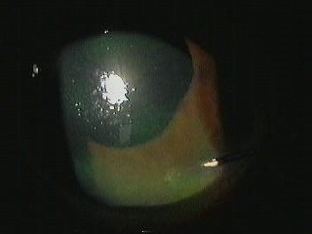
Half inch 30 g needle paracentesis
a) Entry in peripheral cornea, bevel parallel to surface and aimed away from lens
b) Turn to iris parallel and enter
c) In 10 seconds Ta 12 Hg, cornea now clearer

Slide 5
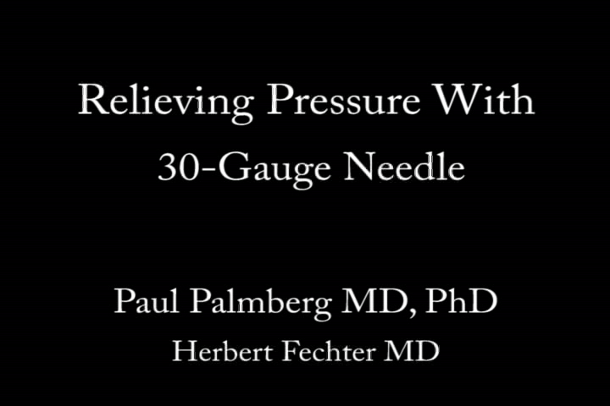

Slide 6
Case: Traumatic Hyphema
A 9 year old African-American boy presented with a microhyphema after a minor blunt injury
Sickle cell prep negative
The IOP was 55 mm Hg after 3 days on timolol/dorzolamide, brimonidine, latanoprost, given in the hospital
A 2+ relative afferent pupil defect developed
The Residents asked me to attend a trab

Slide 7
Case: Traumatic Hyphema
Upon my exam the vision was 20/25, IOP 55, 2+ relative afferent defect confirmed
SLE and gentle Zeiss gonioscopy revealed no visible cells in the AC, normal appearing TM, lens, fundus
What was the mechanism of IOP elevation now?
What was the best management option?

Slide 8
Resolution
The eye was prepped with proparacaine, apraclonidine and 5% povidone iodide and a solid bladed speculum placed.
The IOP fell to 9 mm Hg just after the paracentesis
The IOP stabilized at 12 mm Hg after 30 minutes and remained normal after stopping all IOP meds. WHY?
Presumably, the eye’s Tissue Plasminogen Activator had lysed the fibrin that had been elevating the IOP
But, why then was the IOP still elevated until paracentesis?

Slide 9
Collapse of Schlemm’s Canal
Robert Moses, MD, at Washington University in St. Louis investigated circumferential flow in Schlemm’s canal in fresh normal human eyes in the 1970s.
He cannulated the canal and observed the flow resistance for saline through 90 degrees of canal after filling the AC with silicone oil.
Then he slowly raised the IOP and kept checking
The resistance rose abruptly and reversibly at IOP about 35-40 mm Hg in most eyes.

Slide 10
Invest Ophthalmol Vis Sci. 1981 Jan;20(1):61-8.
Schlemm's canal: the effect of intraocular pressure.
Moses RA, Grodzki WJ Jr, Etheridge EL, Wilson CD.
Abstract
We have shown that in the excised eye when oil in the anterior chamber has made the trabecular mesh impermeable, resistance to circumferential flow along the canal increases moderately as transmural pressure is increased. At the same time, resistance to outflow from the canal through the collector channels increases markedly as transmural pressure is increased from low levels to 35 or 40 mm Hg. We have suggested that the usual primary defect in open-angle glaucoma is reduced facility of the inner canal wall and that collapse of the canal with reduction of filtering area and plugging of collector channels is a secondary effect.

Slide 11

When is This Worth Trying?
In cases in which the initial cause is gone: I have seen three similar cases to this one
30g needle paracentesis is the best way of lowering the IOP in acute angle closure when corneal edema precludes easy LPI
30g needle paracentesis is also useful to lower IOP when meds will not in POAG, as some are then controlled, and others at least are operated upon after a few days at a lower pressure.

Slide 12
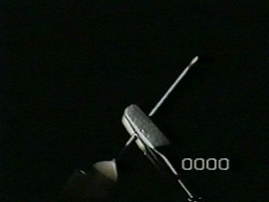
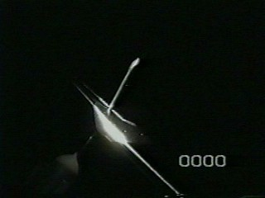
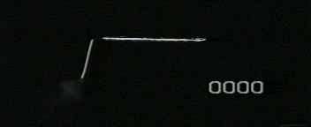
30g Needle Tool
.
Fig a. Bend back 30 degrees at hub of needle
Fig b. Bend forward 60 degrees a few mm from the hub
Figure c. Final bayonet form, on TB syringe

Slide 13
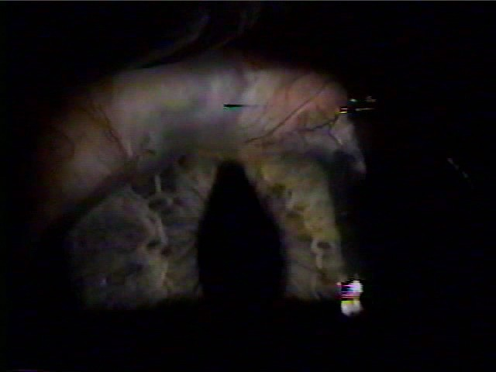
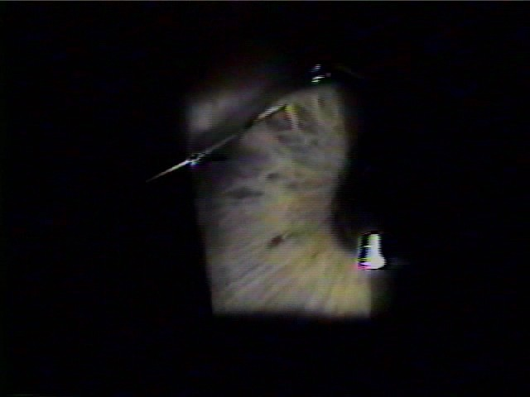
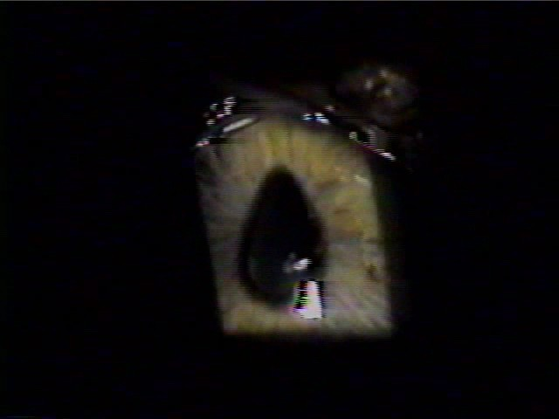
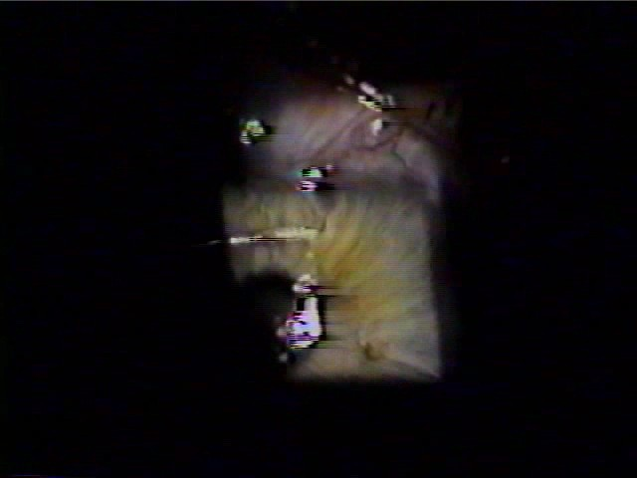
Figure 5. Tugging iris from trabeculectomy ostium
a. Iris updrawn to trabeculectomy ostium
b. 30 g needle engages iris
c. Needle pulling iris free
d. Pupil round, iridectomy visible above

Slide 14

Needling Pupillary Membrane

