Slide 1
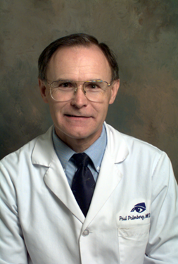
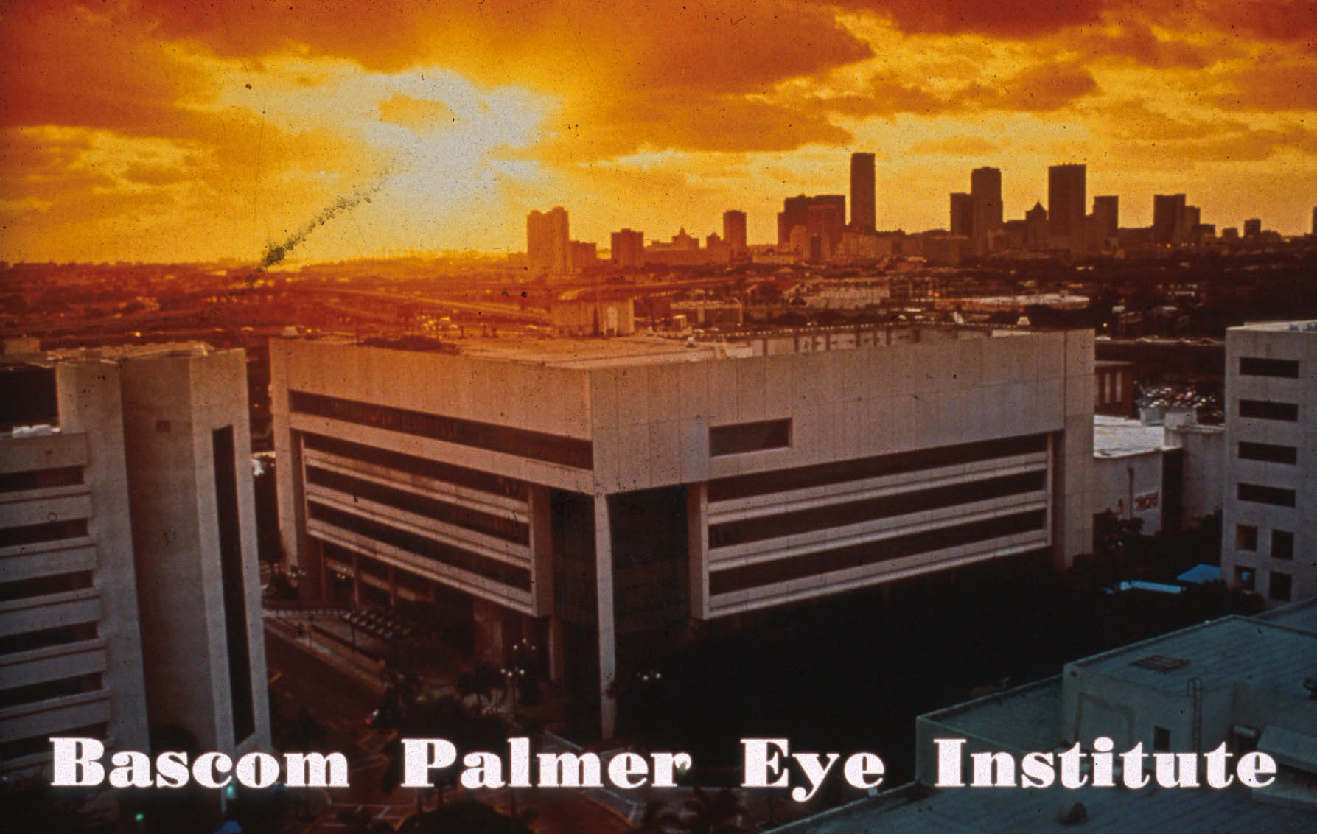

The Coming Paradigm Shift in Glaucoma Management
Paul Palmberg MD PhD
The Edward W D Norton Lecture, Miami, Florida, November 5, 2020

Slide 2
Disclosures
Consultant, trainer for Aurolab (unpaid; lodging)
OHTS 3 Disc reader
Investigator in TVT, PTVT, Abbott Med Optics
Relevant ones—
Consultant, trainer for AqueSys XEN
Allergan
Consultant, Monitor for InnFocus MicroShunt
Santen

Slide 3
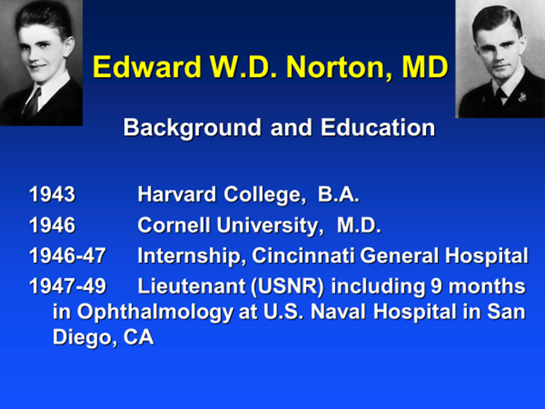
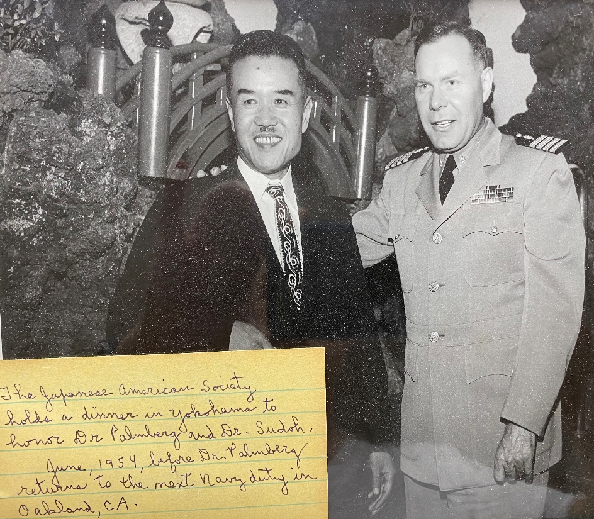
Disclosure: I met Dr. Norton in 1948 Edward Norton and Karl Palmberg US Naval Hospital, San Diego, 1948 in

Slide 4
My Contract from Dr. Norton in 1980
1. The patient comes first
2. Empower the doctors in the community
3. I’m hiring you in glaucoma, but if you later wish to do something else, follow your dreams

Slide 5
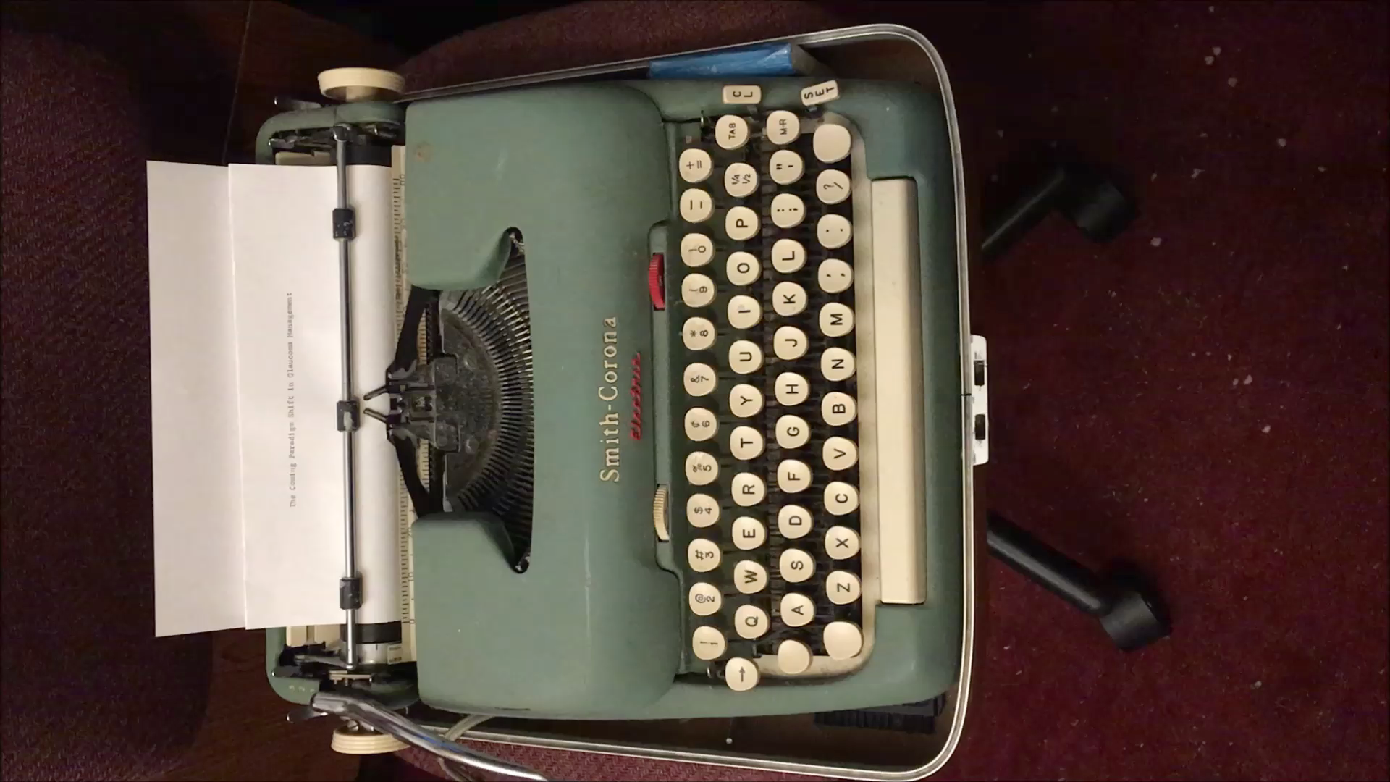

Slide 6
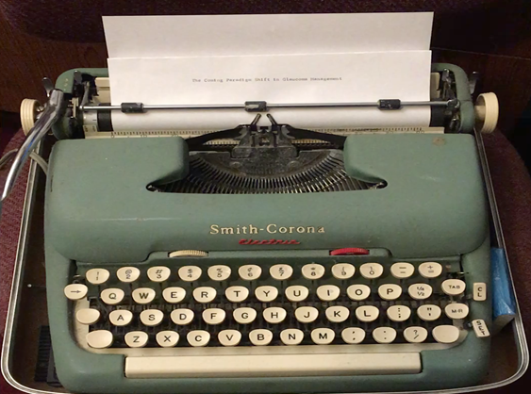

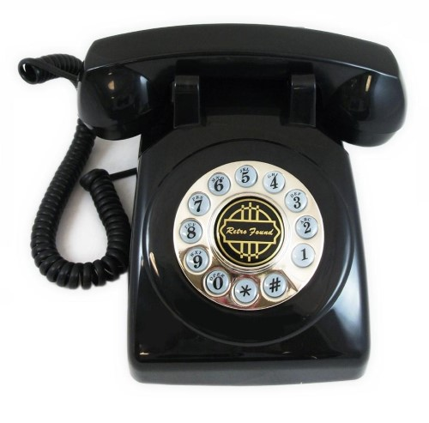
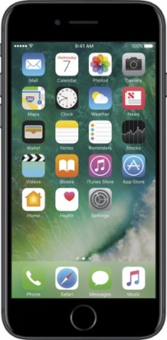
The Coming Paradigm Shift in Glaucoma Management

Slide 7
How Do Paradigm Shifts Come About?
New Understanding of a Problem
Causes of Infection: Bacterial, viral basis
Pharmacological mechanisms (BP, blood glucose, IOP,
retinal edema in diabetes and wet ARMD))
Genetic basis for disease
Disruptive Technology
Antibiotics and vaccines
New drug classes (including genetic replacement)
Computers (business and personal)
Internet communication (email, other social media)
Digital imaging (SD-OCT of RNFL, macula)

Slide 8
Best Treatment for Eye Diseases Based Upon Disease Impact and Risk/Benefit/Cost of Available Treatments
Cataract: Phaco safety moved surgery earlier
Wet AMD: Anti-VEGF agents replaced laser
Diabetic Retinopathy: Anti-VEGF, laser, steroid
Glaucoma: Meds, laser; surgery (for 40 years) due to:
uncertainty about progression
risks of trabeculectomy and tubes
BUT THIS IS ABOUT TO CHANGE:

Slide 9
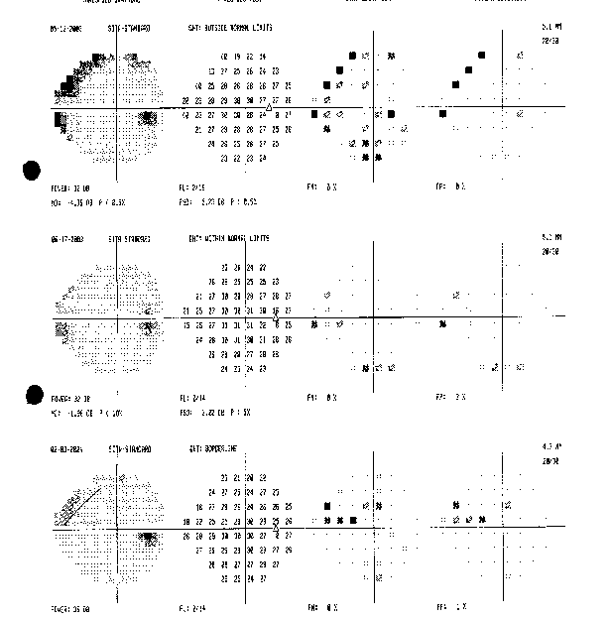
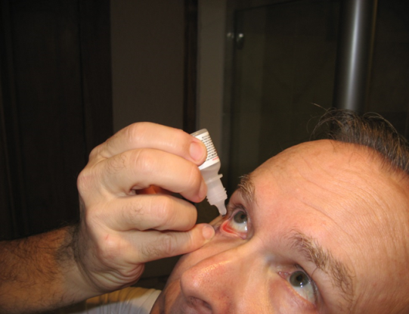
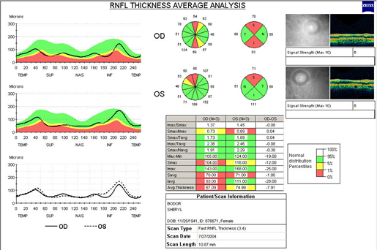
What is the Risk that Your Patient will Progress at the Current IOP?
Tmax OD 26
AAO At least a 20% reduction—Is that optimal?
If now 26….?
If now 20....?
If now 17….?
If now 14….?
If now 11….?

Slide 10
The Coming Paradigm Shift in Glaucoma Management
New Evidence About Optimal Treatment
In Advanced Damage
In Early Damage
New MIGS Surgical Options with Lesser Risk:
Angle surgery
Suprachoroidal space implants
Safer Substitutes for trabeculectomy:
XEN
PreserFlo MicroShunt (less hypotony, lens change)
Detecting Apoptosing Retinal Cells

Slide 11
Sunday Afternoons in St. Louis
What’s a Fellow to do?
How in one year does one get a long-term perspective on a chronic disease?
Learn from the past!
Sunday afternoon chart reviews of long follow up cases
At low normal IOPs advanced damage cases stable for a decade !
At high teen IOPs most progressed substantially.
This went against the prevailing view:
high teens was the goal; after all, those are “normal” pressures
one could only slow the damage in glaucoma.

Slide 12
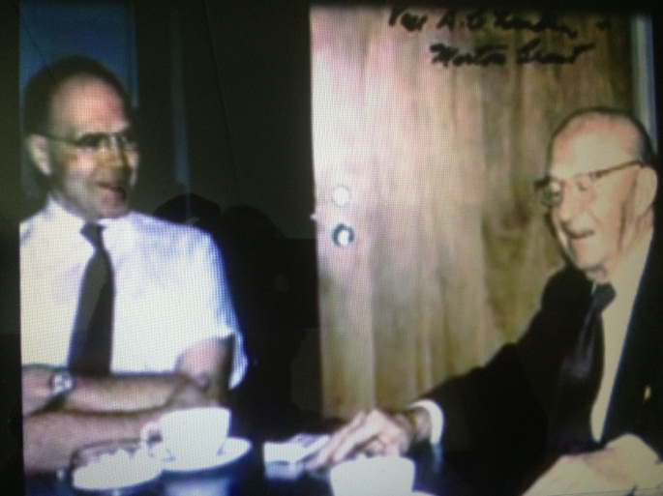

A New Perspective on “Target Pressures”
to
Morton Grant, MD Paul Chandler, MD
Paul Palmberg, MD, PhD

Slide 13
Origen of the Target Pressure Concept
Paul Chandler had beat me to it.
1959 AAO, 1960 AJO
See also Chandler, Survey Ophthalmology 1977; 21:412-428

Slide 14
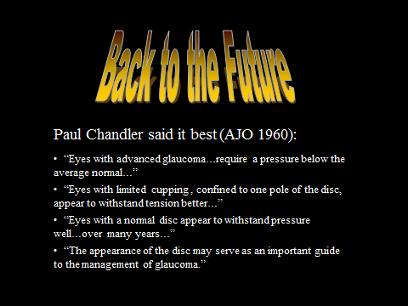

Slide 15
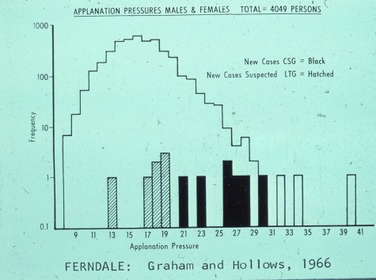
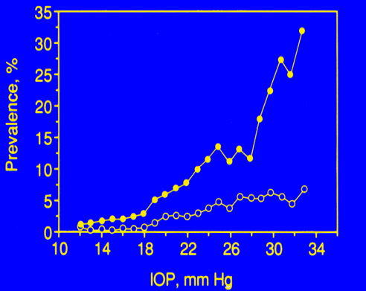
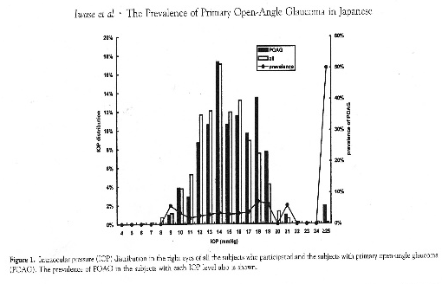
Two Very Different Questions:
How much of glaucoma damage
is associated with an excess pressure distribution?
NOT MUCH! 1/3 in England, US, 1/10 in Japan!
2. How much of glaucoma damage
is pressure-dependent and avoidable?

Slide 16
Two Very Different Questions:
How much of glaucoma damage
is associated with an excess pressure distribution?
NOT MUCH! 1/3 in England, US, 1/10 in Japan!
2. How much of glaucoma damage
is pressure-dependent and avoidable?
NEARLY ALL! How can that be?

Slide 17
The Pressure-Dependence of Glaucoma Damage
IOP values near episcleral venous pressure might compensate for whatever else is wrong in glaucoma, by improving blood flow to, or reducing stress on, the optic nerve.
This is not at all like blood sugar in diabetes or hypertension where upper normal would be a reasonable goal!
The advent of antimetabolite filtering surgery allowed us to prove the benefit of low normal IOPs.

Slide 18
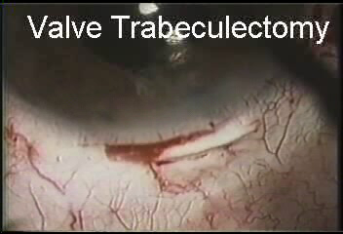
Technique: Suner, et al, Ophthalmology 1997:104:207-214

Slide 19
Primary Filtering Surgery with 5-FU or Mitomycin: Intraocular Pressure Control and Visual Field Data
mm Hg # (IOP) MD PSD # fields
Pre-OP 26.1 212 -14.3 7.58 181
1 Year 10.7 183 -13.6 7.59 117
2 Years 10.8 161 -12.4 7.67 96
3 Years 10.8 143 -13.3 8.18 92
4 Years 10.5 125 -13.6 8.05 71
5 Years 11.8 123 -11.9 7.68 65
6 Years 10.6 99 -13.0 8.70 47
7 Years 11.0 81 -12.6 9.34 42
8 Years 11.0 63 -12.7 8.79 22
9 Years 10.4 46 -10.7 7.42 19
10 Years 11.0 30 -12.1 8.71 13
Ishida K, E Escalona, J Schiffman, Palmberg P, ARVO 2003
Technique: Suner, et al, Ophthalmology 1997:104:207-214.

Slide 20
Primary Filtering Surgery with 5-FU or Mitomycin: Intraocular Pressure Control and Visual Field Data
mm Hg # (IOP) MD PSD # fields
Pre-OP 26.1 212 -14.3 7.58 181
1 Year 10.7 183 -13.6 7.59 117
2 Years 10.8 161 -12.4 7.67 96
3 Years 10.8 143 -13.3 8.18 92
4 Years 10.5 125 -13.6 8.05 71
5 Years 11.8 123 -11.9 7.68 65
6 Years 10.6 99 -13.0 8.70 47
7 Years 11.0 81 -12.6 9.34 42
8 Years 11.0 63 -12.7 8.79 22
9 Years 10.4 46 -10.7 7.42 19
10 Years 11.0 30 -12.1 8.71 13
Ishida K, E Escalona, J Schiffman, Palmberg P, ARVO 2003
Technique: Suner, et al, Ophthalmology 1997:104:207-214.

Slide 21
Mean Deviation
Change in MD
MD(dB)±SEM
Change MD(dB) ±SEM
-6
6
-8
4
-10
2
-12
0
-14
-2
-16
-18
-4
deterioration < 0
-20
-6
Pre-op 1 2 3 4 5 6 7 8 9 10 11 12 13 14
Pre-op 1 2 3 4 5 6 7 8 9 10 11 12 13 14
Time Post Surgery (years)
Time Post Surgery (years)
N= 175 114 94 93 70 75 51 52 33 34 19 14 12 10 4
N= 108 85 85 65 67 48 45 31 28 15 13 9 7 4
No net progression in 10 years

Slide 22
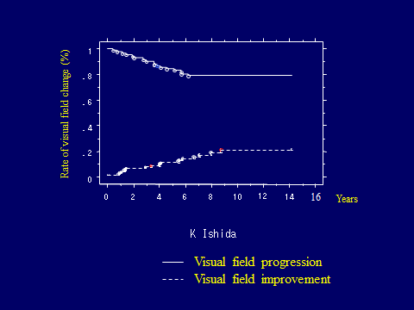
Yet some subjects did “progress” or “improve” 3 dB of MD two consecutive visits
I thought it was due to noise.
I was wrong!

Slide 23
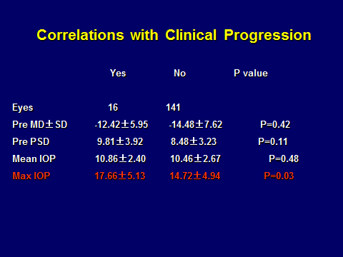
What matters most depends on the study design:
In surgical studies: the peak will be most important;
But in observational or medical treatment—the mean

Slide 24
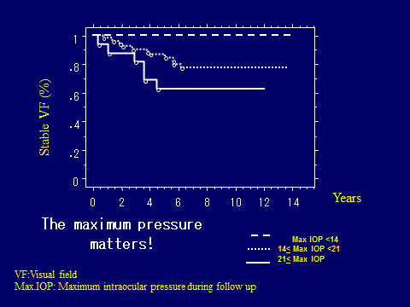
0%
21%
38%
0/15
11/52
6/16

Slide 25
CSI-Miami: VF Improvement of 2 dB!
With Peak IOP < 13 mm Hg
8
6
4
2
0
1
-2
2
-4
3
-6
-8
-10
-12
-14
⊿1MD
⊿2MD
⊿3MD
⊿4MD
⊿5MD
⊿6MD
⊿7MD
⊿8MD
⊿9MD
⊿10MD
⊿11MD
⊿12MD
⊿13MD
⊿14MD
１： max IOP <14
２：14< max IOP <21
３：21< max IOP

Slide 26
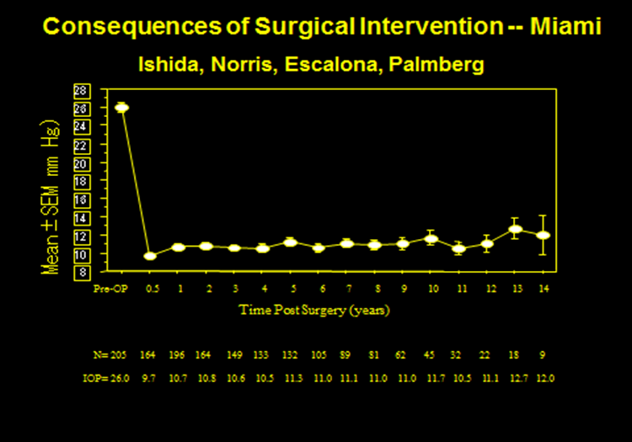
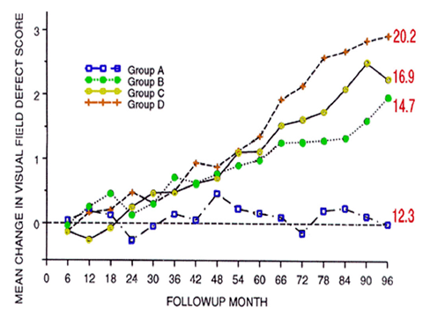
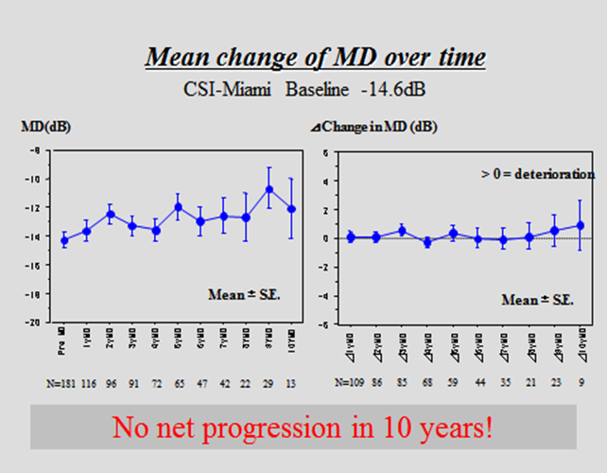
Validation of the Result from Clinical Trials
AGIS and CSI-Miami -10dB, get to low teens

Slide 27

Advanced Glaucoma Intervention Study
Average MD was -10.5 dB
All < 18 mm Hg
75%-99% < 18
50%-74% < 18
< 50% < 18
The AGIS Investigators. Am J Ophthalmol. 2000;130:429-440.

Slide 28
Advanced Glaucoma Intervention Study
70%?
100%<18
75%-99% < 18
50%-74% < 18
< 50% < 18
Not everyone with advanced damage needs an IOP < 15 mm Hg, but one’s odds improve!
30%?
13%
Risk of 5 dB progression/8yrs
The AGIS Investigators. Am J Ophthalmol. 2000;130:429-440.

Slide 29
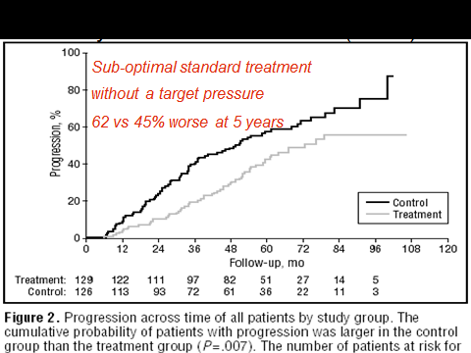
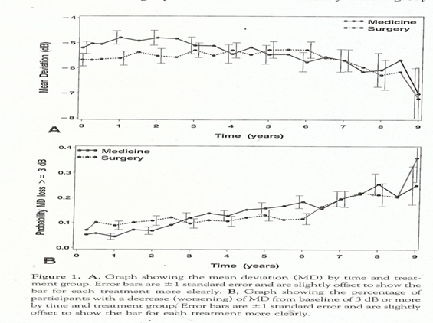
EMGT vs CIGTS Newly Diagnosed, -5dB MD
No Target Pressure in EMGT: Aggressive Target Pressure in CIGTS
Disappointing treatment effect No net progression with 30%+ lower IOP
No net progression!
20%
How could there be subjects getting worse in CIGTS without the mean changing?

Slide 30
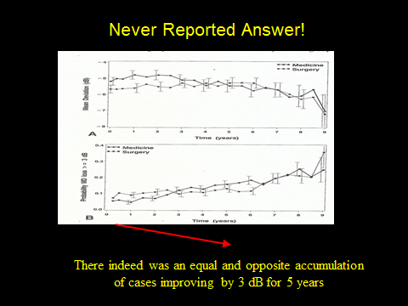

Slide 31
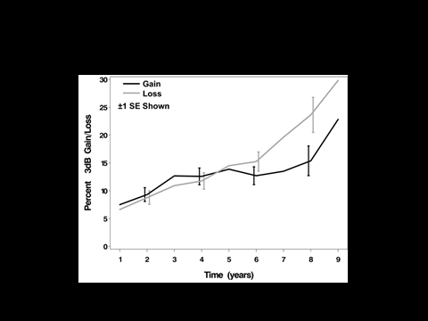

Slide 32
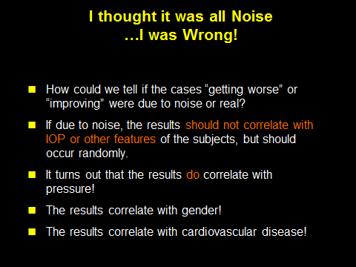

Slide 33
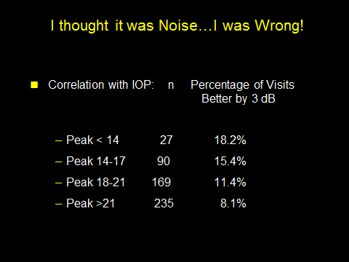
In the first 5 years there were 10 visits to compare to 2 baseline HVFs
Is there a way to estimate how much of this is signal
and how much is “noise” (random variation)?

Slide 34
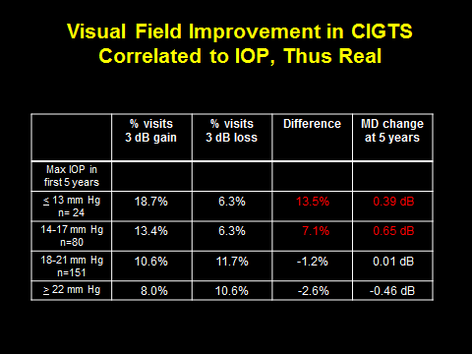
The difference, better – worse, should be real
12.4%
n=222
Musch, Gillespie, Palmberg, Spaeth, Niziol, Lichter, AJO, 2014;158:96-104

Slide 35
Interpretation
What does this new analysis mean regarding how much of apparent change is real?
IF you were in the peak < 13 mm Hg group, the “improvement” was real at least (18.7-6.3)/18.7 = 66% of the time
But overall only a 20% of apparent improvement cases were “necessarily” real and up to 80% MAY have been due to noise (variability and repeated testing)!
That implies also that the majority of cases of apparent worsening may also have been due to noise!
A lesson from this may be that seeing one field that is worse by only 3dB MD will often overcall deterioration—you would like to have some other confirmation (focal loss, structural change or SOME WAY TO MEASURE THE PRESENCE OF DYING AND STRESSED CELLS…).

Slide 36
How I Would Like to See Target Pressure Concept Applied
Use the Data from Clinical Trials to inform goal/choices
Modify by actual experience with the patient
Weigh the risk/benefit of current IOP vs intervention, and the risk of progression vs various IOPs
Consider life expectancy, visual needs, preferences.

Slide 37
Target Pressure Goes Quantitative!
Now it is Risk/Benefit
If we consider a large group of patients at diagnosis with POAG and early Visual Field Loss (as in CIGTS, average -5 dB MD), a peak IOP of < 13 mm Hg results in stable fields for 7 years, and even a 10% VF recovery.

Slide 38
Target Pressure Goes Quantitative!
Now it is Risk/Benefit
If we consider a large group of patients at diagnosis with POAG and early Visual Field Loss (as in CIGTS, average -5 dB MD), a peak IOP of < 13 mm Hg results in stable fields for 7 years, and even a 10% VF recovery.
In patients with advanced VF loss (as in CSI-Miami) coming to surgery, a peak IOP of < 13 mm Hg resulted in stable fields for 8+ years, and even a recovery of 14% (2dB)

Slide 39
Target Pressure Goes Quantitative!
Now it is Risk/Benefit
If we consider a large group of patients at diagnosis with POAG and early Visual Field Loss (as in CIGTS, average -5 dB MD), a peak IOP of < 13 mm Hg results in stable fields for 7 years, and even a 10% VF recovery.
In patients with advanced VF loss (as in CSI-Miami) coming to surgery, a peak IOP of < 13 mm Hg resulted in stable fields for 8+ years, and even a recovery of 14% (2dB)
However, one likely would be treating everyone aggressively to benefit a minority, with offsetting risks from surgery for all.
This might be more acceptable if the treatment were very safe and long-lasting, and not too expensive.
I will be discussing the XEN and MicroShunt substitutes for trabeculectomy later today and key observations from the clinical trials in which I was involved that guide HOW to do them.

Slide 40
Target Pressure Goes Quantitative!
Now it is Risk/Benefit
If we consider a large group of patients at diagnosis with POAG and early Visual Field Loss (as in CIGTS, average -5 dB MD), a peak IOP of < 13 mm Hg results in stable fields for 7 years, and even a 10% VF recovery.
In patients with advanced VF loss (as in CSI-Miami) coming to surgery, a peak IOP of < 13 mm Hg resulted in stable fields for 8+ years, and even a recovery of 14% (2dB)
However, one likely would be treating everyone aggressively to benefit a minority, with offsetting risks from surgery for all.
This might be more acceptable if the treatment were very safe and long-lasting, and not too expensive.
BUT IT WOULD BE FAR BETTER IF WE COULD SELECTIVELY TREAT JUST THE AMOUNT NEEDED FOR THE INDIVIDUAL

Slide 41
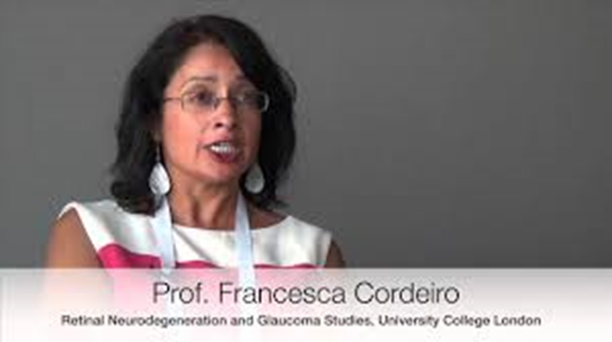
It is 2025, and the FDA and EMA Have Approved D.A.R.C.
Maria Francesca Cordeiro, MD, PhD
Detecting Apoptosing Retinal Cells in Vivo with a Safe Test

Slide 42
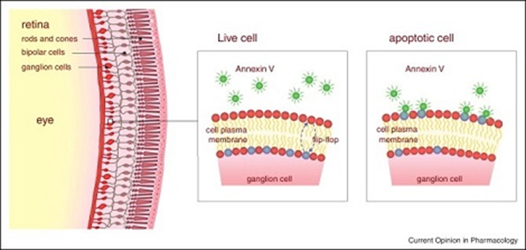
Maria Francesca Cordeiro, MD, PhD. and DARC
Detecting Apoptosing (Dying) Retinal Cells in Vivo
with a Safe Test

Slide 43
Is There a Way to Know Who Would Benefit Most? Detecting Apoptosing Retinal Cells (DARC)
Real-time imaging of single neuronal cell apoptosis in patients with glaucoma
Cordeiro MF, et al
Brain, Volume 140, Issue 6
1 June 2017, Pages 1757–1767,
This real time detection of dying RGCs correlated with glaucoma,
glaucoma progression, with CCT, and with age!

Slide 44
DARC Now Automated! Algorithm used with current OCT Instruments using OCTA filters counts the stressed or dying cells
A CNN-aided method to predict glaucoma progression using DARC (Detection of Apoptosing Retinal Cells)
Normando EM…Cordeiro MF
Expert Review of Molecular Diagnostics
Volume 2020;20:737-748
Published May 2020

Slide 45
Prediction of OCT Progression

Slide 46
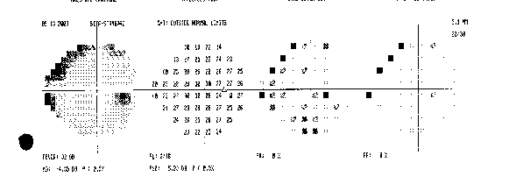
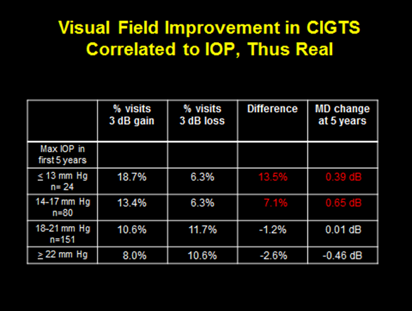
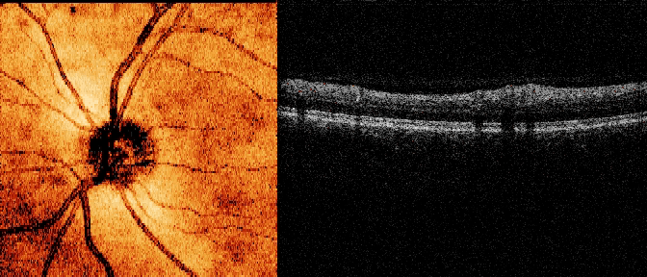
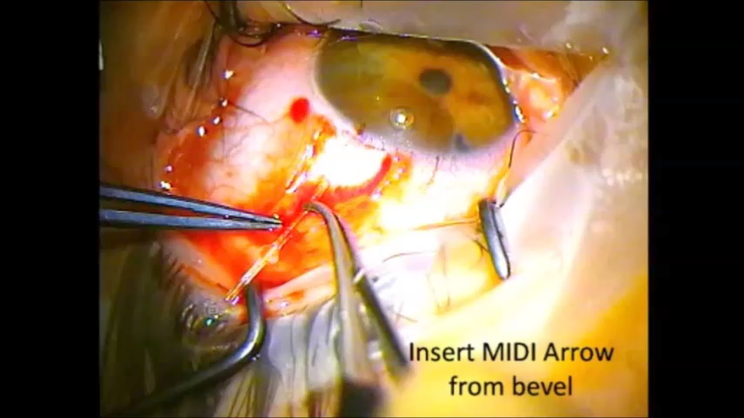

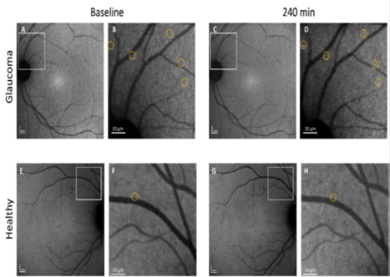
What Will Glaucoma Care be Like In the Future? Could be Individualized by Knowing the Rate of Cell Loss
1)Cell loss rate tested at diagnosis to decide IOP goal 2) Retested after meds/laser done…then loss rate that of aging?
Stage by Function
Stage by Structure
Treatt
OR? Cure with Gene Therapy?
Stage by Rate of Cell Loss

Slide 47
Thank You Miami Community!
Thanks to our Glaucoma Faculty Members:
Doug, Elizabeth, Rich, Steve, Alana, David, Don, Francisco, Richard, Anna, Peter, Elena, Eric, Arindel, Sarah, Luis, Adam, Swarup, Krishna
Thanks to the other 80 Faculty, 107 Fellows and
260 Residents over these 40 years
Thanks to the Community Ophthalmologists:
Maria Guerra, Leonor Murias, Rafael Hernandez,
Jorge Perez, Henry Trattler, Lou Dan, David Howitt, Harold Stanley, Marc Goldberg, Gene Eisner,
Manny Newmark and many others who teamed with me
And of course, to Dr. Edward W D Norton, “The Chief”

