Slide 1
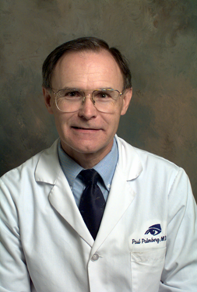
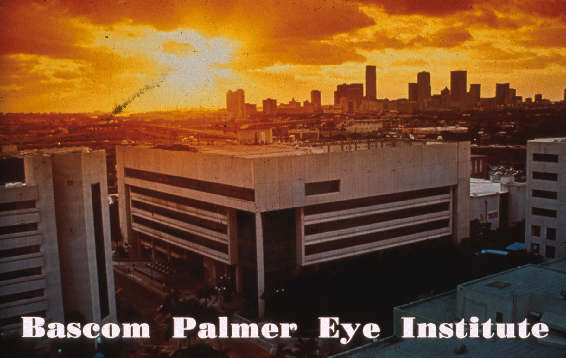
Paul Palmberg MD PhD

Slide 2
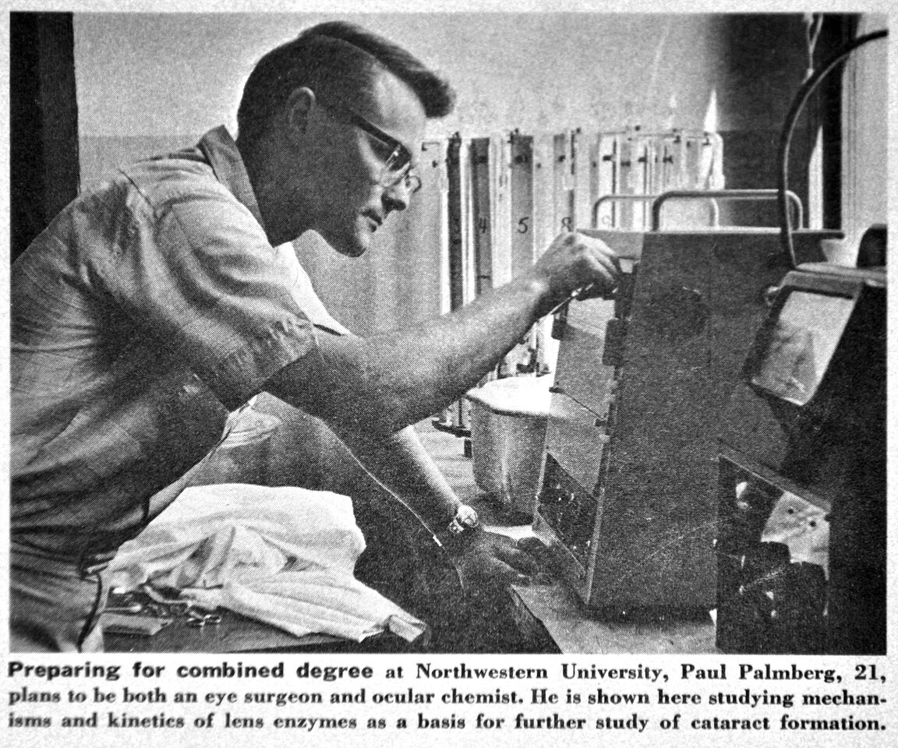
American Medical News
Story on the new Medical Scientist Training Program at
Northwestern University
1965-1970
Mentor and Role Model:
E. Albert Zeller, MD, PhD
(worked with
Nobel Laurates
Tadeus Reichstein
James Sumner)

Slide 3
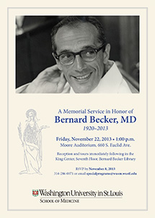
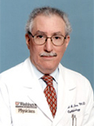
Mentors:
Washington University in St. Louis: Residency and Clinical and Research Fellowships in Glaucoma and Chief Residency 1971-7
Bernard Becker, MD
Michael Kass, MD

Slide 4
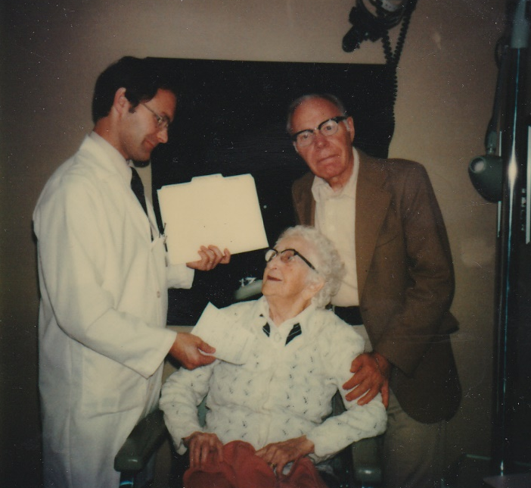
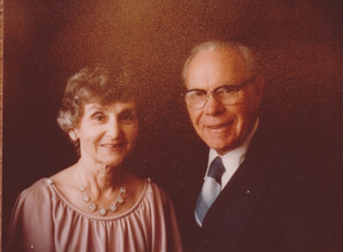
Paul examines 100 year old Grandmother as Karl looks on. At Washington University in St. Louis in 1988
Laura Palmberg, MS Karl Palmberg, MD
School Psychologist Ophthalmologist

Slide 5
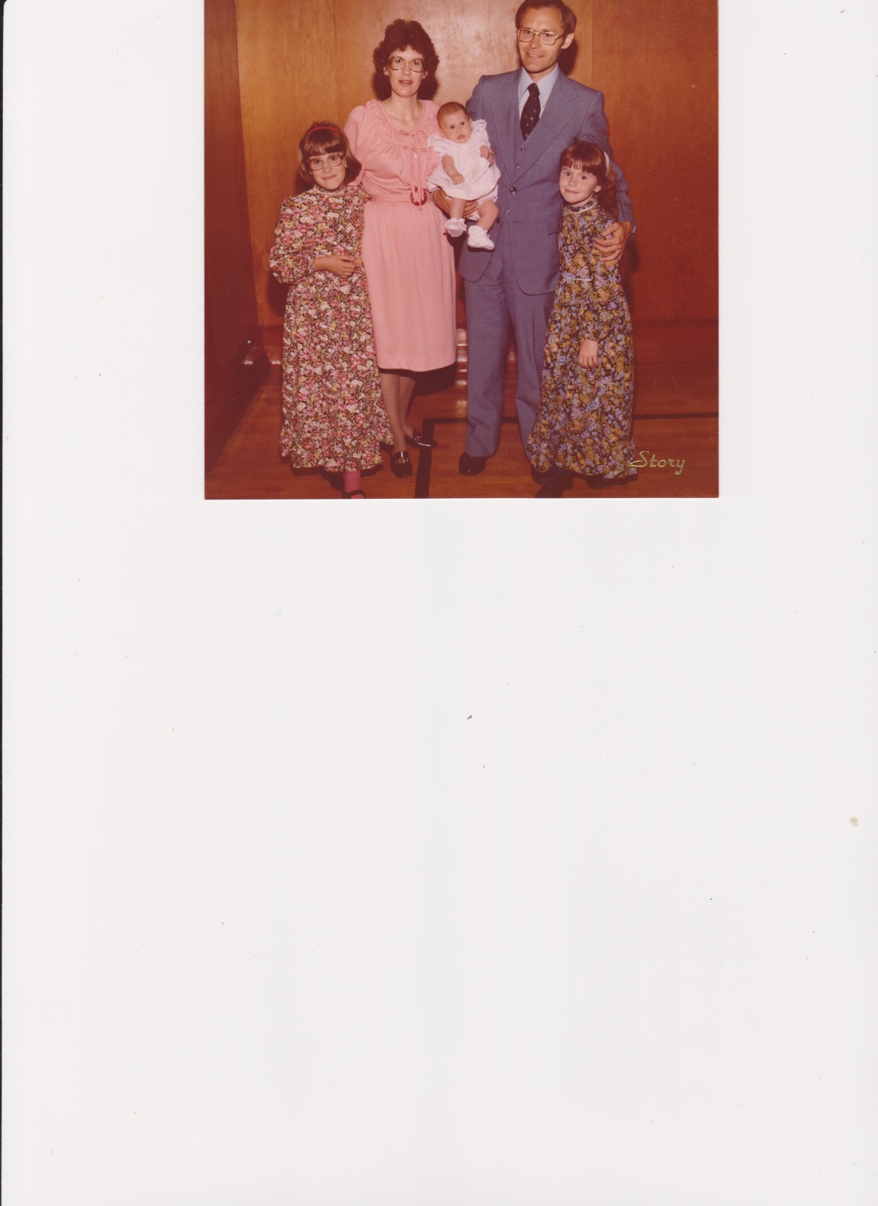
Laura, Carol, Rebecca, Paul and Elizabeth Palmberg
Moving from St. Louis to Miami 1980

Slide 6
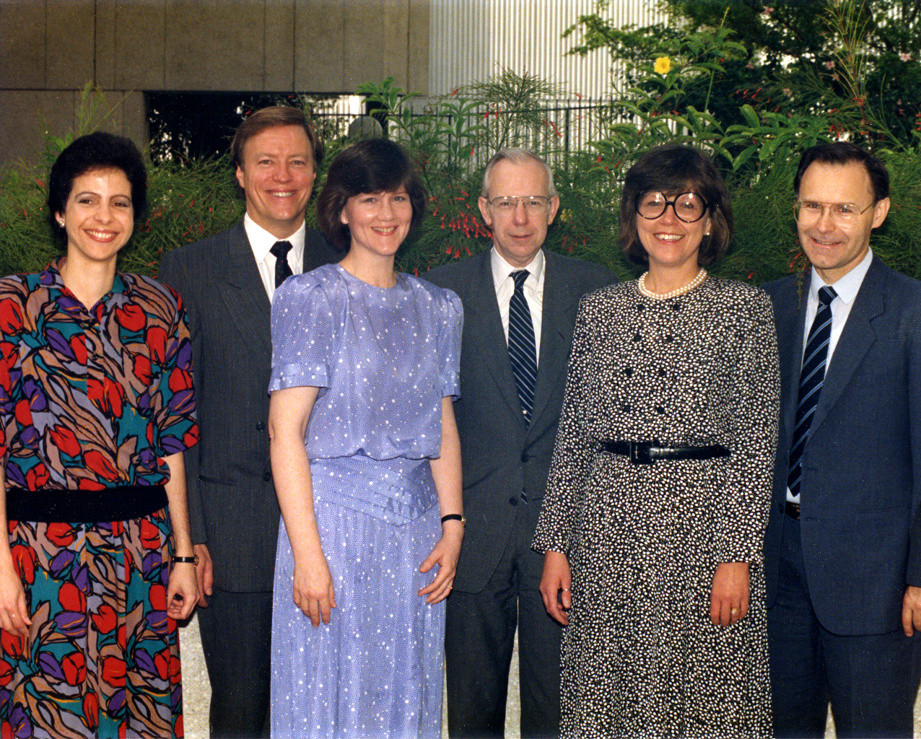
Bascom Palmer Glaucoma Faculty and Fellows
Martha Araujo Deborah Darnley Elizabeth Hodapp
Rich Parrish Douglas Anderson Paul Palmberg

Slide 7
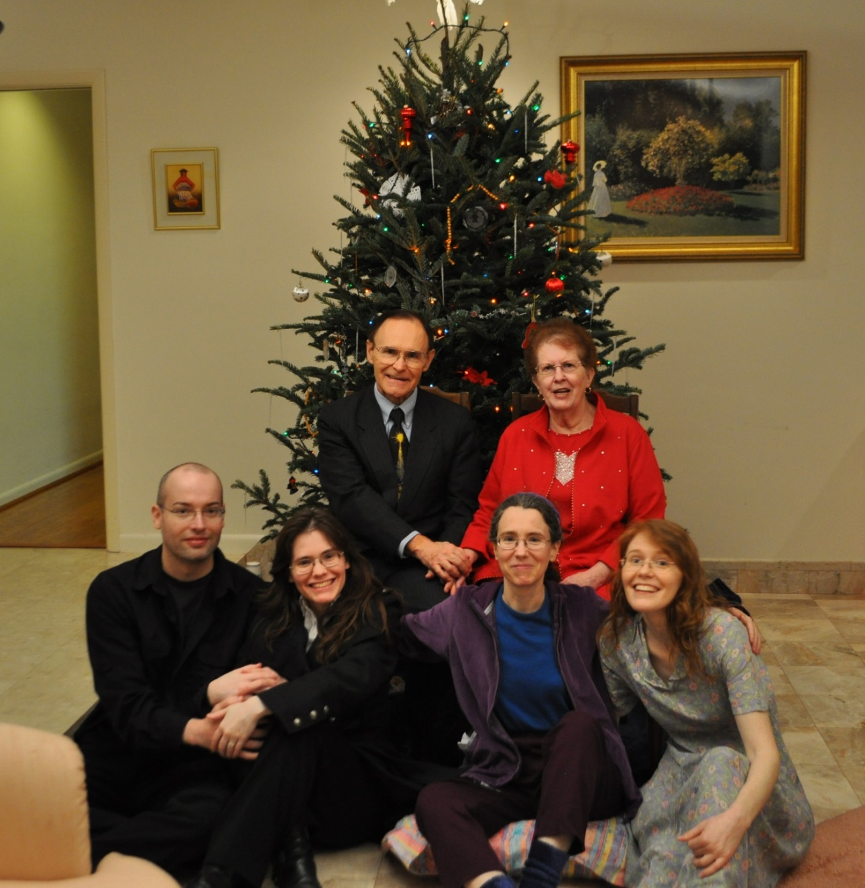
Christmas in Miami 2012

Slide 8
”Cherish each moment, even the ones that suck”
Elizabeth Palmberg (1970-2014)

Slide 9
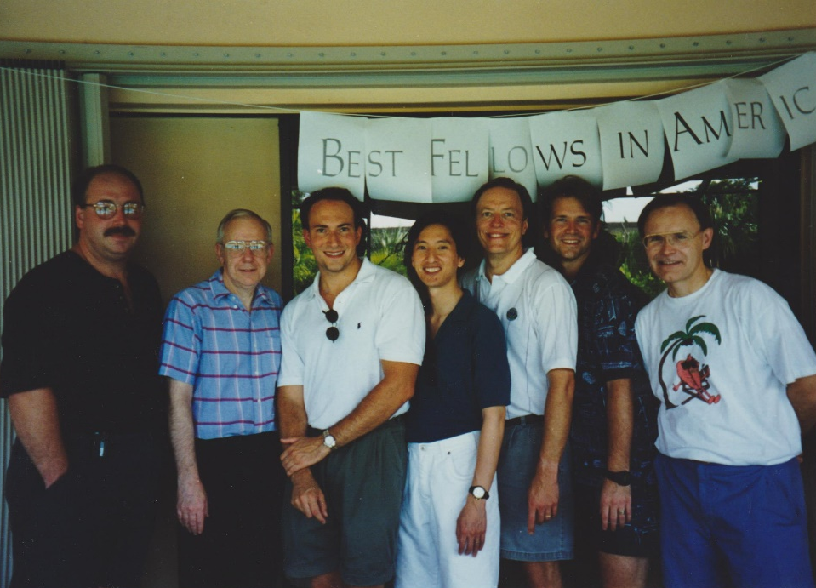
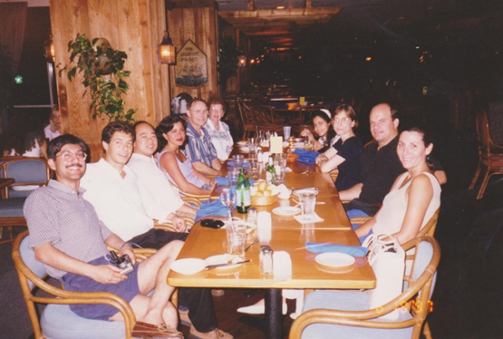
James Douglas David Darryll Rich Don Paul Nauman Jorge Quang Paul, Carol, Anna Eleonore
Robinson Anderson Greenfield WuDunn Parrish Budenz Palmberg Imami Lynch Nguyen Galanopalous Savatovsky
Some of the 107 Clinical Fellows and 107 Foreign Observer Fellows at BPEI

Slide 10
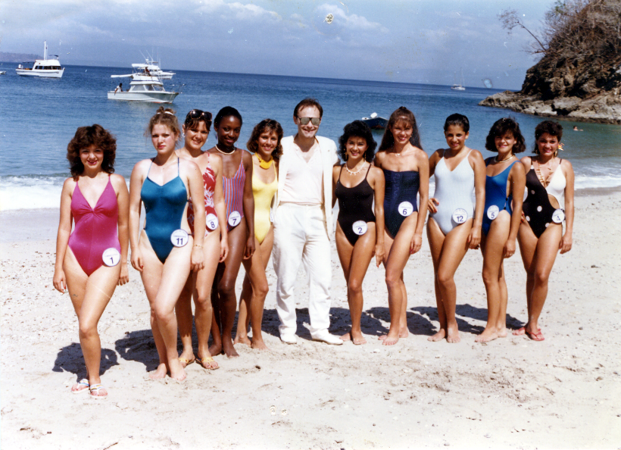
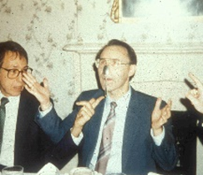
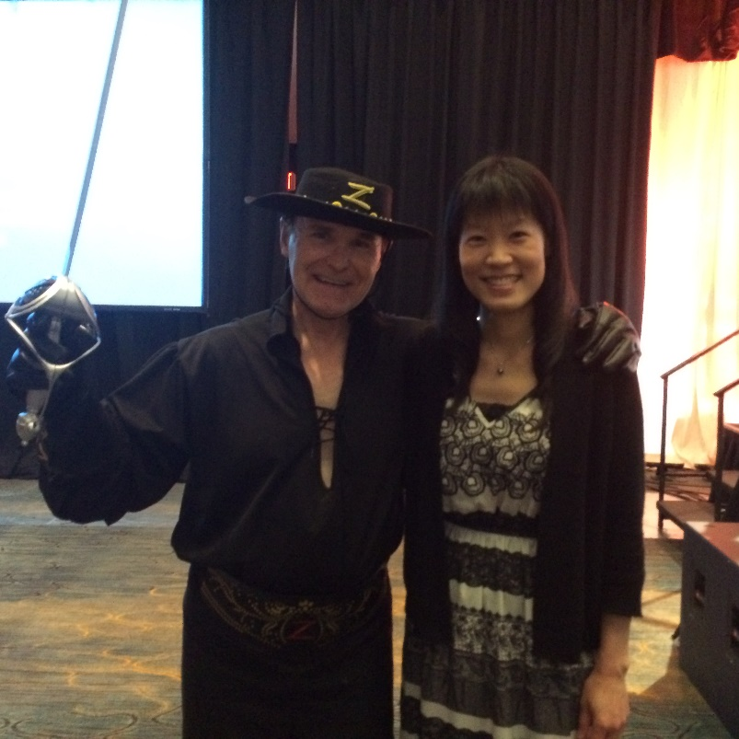
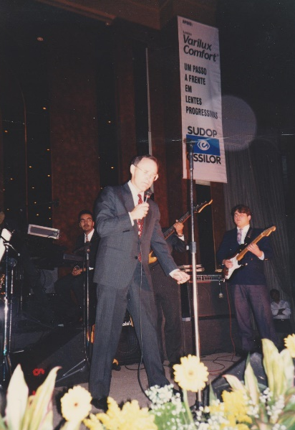
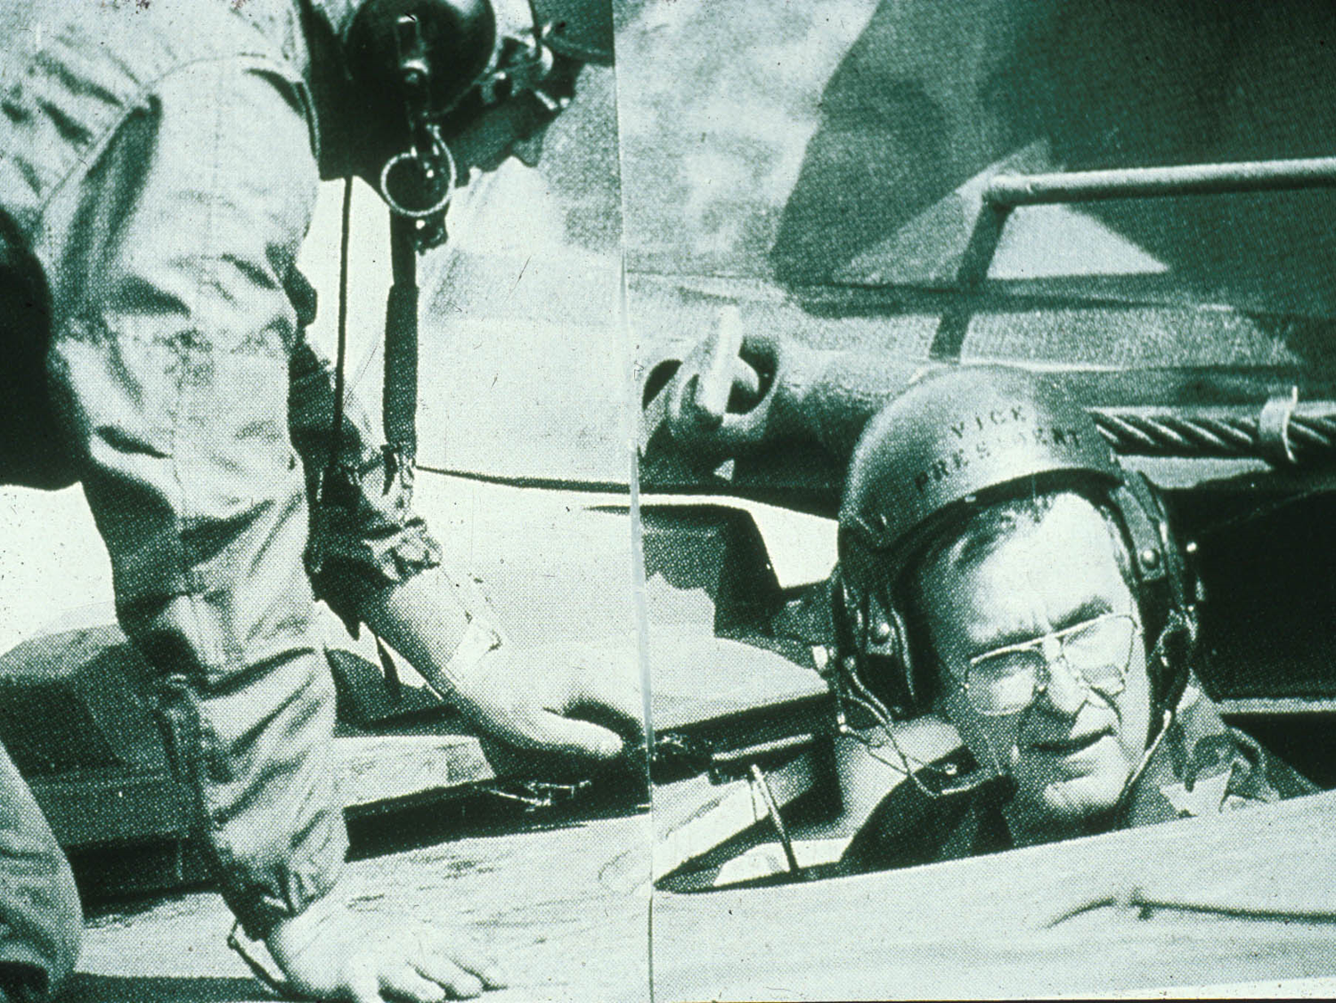
New Orleans Academy of Ophthalmology
Don Johnson in Costa Rica
Micro Zorro at AGS 2016
George H W Bush
Elvis, New Orleans House of Blues

Slide 11
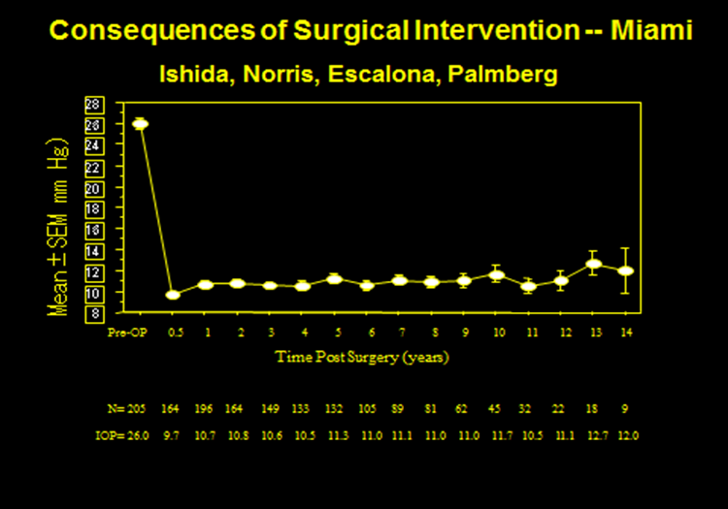
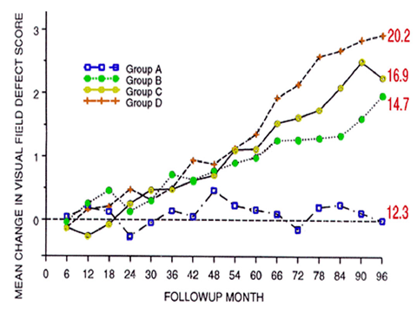
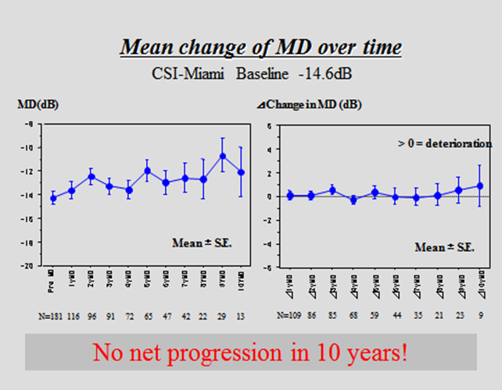
Validation of the Target Pressure Concept from Clinical Trials
AGIS 7: Am J Ophthalmol 2000;130(4):429-4

Slide 12
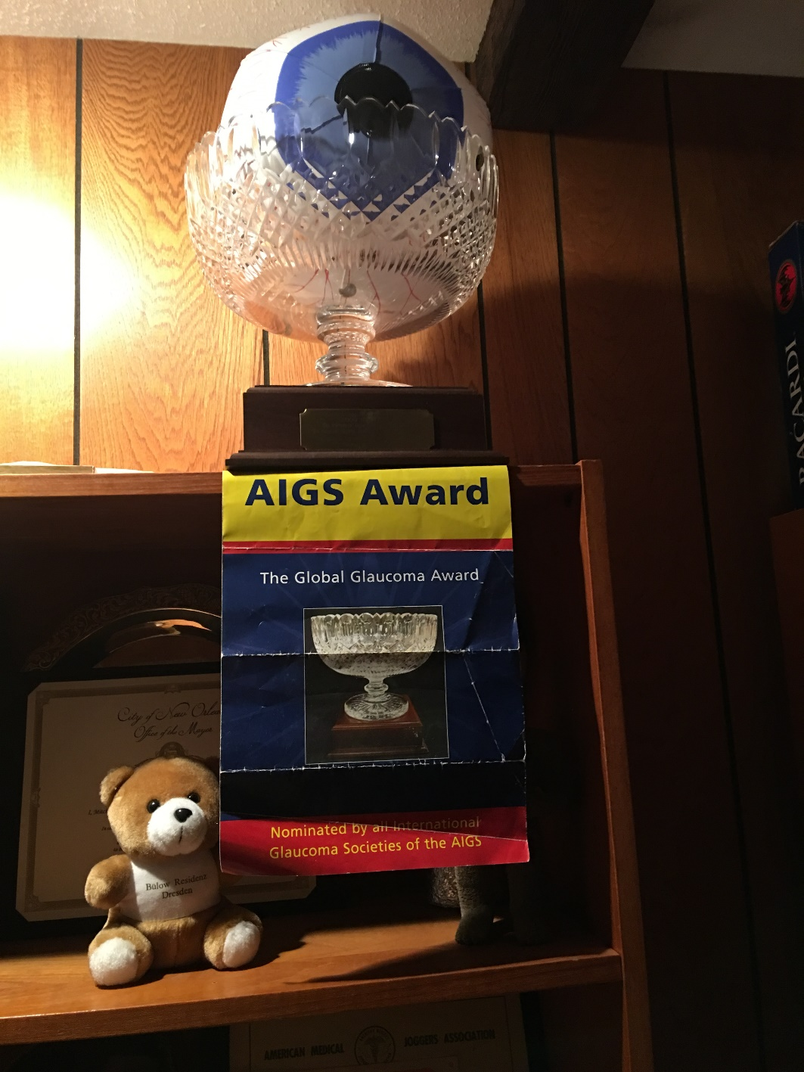
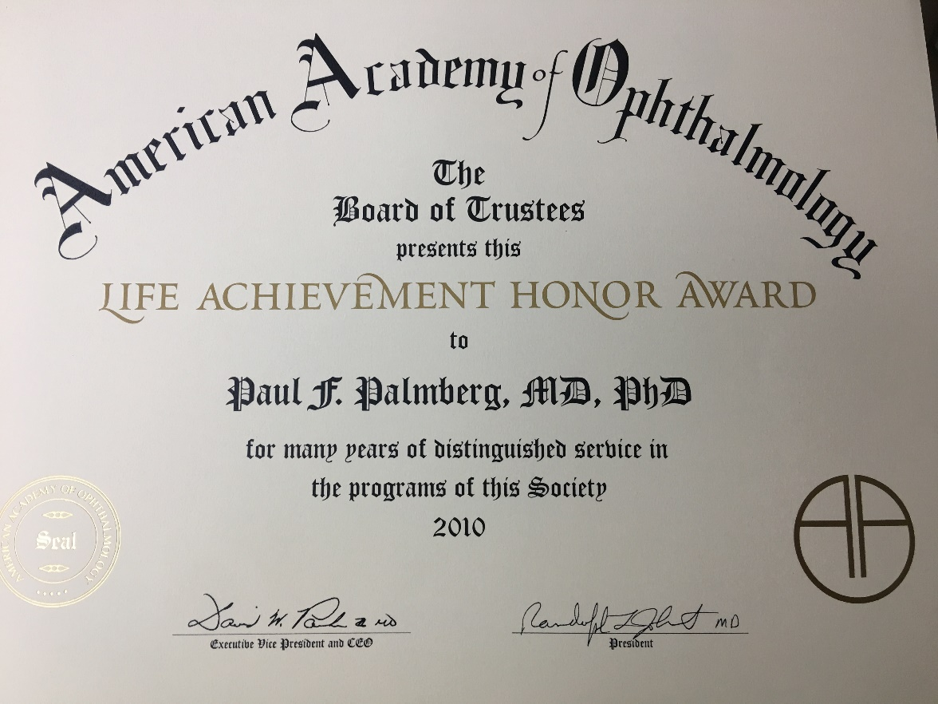
American Academy of Ophthalmology
Life Achievement Award
Association of International Glaucoma Societies Award 2000

Slide 13
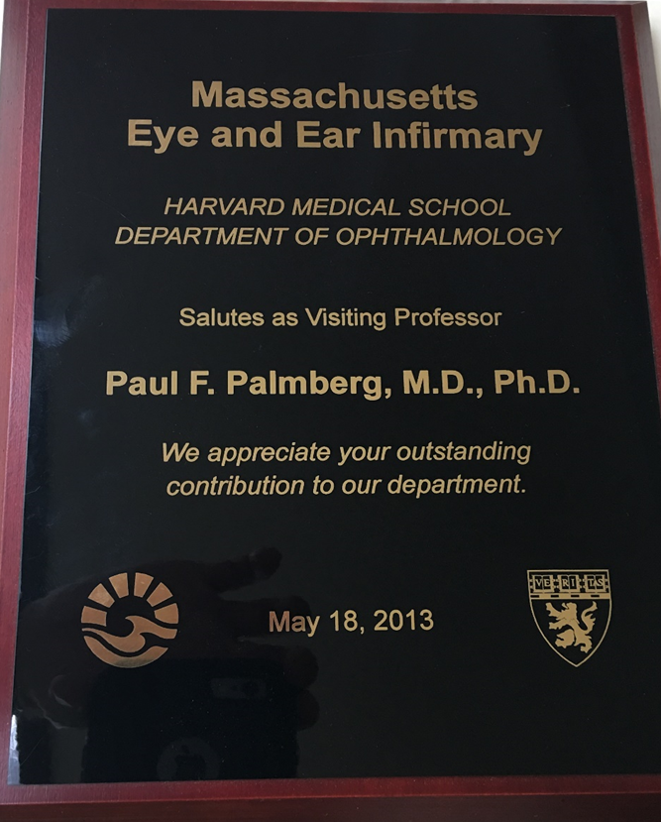
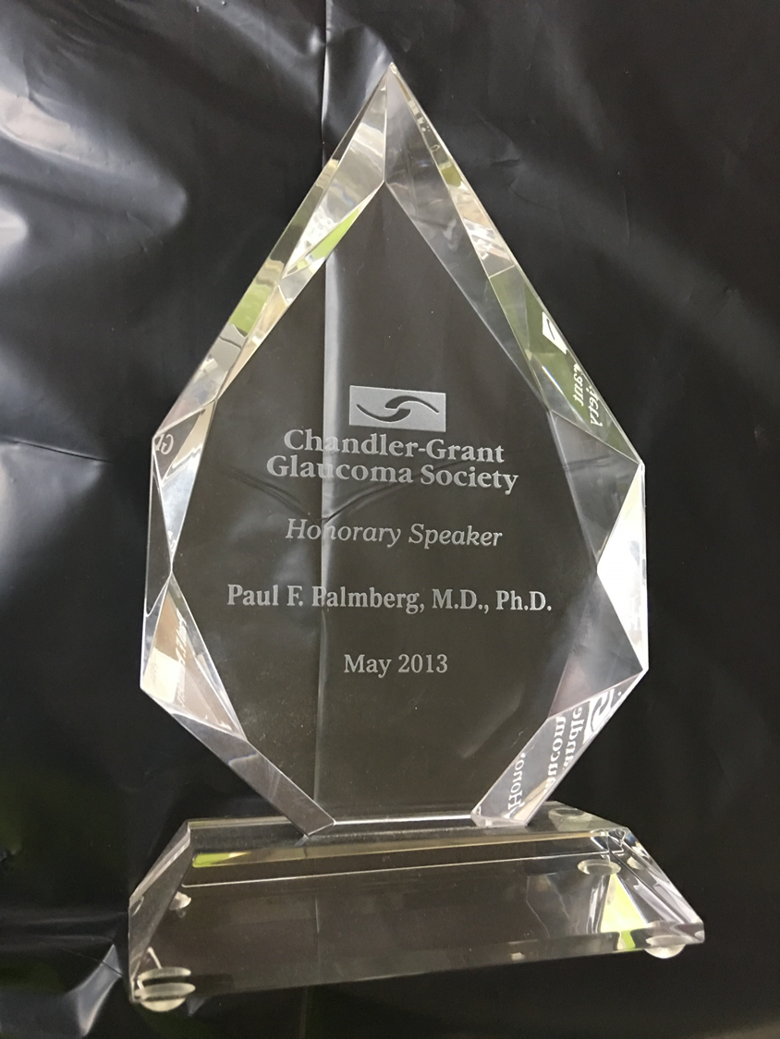
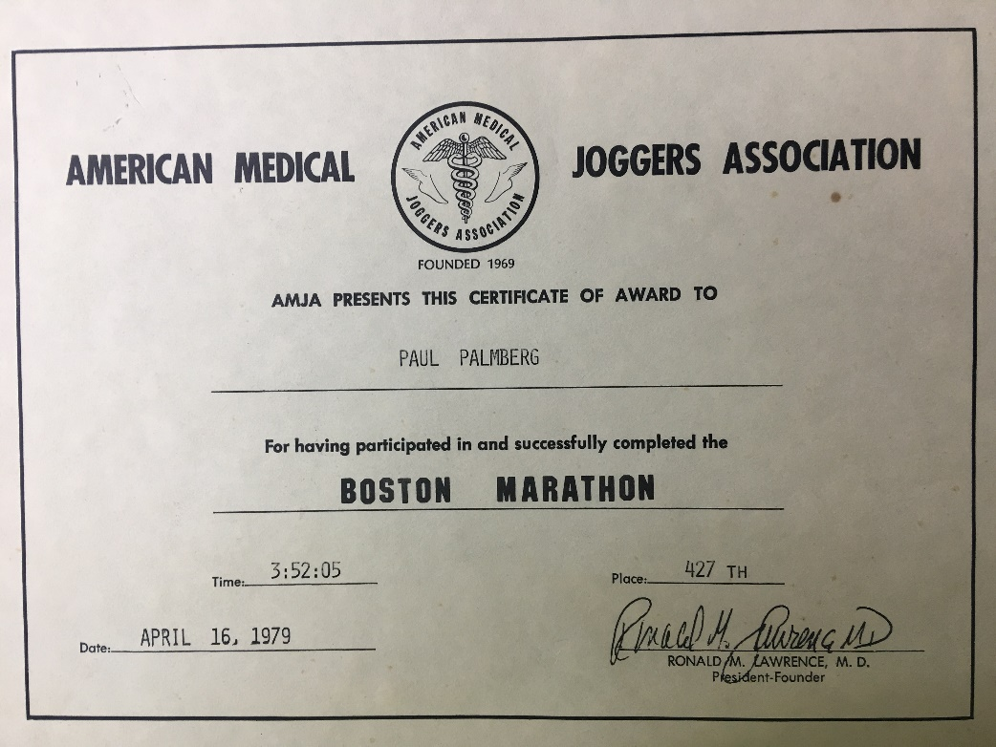
Boston Marathon 1979
Chandler-Grant Society
Massachusetts Eye and Ear Infirmary

Slide 14
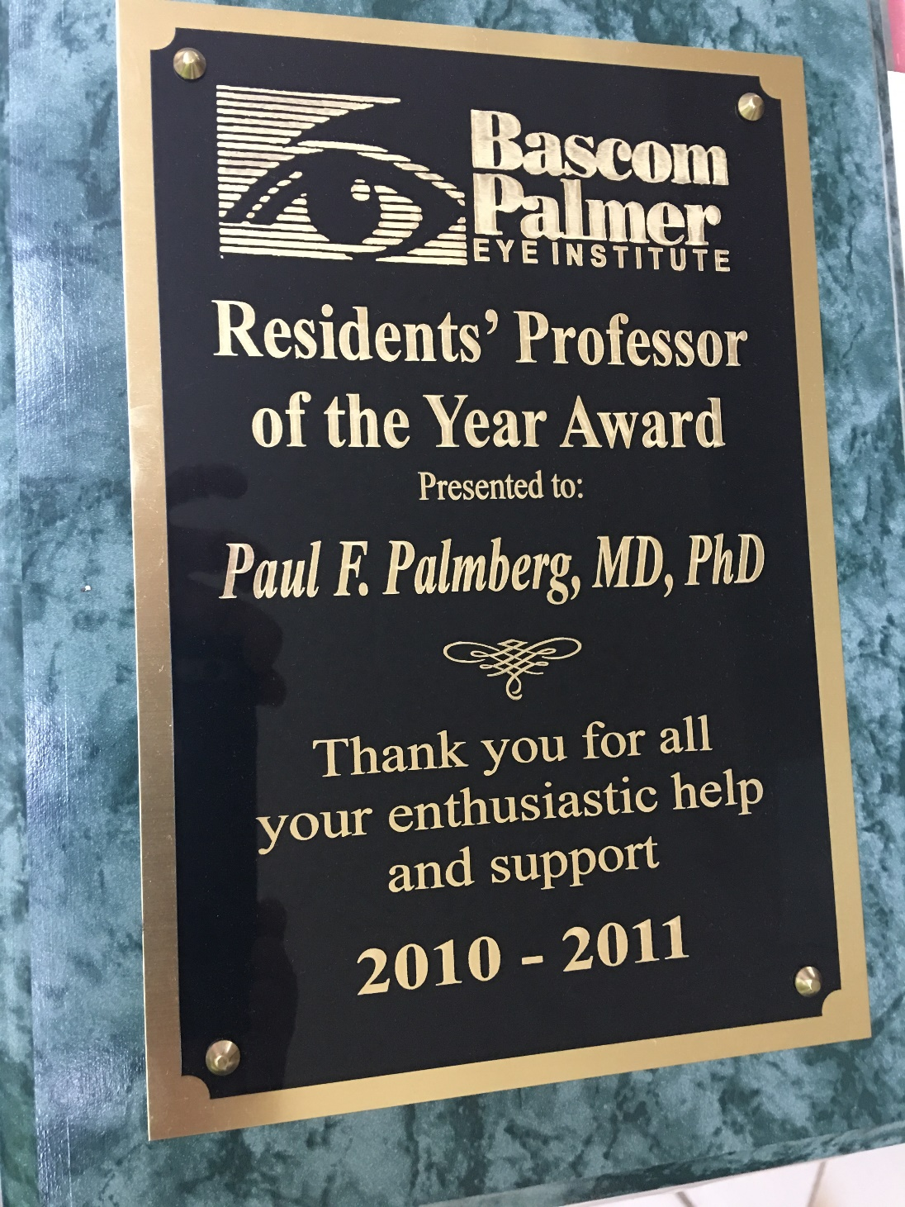
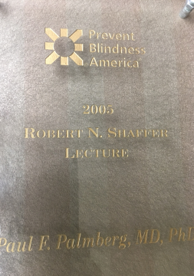
Shaffer Lecture AAO 2015

Slide 15
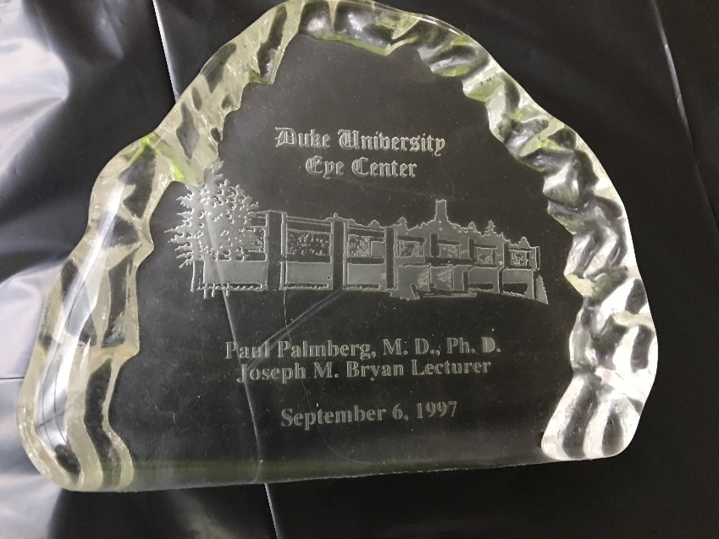
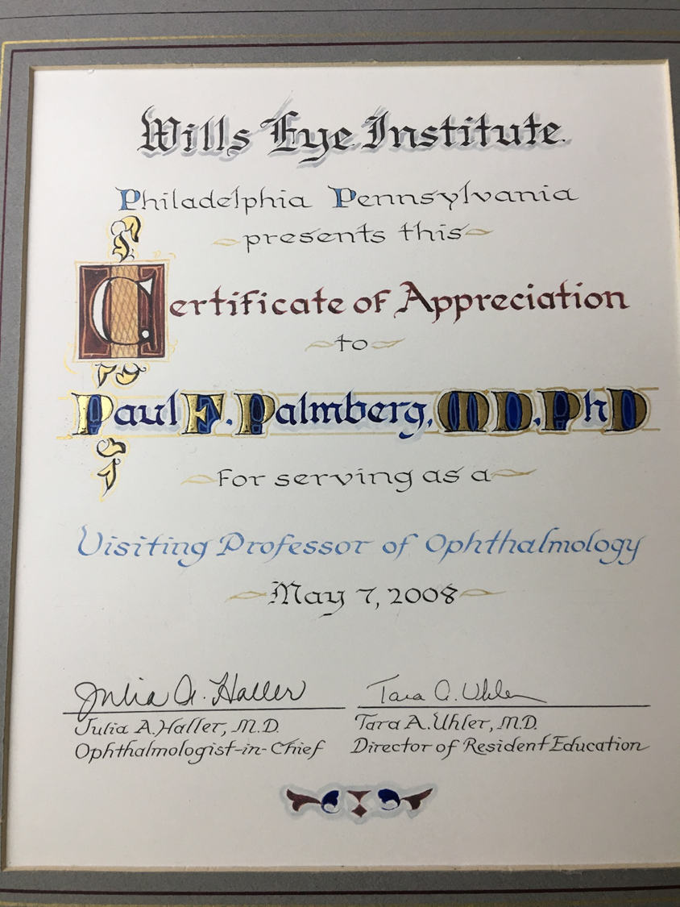
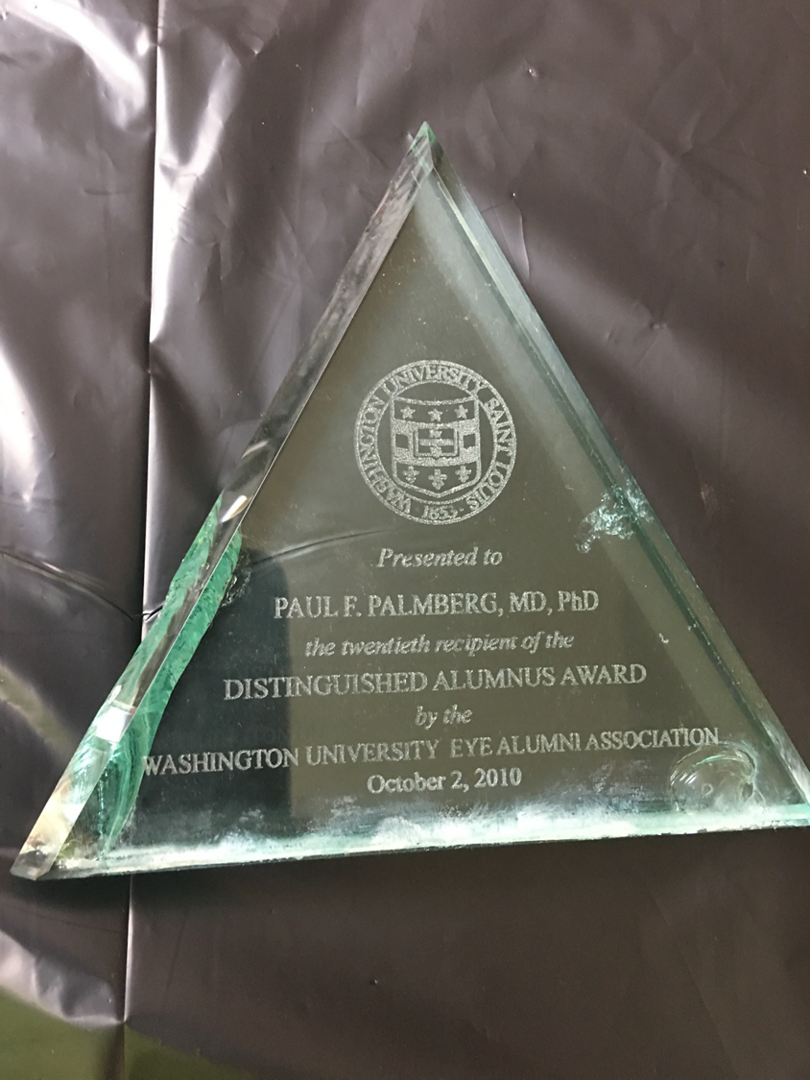
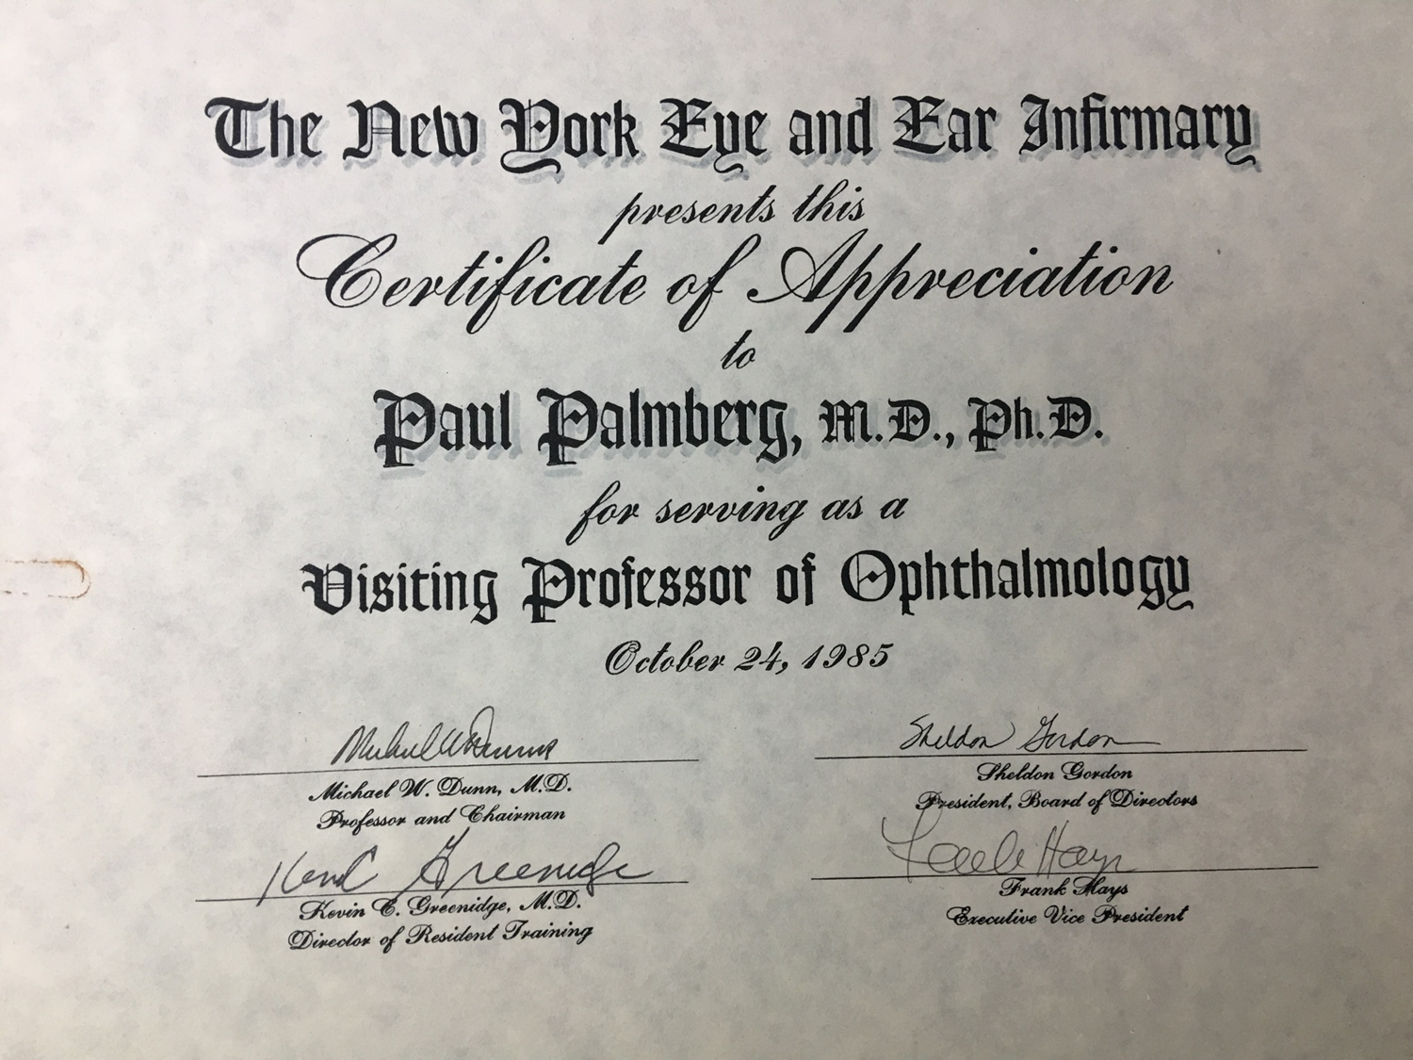
Duke University
Wills Eye Institute
Washington University
New York Eye and Ear Institute

Slide 16
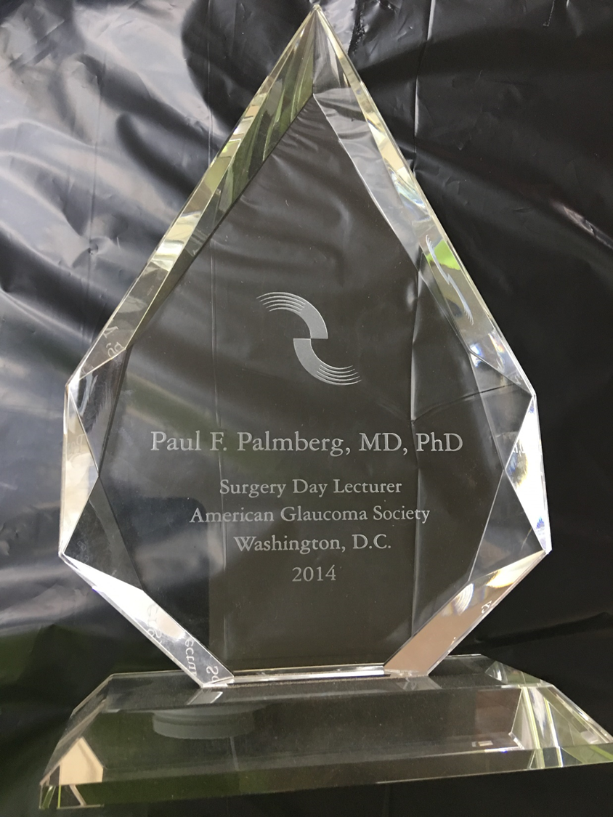
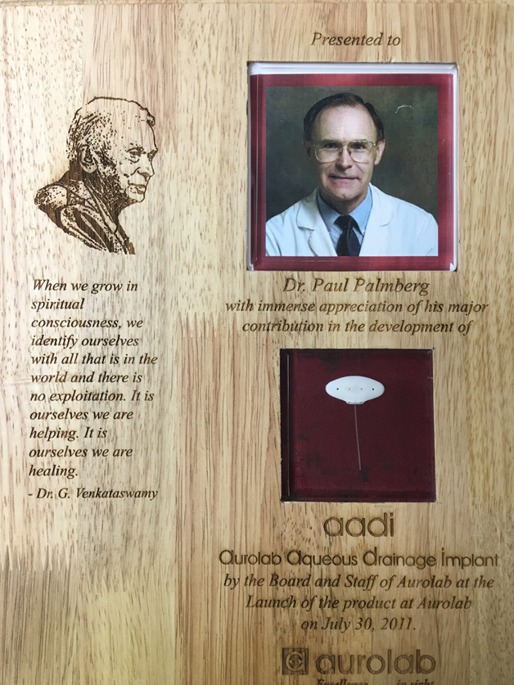
American Glaucoma Society Surgery Day Lecture 2014
Aravind AADI Launch

Slide 17
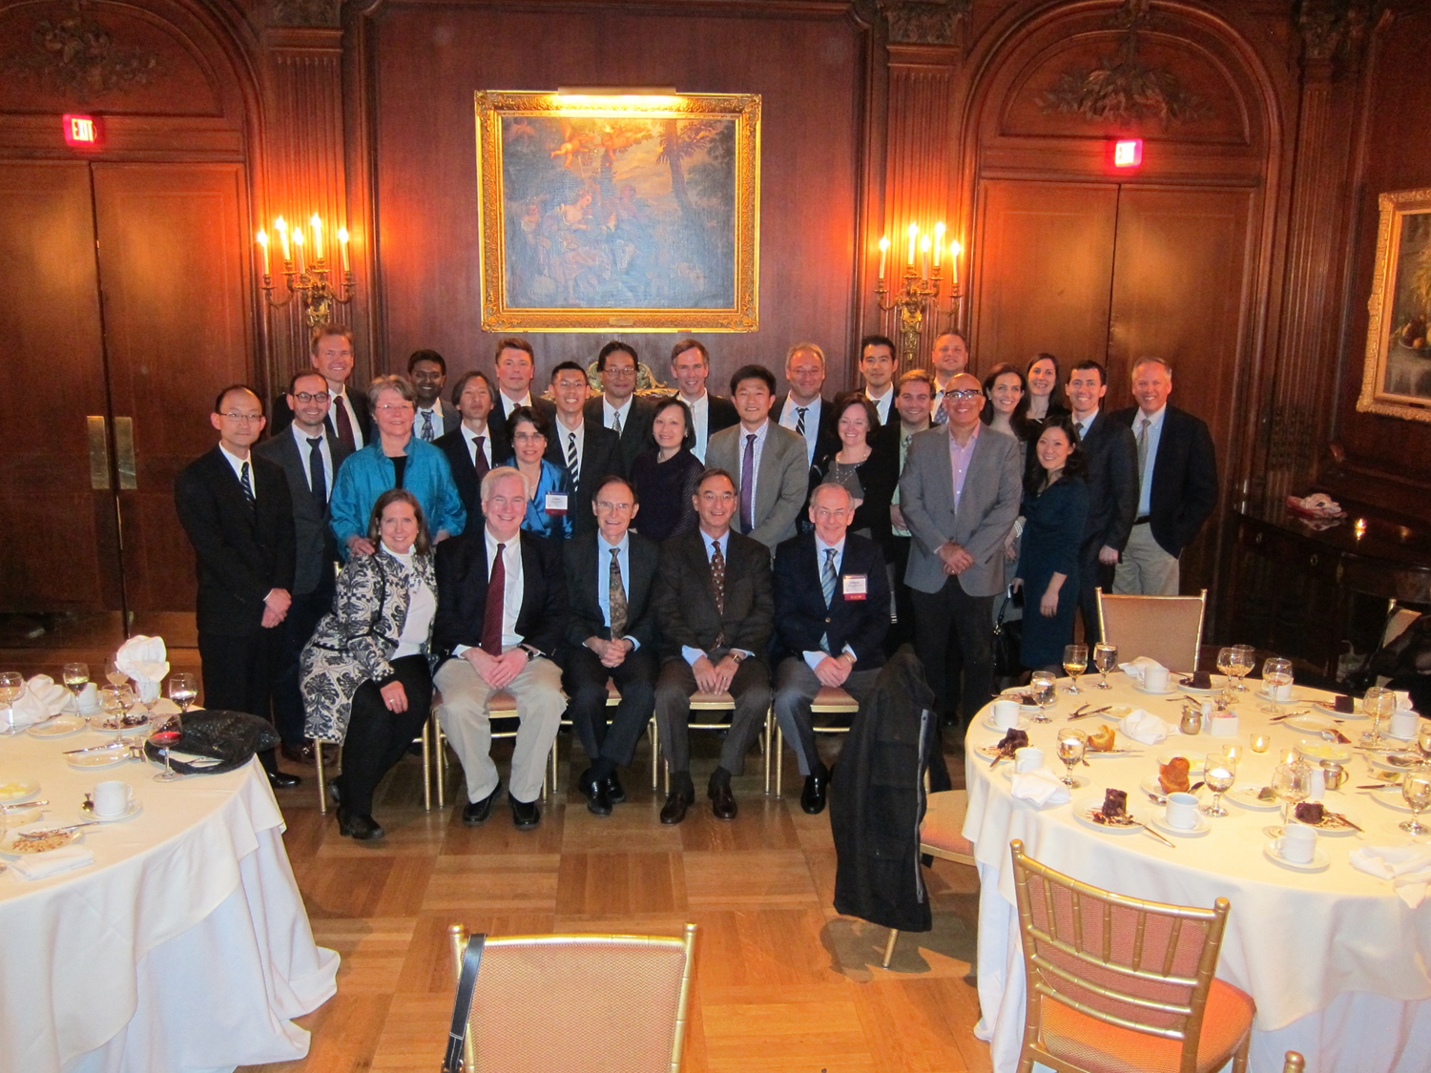
Fellows Roast Paul at AGS 2014
Surgery Day Lecturer
Cosmos Club, Washington, D.C.

Slide 18
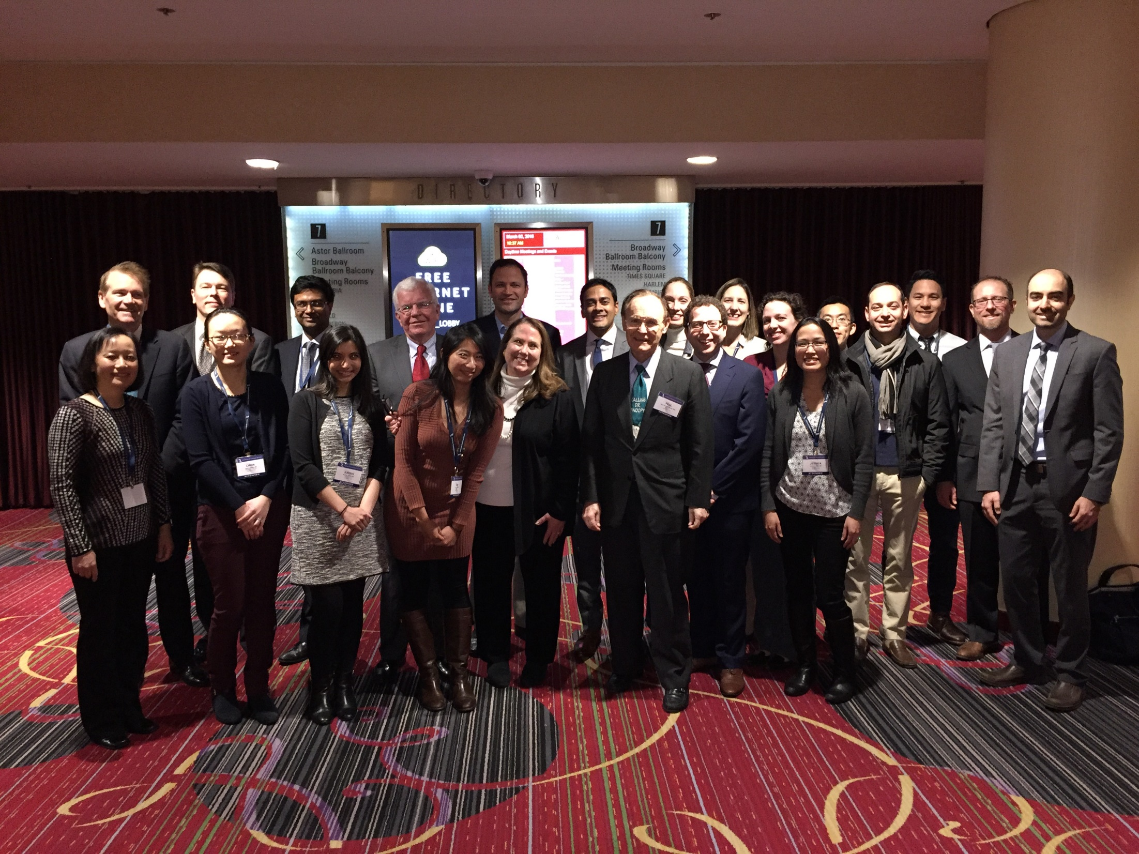
Flashmob of Fellows at AGS 2018 in NYC
Receiving Educator of the Year for AGS

