Slide 1

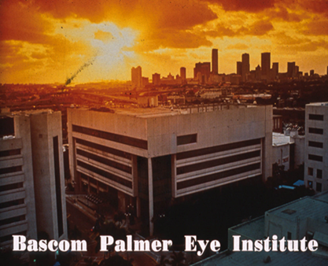
Solving Problems in Glaucoma Surgery!
Solutions Part 5: Trans-corneal Bleb Needling
Paul Palmberg, MD, PhD
Consultant and Medical Monitor for InnFocus Micro Shunt FDA Clinical Trial
Consultant (unpaid) and trainer for Aurolab AADI Clinical Trial
Consultant and trainer for AqueSys XEN FDA clinical trial

Slide 2
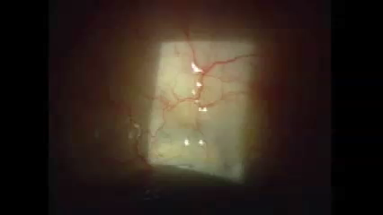

Trans-Corneal Needling

Slide 3
Advantages of This Technique
No leak in conjunctiva (less infection risk)
Usually no hypotony because the bleb still has a margin
Usually no bleeding
Easily done at the slit lamp

