Slide 1
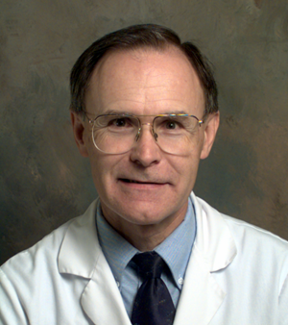


Solving Problems in Glaucoma Surgery!
Painful Blebs and Their Management:
Compression Sutures and Cautery
Grand Rounds
January 27, 2022
Paul Palmberg, MD, PhD
Financial Disclosures, none relevant to this talk.
Consultant and Medical Monitor for InnFocus Micro Shunt FDA Clinical Trial
Consultant (unpaid) and trainer for Aurolab AADI Clinical Trial
Consultant and trainer for AqueSys XEN FDA clinical trial
Consultant Radiance Therapeutics

Slide 2
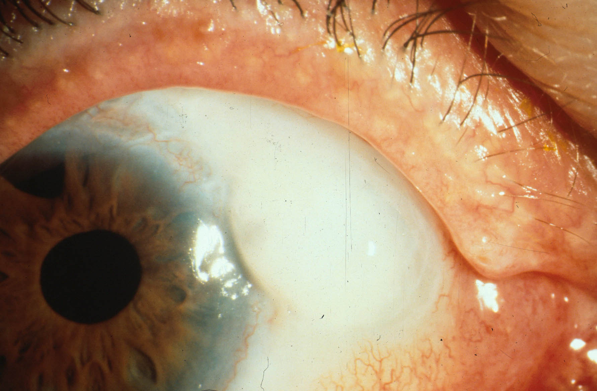
This elderly man had a very painful Dellen in front of an exposed, highly elevated bleb. Ta 08 mm Hg, only eye, 20⁰ field. How can the bleb be saved and the pain alleviated?
(Ophthalmic Surgery, Albert, 2004, p-105)

Slide 3
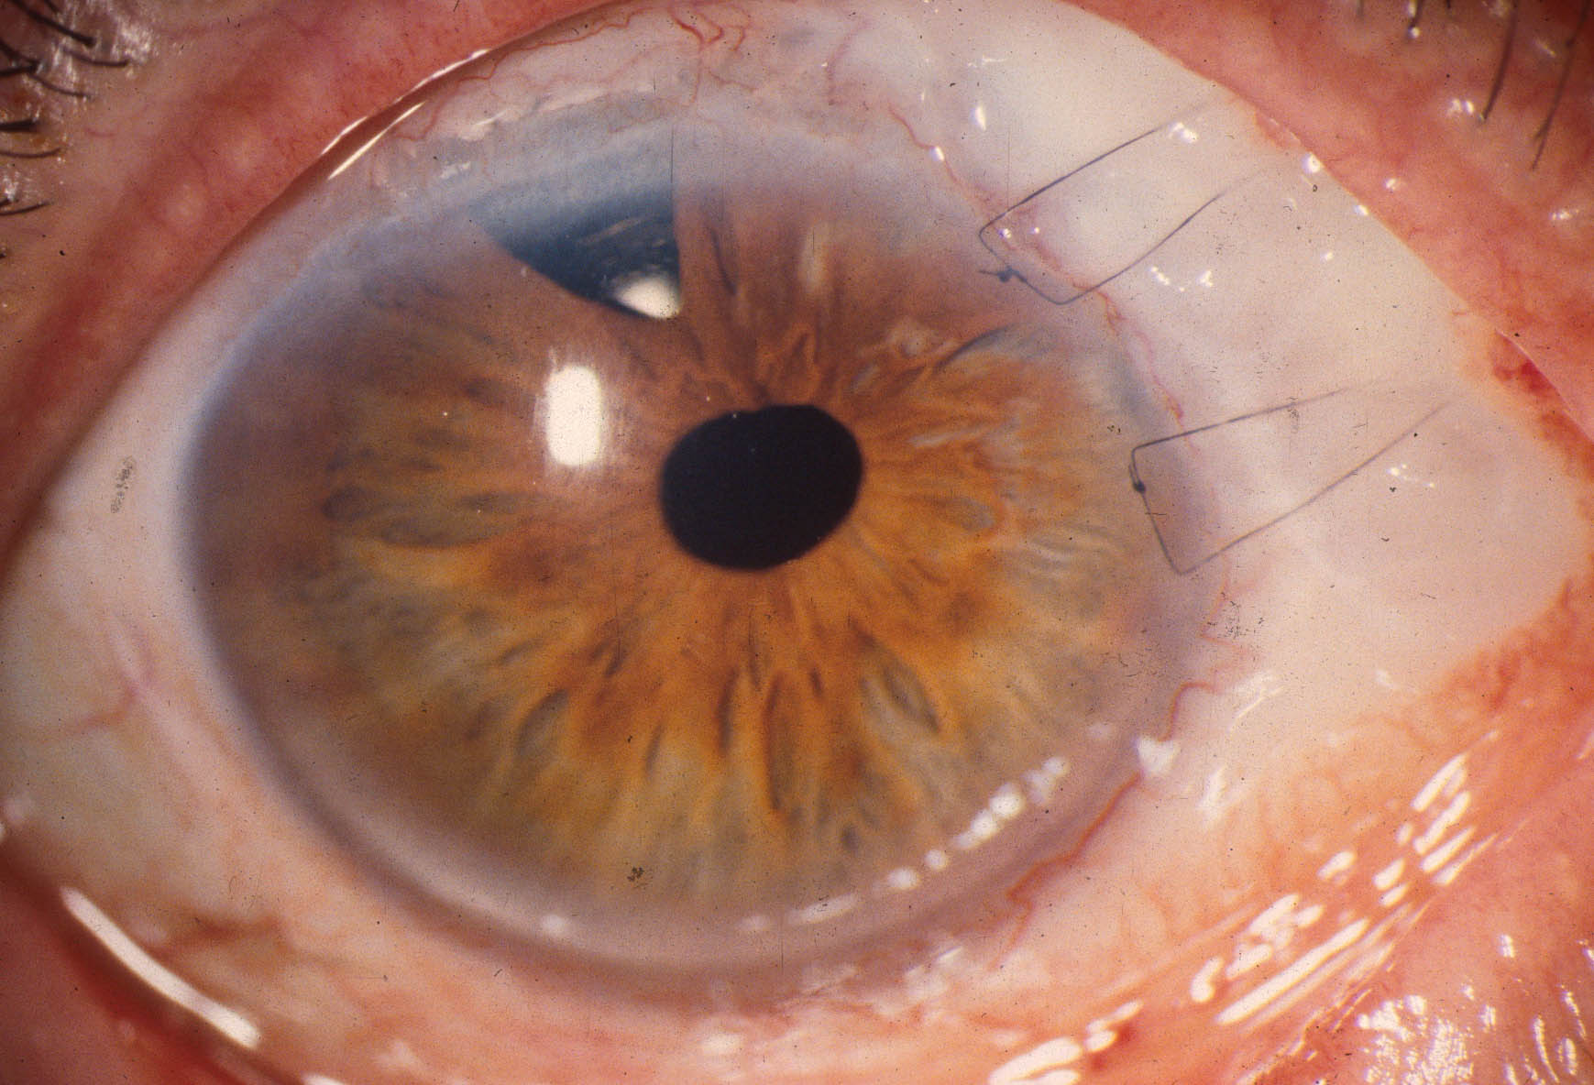
Two 9-0 nylon mattress compression sutures were anchored in clear cornea in front of bleb and anchored in deep Tenon’s capsule behind, and the knots rotated into cornea.

Slide 4
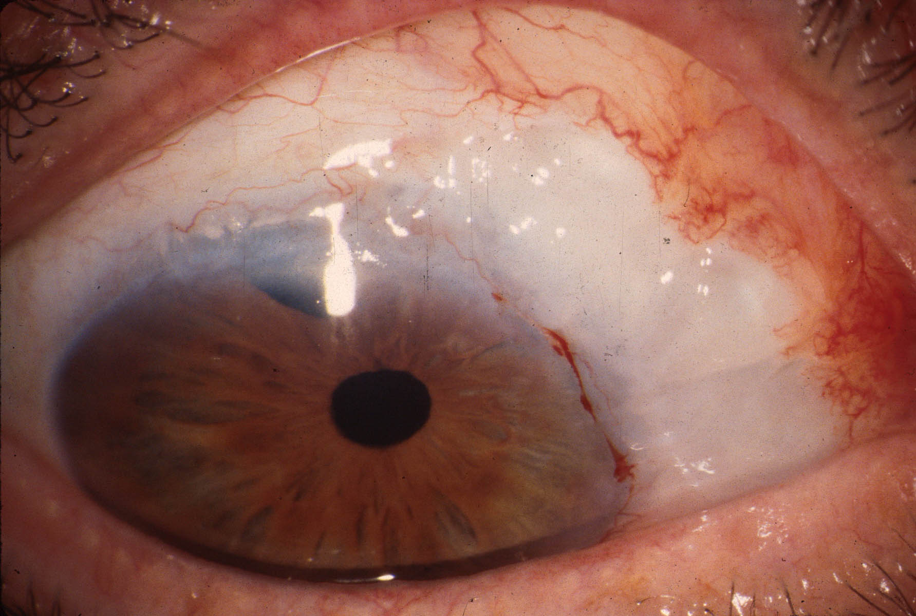
At 14 days, when sutures out, patient “100% better”, Ta 08 mm Hg. The bleb contour was changed, Dellen gone and did not return.

Slide 5
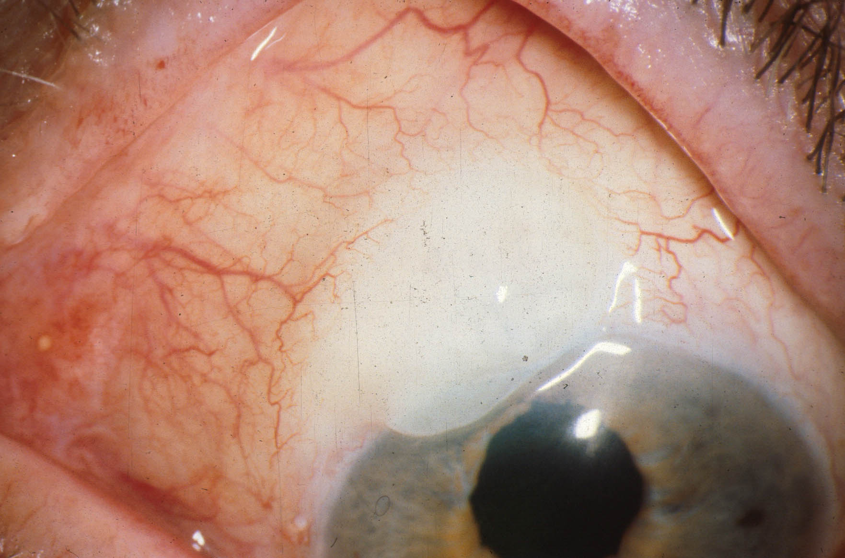
This woman felt a brief, but sharp pain when blinking. Reported a popping sound in the eye. Ta 10 mm Hg.

Slide 6
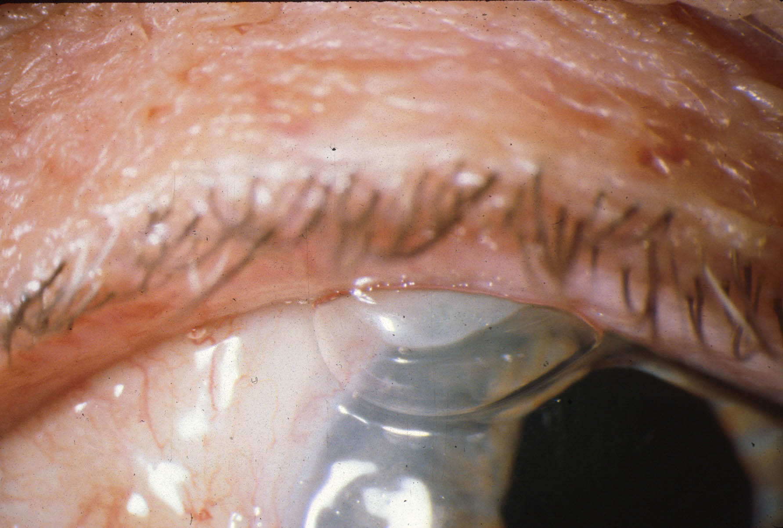
Patient was right! She had “bubble dysesthesia”, caused by lid capturing air and tears with blinking.

Slide 7
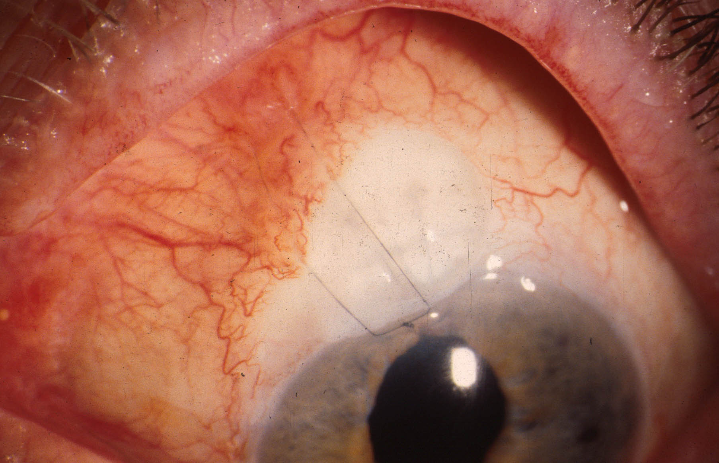
9-0 nylon bleb compression suture flattened bleb, eliminated bubbles and pain.

Slide 8
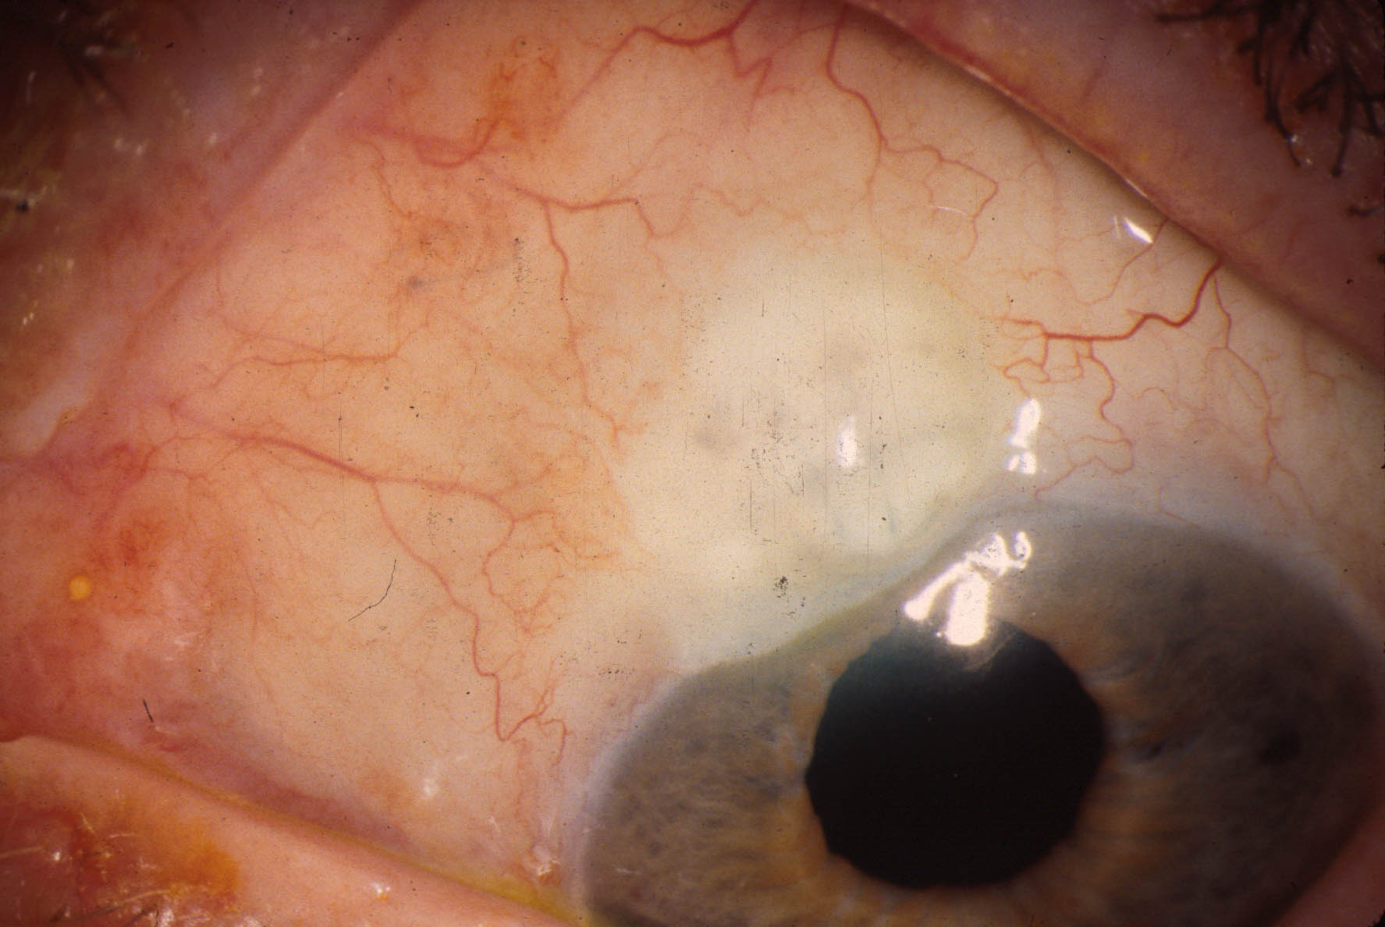
Suture removed in 3 weeks, bleb contour permanently changed, relief continued. Technique effective in 83% of cases.

Slide 9

Notes:
Cautery for circumferential bleb 1.5x.mp4

Slide 10
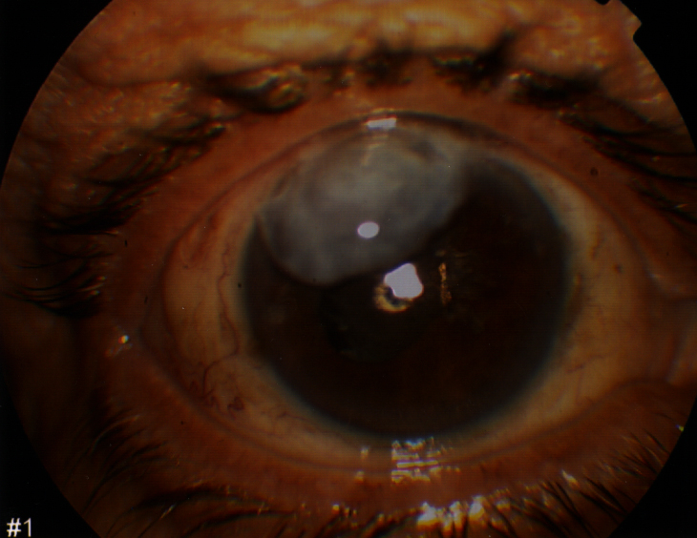
Large Overhanging Bleb

Slide 11
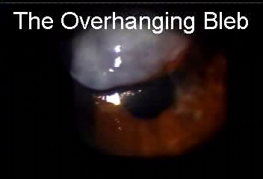

Slide 12
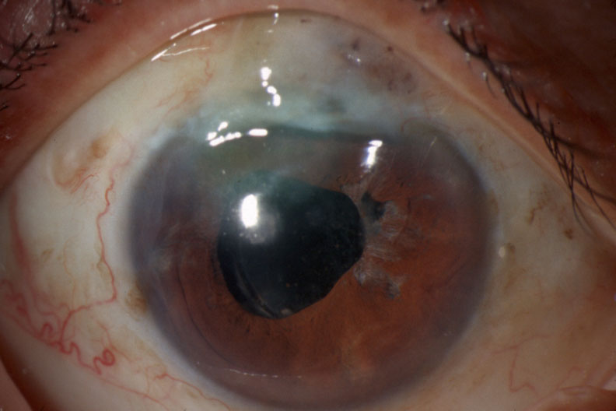
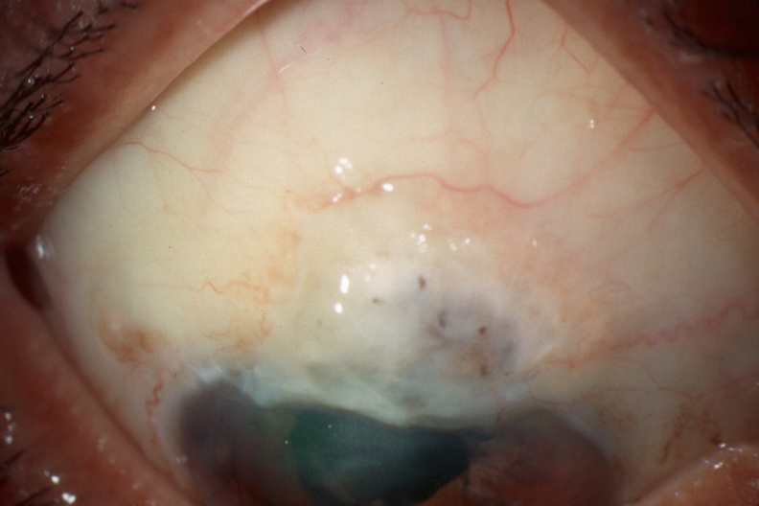
POD# 7
VA 20/60⁺² (Reduced astigmatism)
Ta = 10 mmHg

Slide 13
The Four Types of Painful Blebs
High bleb producing Dellen
Bubble dysesthesia
Overhanging bleb
Circumferential bleb
All can be repaired without loss of bleb function!

Slide 14
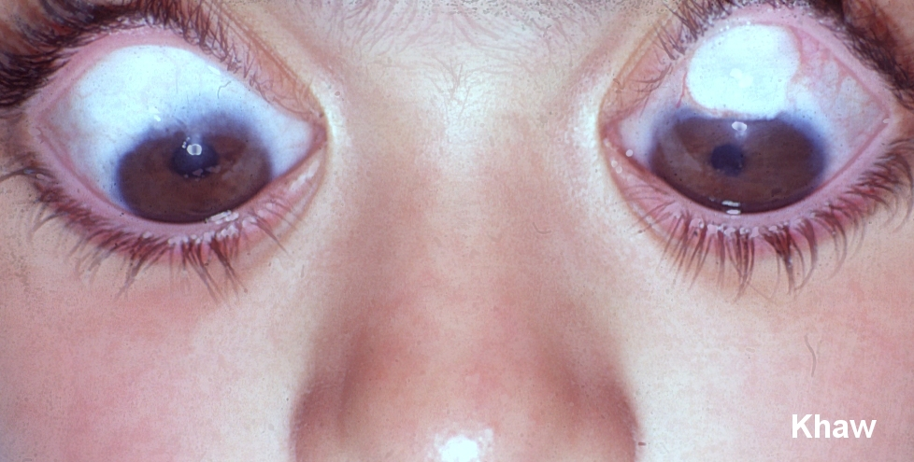
Applying MMC widely under a fornix flap avoids “ring of steel” which can delimit the bleb posteriorly
Thank you Sir Peng Khaw!
After change
Fornix based
Large Area
MMC 0.5 mg/ml
Before Change
Limbus based
Small Area
MMC 0.4 mg/ml
Bleb related problems inc leaks / blebitis / endophthalmitis
0% 20%
My bleb problems greatly reduced with this technique.
Ophthalmology 2003 in press

Slide 15
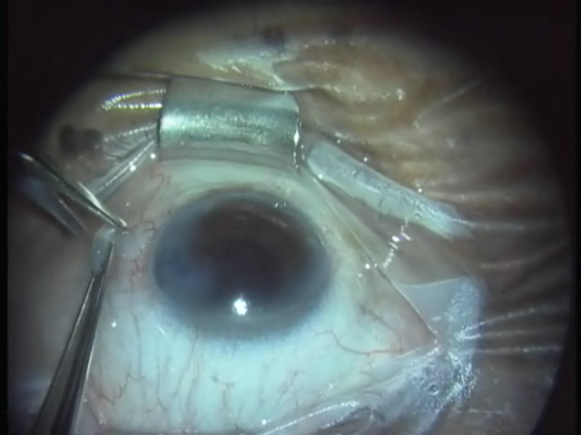
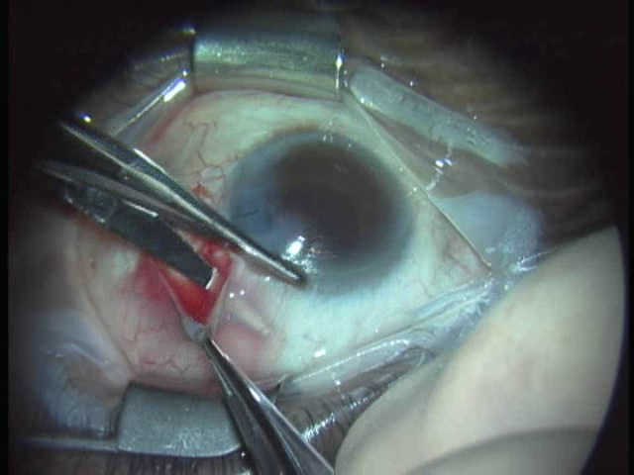
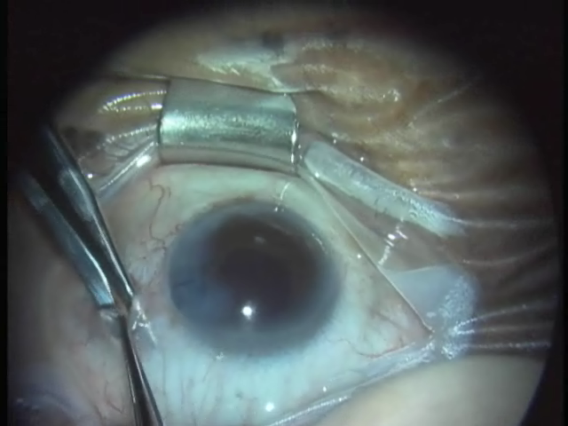
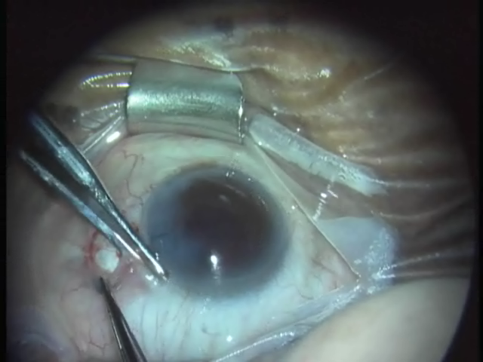
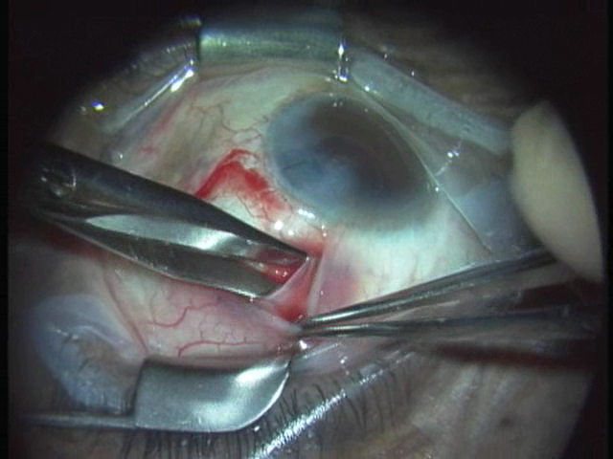
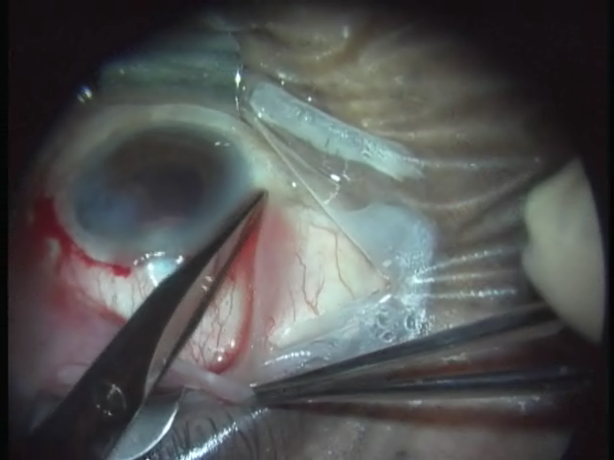
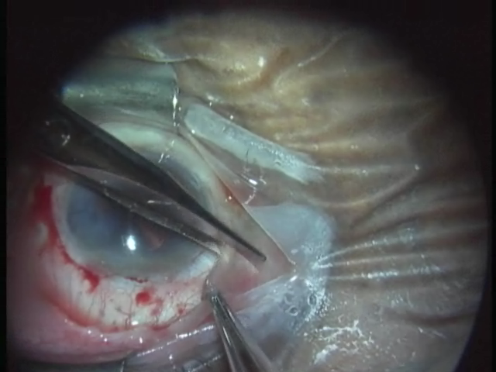
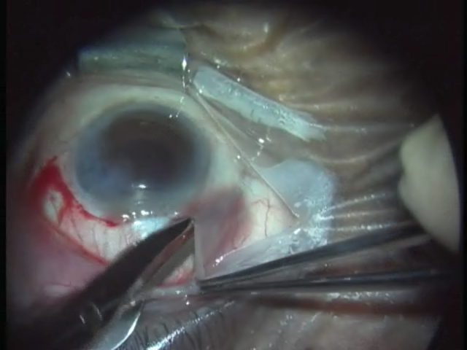
Conjunctival Flap—Avoiding Bleeding Get Under, not into Tenon’s! Tenon’ thickest from 10-2 o’clock above, and from 4 to 8 below Sneak under the Border!

Slide 16
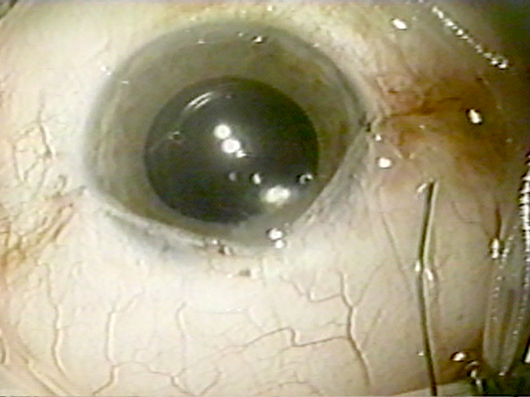

How to Achieve a Water-Tight Conjunctival Closure
Closure to each side
with knots buried:
8-0 Vicryl Mattress at limbus
Continue as running to apex of relaxing incision
Back under
to tie underneath.
Snug, not bunched

Slide 17

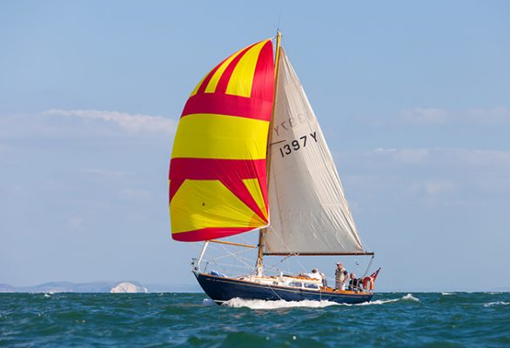
How to Achieve a Water-Tight Conjunctival Closure and a “Spinnaker Sail Bleb” With Hydrated Tenon’s Capsule Don’t compress Tenon’s at the filtration site!
Hydrate the Tenon’s capsule by injecting steroid-antibiotic solution under the flap edge with a cannula

Slide 18
Start with a Happy Bleb!
Continue with a Happy Bleb!

