Slide 1




In Honor of Francisco Fantes, MD 1955-2012
Paul Palmberg, MD, PhD

Slide 2
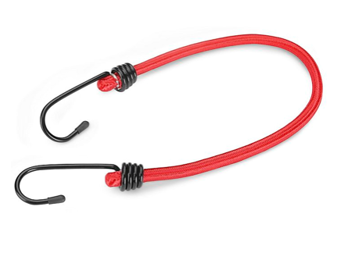
A Surprising Intervention!
20-year-old female
History of blunt trauma to the left eye (bungee cord)
Presented to BPEI ER 11/20/17, 1 day after trauma
Chief complaint: Pain, blurry vision in left eye
Visual Acuity: OD 20/20 OS 20/25
Pupils: Round, reactive, no APD
IOP: 17 mm Hg OU
Visual Fields: Full to finger counting

Slide 3
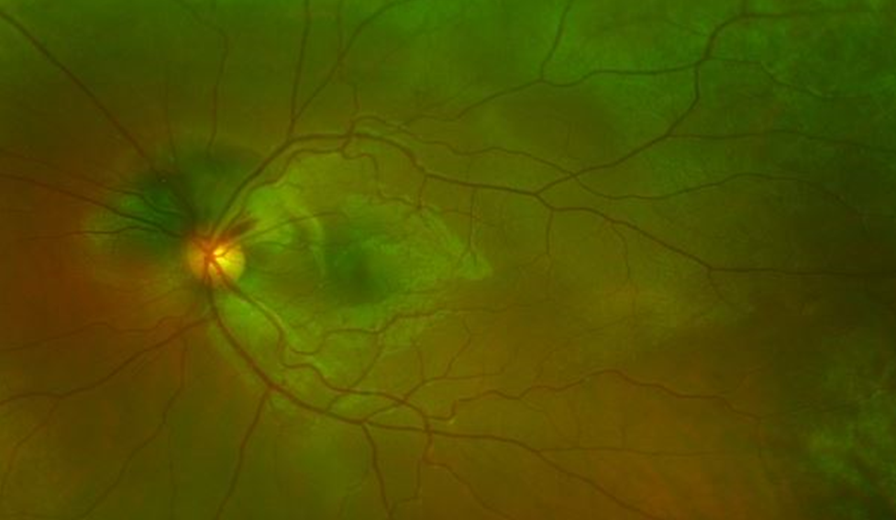
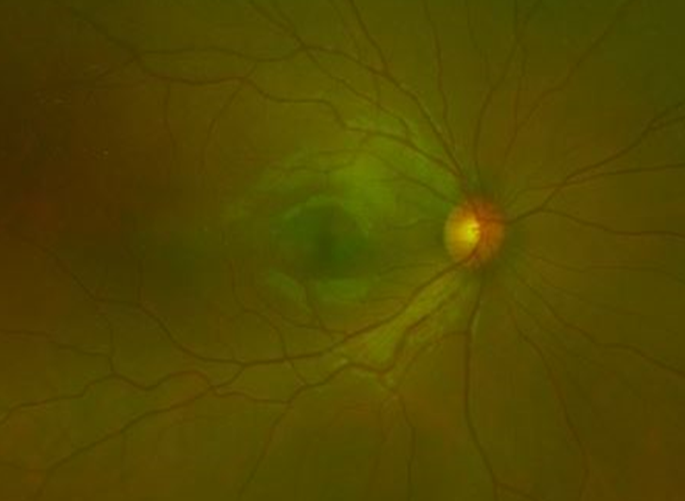
Examination Findings and Fundus Photos
Slit lamp exam:
Temporal sub-conjunctival hemorrhage, no scleral laceration
Anterior chamber: OS -- 3+ cells and pigment, no hyphema
Angle recession OS
Iris and lens normal OU

Slide 4
Suspicion of choroidal rupture

Slide 5
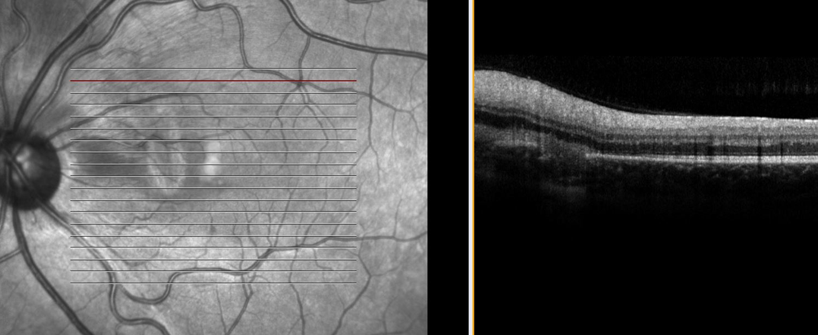
OCT: Choroidal Rupture: Yes, there is!

Slide 6
IOP began to rise 14 days post-injury, rose to 35 mm Hg
At 35 days post injury Va OS 20/25, Ta 31 on max topical meds and acetazolamide 500 mg Hg
At 45 days post injury Trabeculectomy with MMC OS,
with 0.3 ml of 0.2 mg/ml = 60 ug injected
First post-op day OS Va 20/80,
Ta OS 24 gentle massage to 18
PO day 6 OS Va 20/80, Ta 09 mm Hg, vision “distorted”

Slide 7
Question 1
What would you do about the decrease in vision + metamorphopsia in the early post-operative period?
Monitor vision and IOP, expecting it will improve?
Dilated fundus exam for hypotony maculopathy? No folds.
Get OCT to better assess the retina?

Slide 8
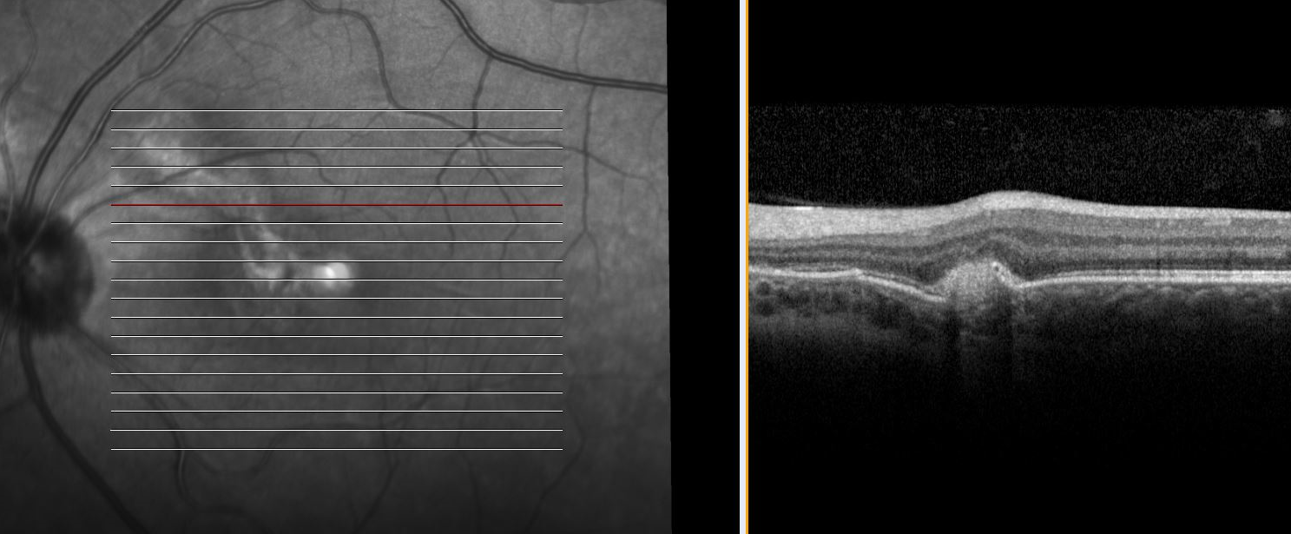
2nd Year Resident Stephen Russell got a macular OCT
No hypotony maculopathy, nor CME
Choroidal Neovascular Membrane seen with leakage to the fovea
After consultation with the retinal service given intravitreal Avastin!

Slide 9
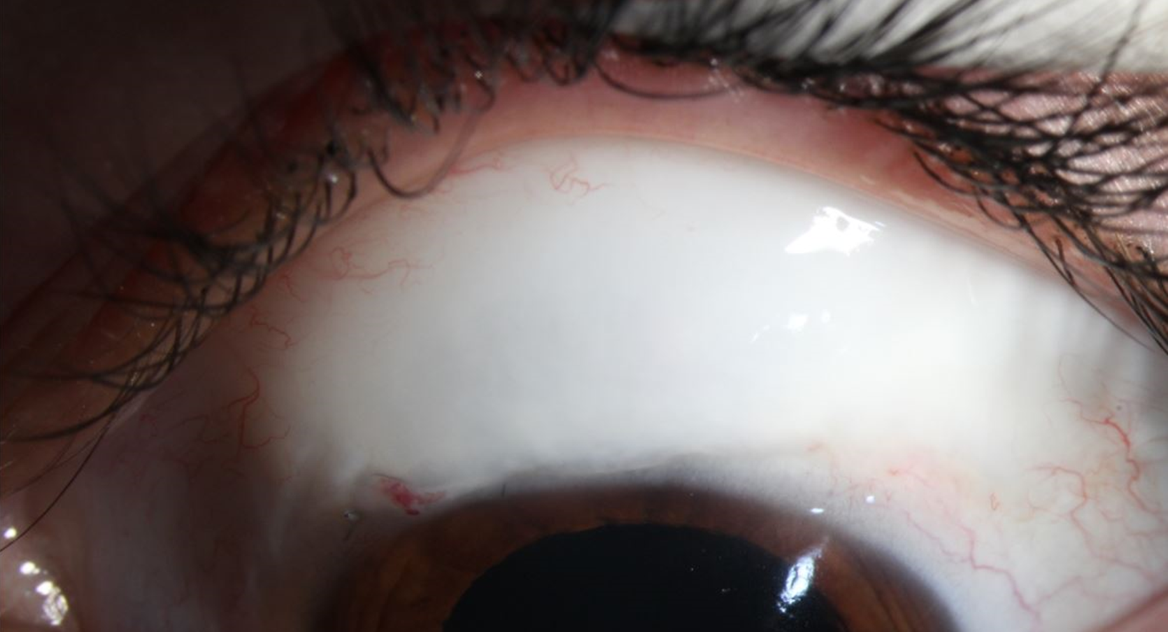
Vision steadily improved
OS 20/40 in 2 weeks, Ta OS 8 mm Hg
OS 20/20 in 5 weeks, Ta OS 9 mm Hg

Slide 10
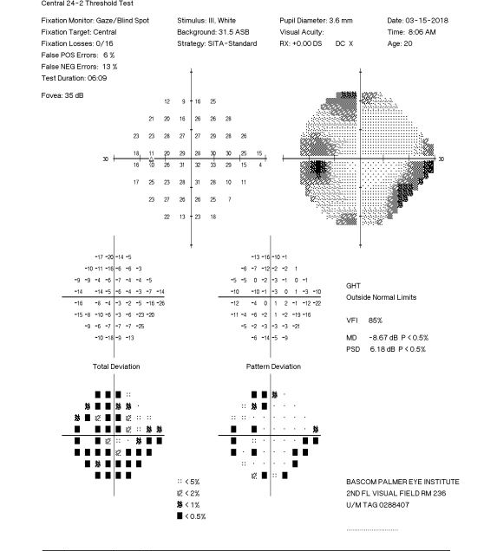
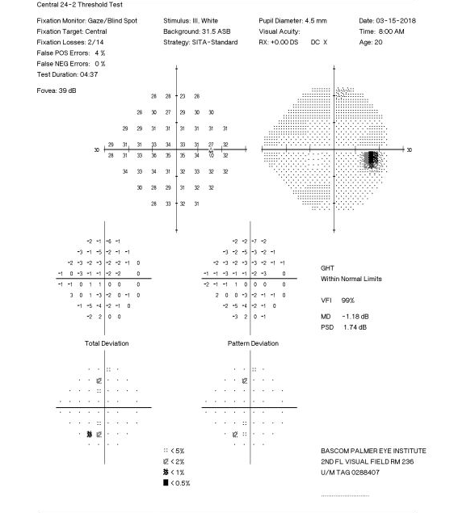
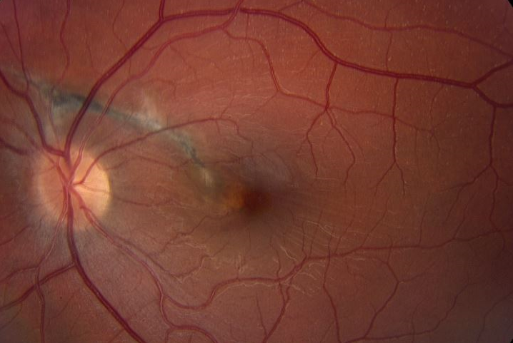

Slide 11
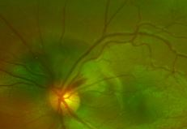
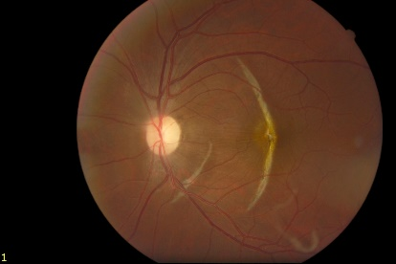
Clinical Picture
Subretinal hemorrhage obscures the rupture early on
Choroidal rupture later seen as a curvilinear
or crescent-shaped line
Fibrovascular activity leads to scar in the ruptured area
Atrophy and thinning of the retina may occur
Patel MM, Chee YE, Eliott D. Choroidal Rupture. Int Ophthalmol Clin. 2013;53(4):69-78.

Slide 12
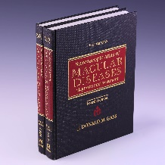
CNV after Choroidal Rupture
Dr. Gass, 1970
Incidence: 10% of eyes with choroidal rupture
Risk factors
Most common 1-18 months after injury
80% of patients with CNV develop it within 1 year
Longer ruptures
Macular ruptures
Older age
Gass J. Steroscopic Atlas of Macular Diseases. St Louis: C.V. Mosby Co; 1970
Ament CS, Zacks DN, Lane AM, et al. Predictors of Visual Outcome and Choroidal Neovascular Membrane Formation After Traumatic Choroidal Rupture. Arch Ophthalmol. 2006;124(7):957.
Notes:
(0% in ruptures <1.10 mm, 11% in ruptures 1.10–2.35 mm in length, and 50% in ruptures >2.35 mm in length)

Slide 13
KEY POINTS:
Patients with history of blunt ocular trauma need to be monitored for glaucoma for the rest of their lives (10% late)
Monitor the other eye too, rose to OD 27 mm Hg (1/3 OAOH)
Monitor closely for development of CNV in eyes with choroidal rupture, especially within the 1st year
Consider alternative causes of vision loss in patients
in the post-op period- don’t just blame the surgery

